Slide 1
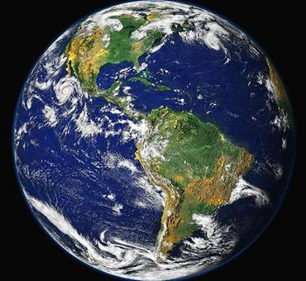
Our home…

Slide 2
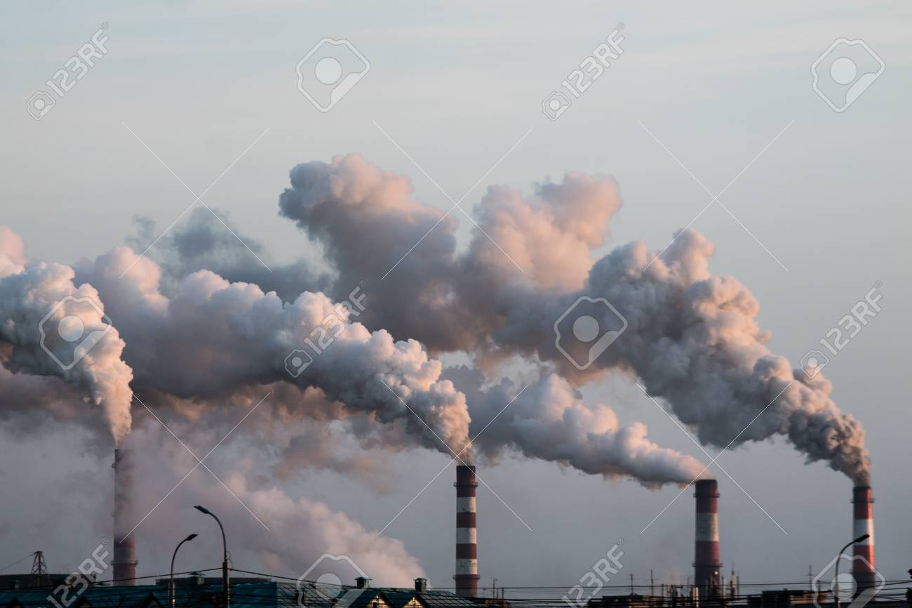
What is COP26?
It’s the 26th Conference of the Parties
Countries aiming to keep the world’s temperature below 2°C

Slide 3
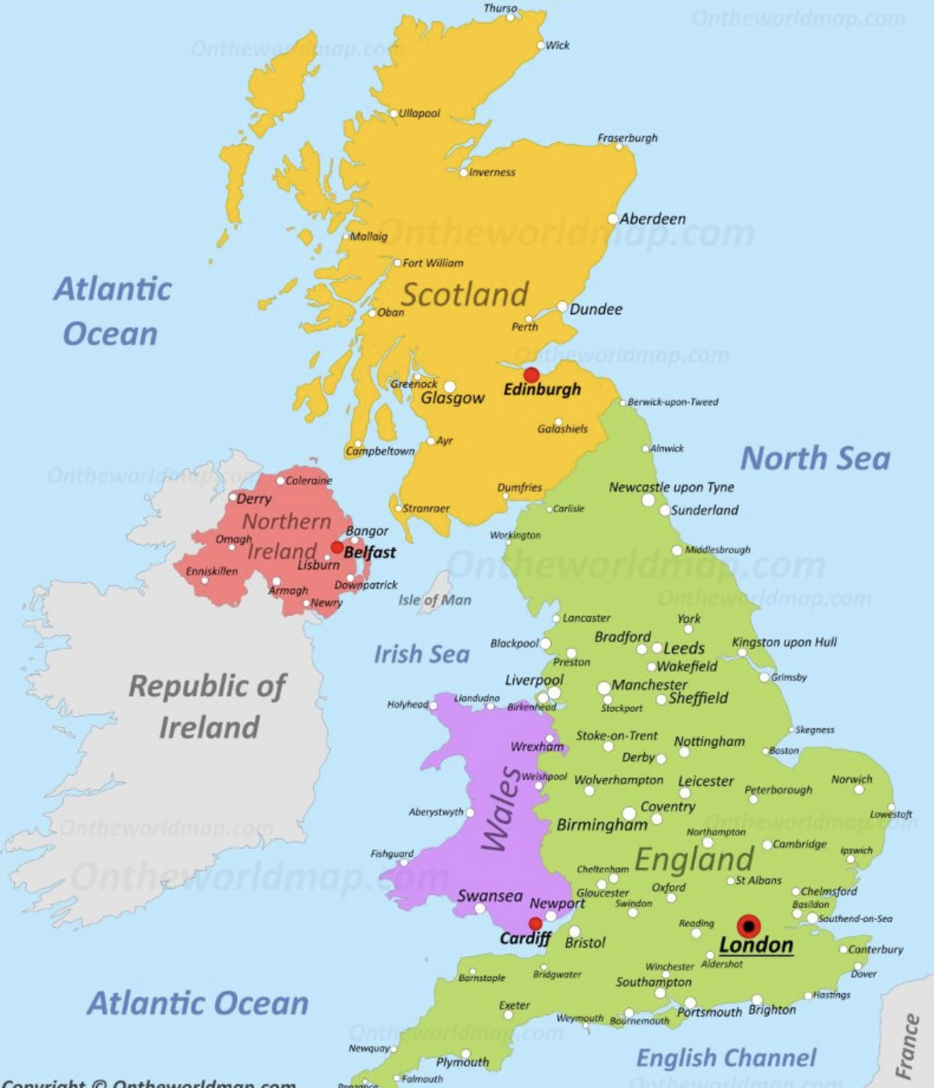
Glasgow
Torquay

Slide 4
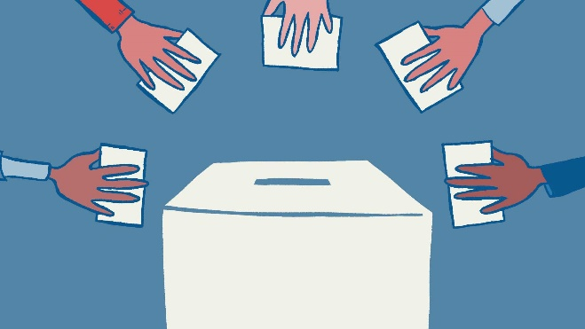
What can I do to look after my home?
Oscar – the world first ever virtual children’s parliament
Democracy

Slide 6
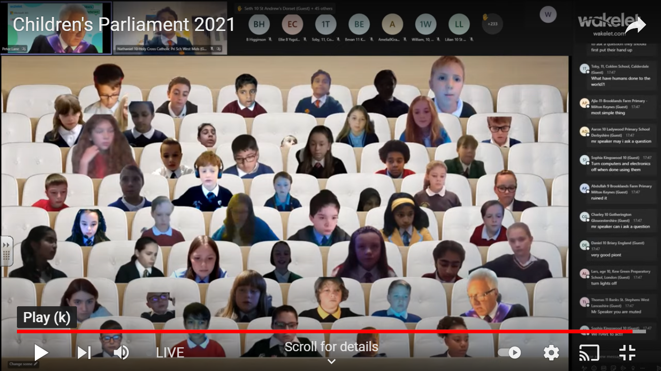
Mr speaker, we are all aware buying locally is the most economically and environmentally friendly way to source produce, though not everything is grown in the United Kingdom. This is where the importance of fairtrade comes in. Not only does this guarantee a fair wage to farmers in some of the poorest communities, it also ensures that these farmers maintain the high standards fairtrade sets and ensures they minimise the use of non-renewable energy sources and harmful pesticides and in turn, helps reduce the impact on climate change.
Why Mr speaker, is the United Kingdom not setting an example to the rest of the world by forcing supermarkets to only source, where applicable, fair trade products?

Slide 7
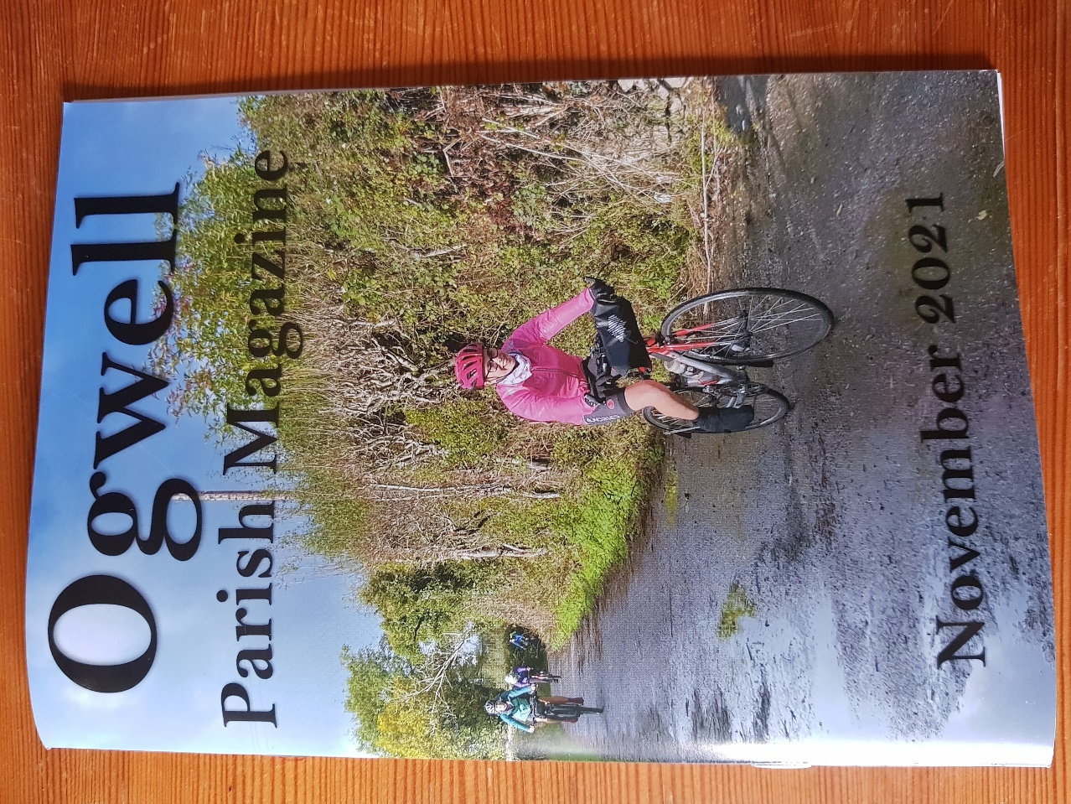
Jessie Stevens –
People Pedal Power –
less cars, more bikes

Slide 8
What can I do to look after my home?
https://youtu.be/gGYtjLphS0I

