Slide 1
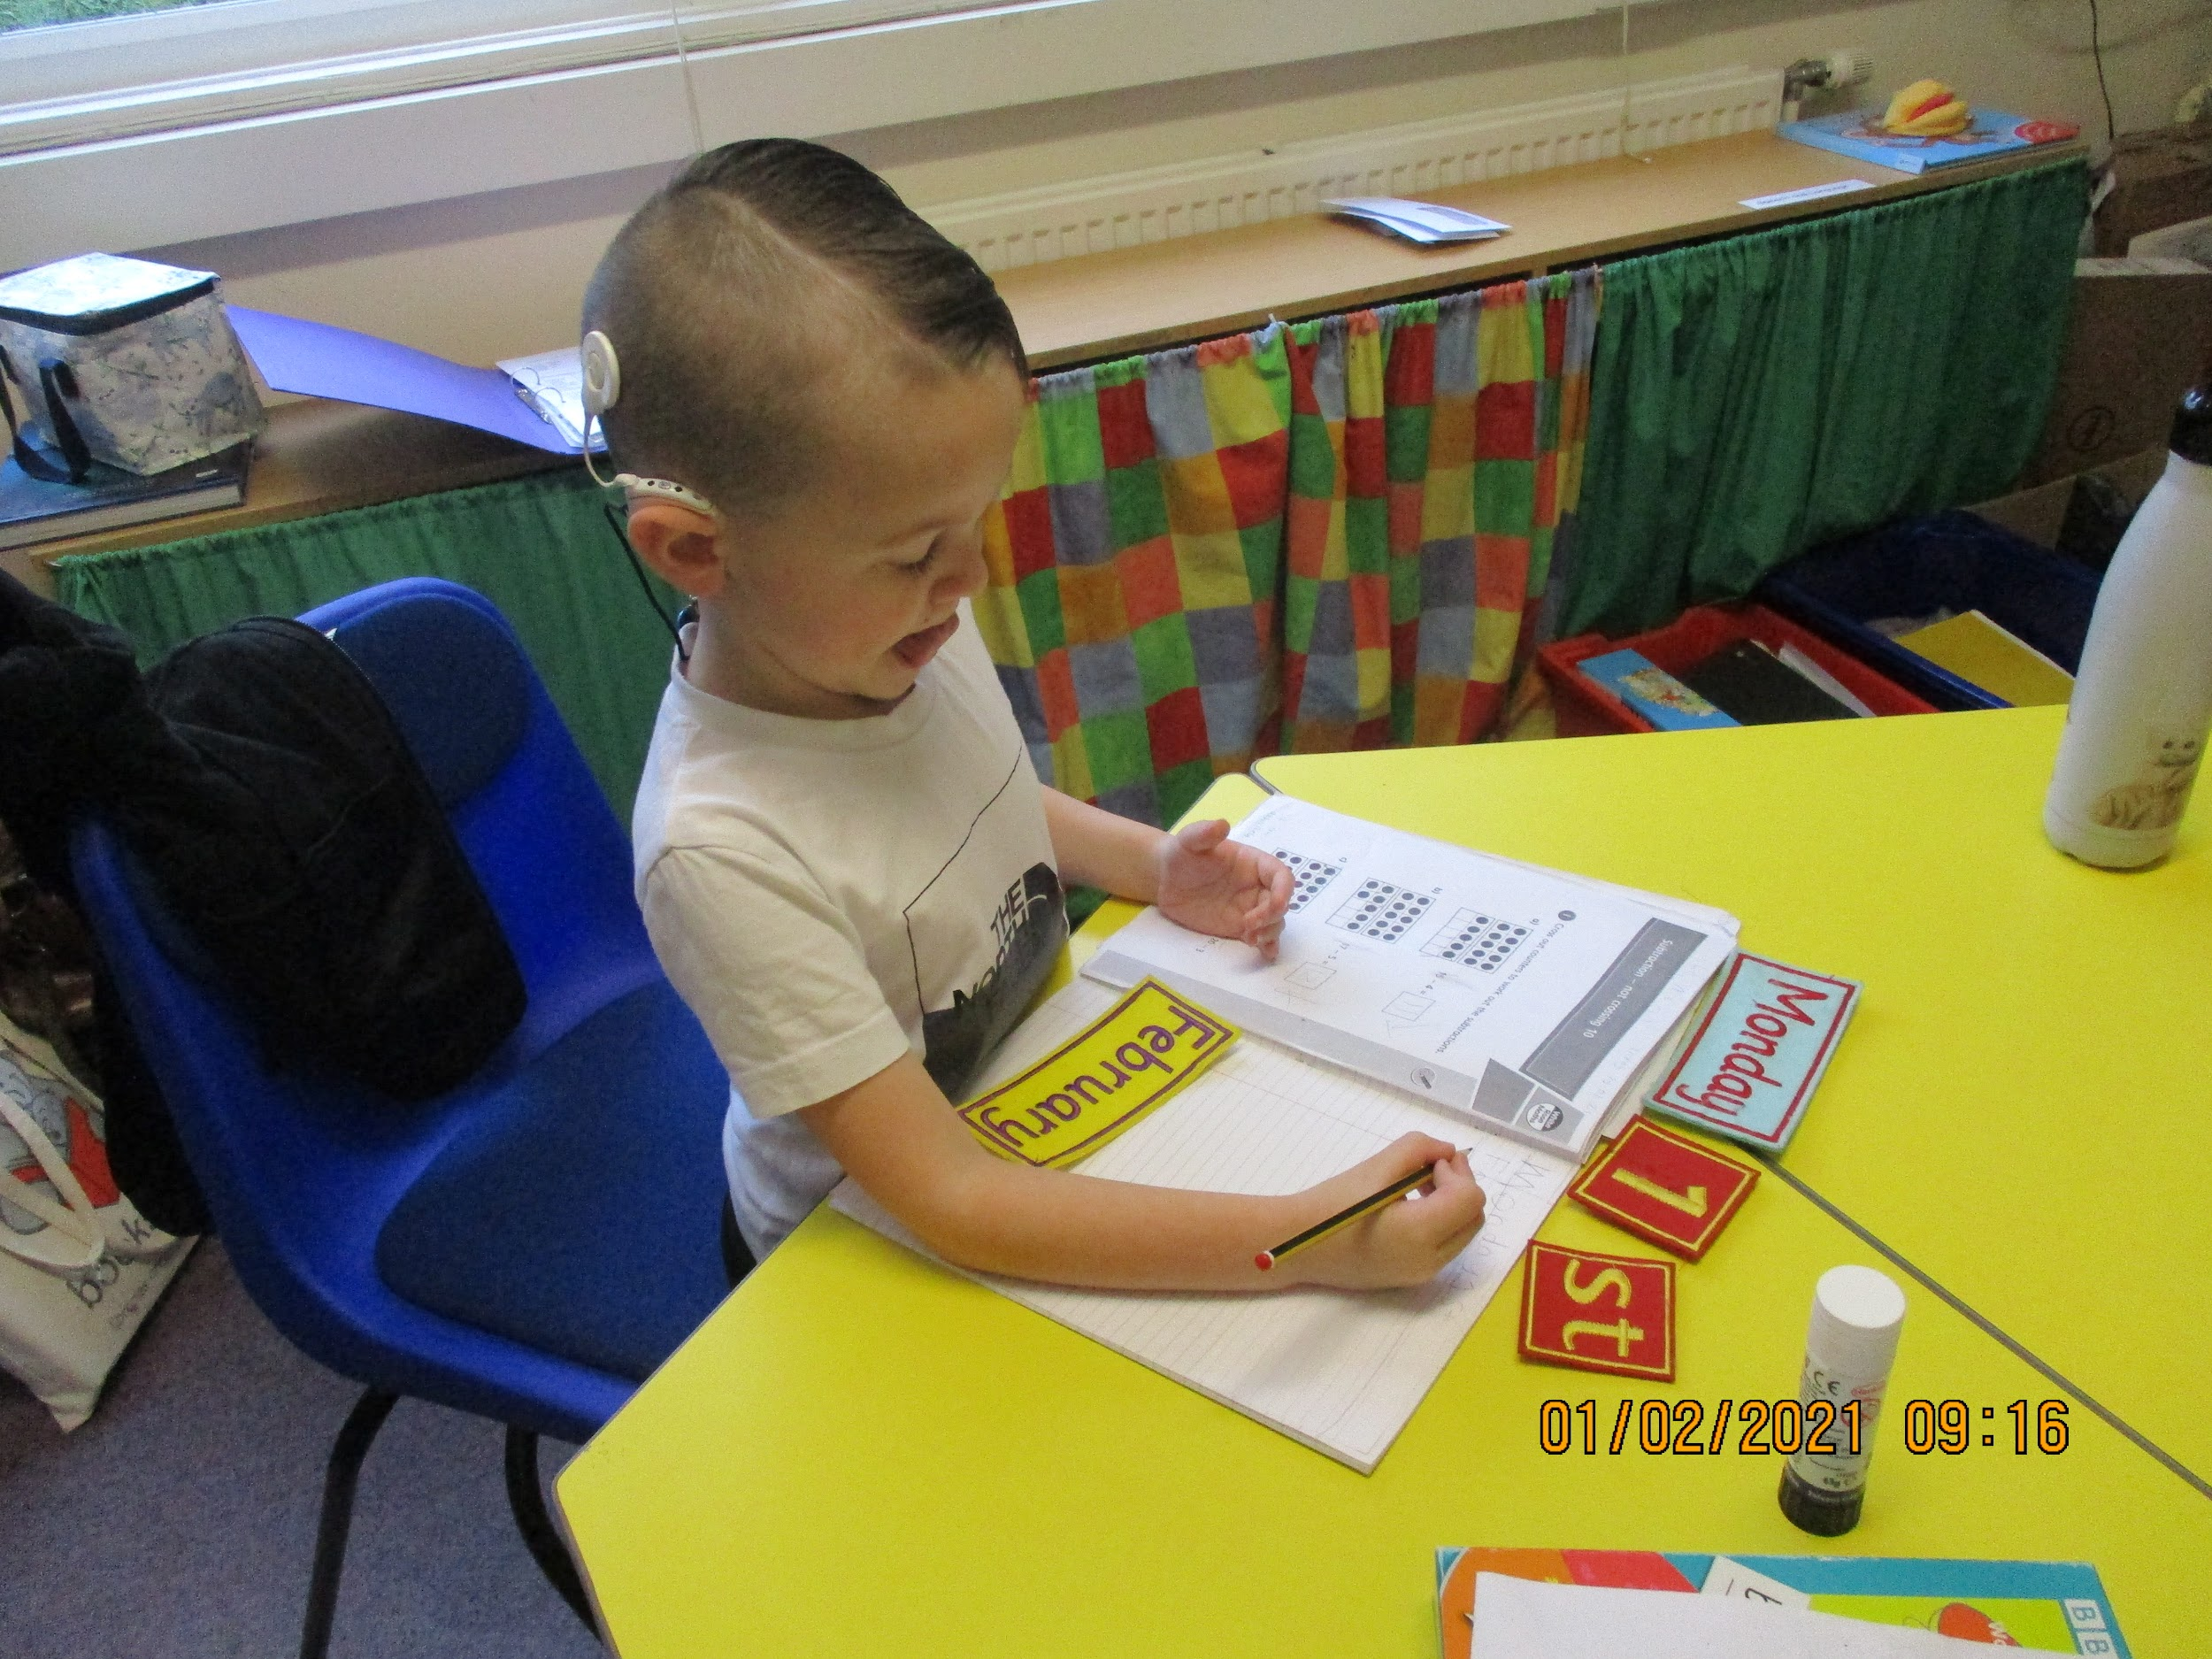
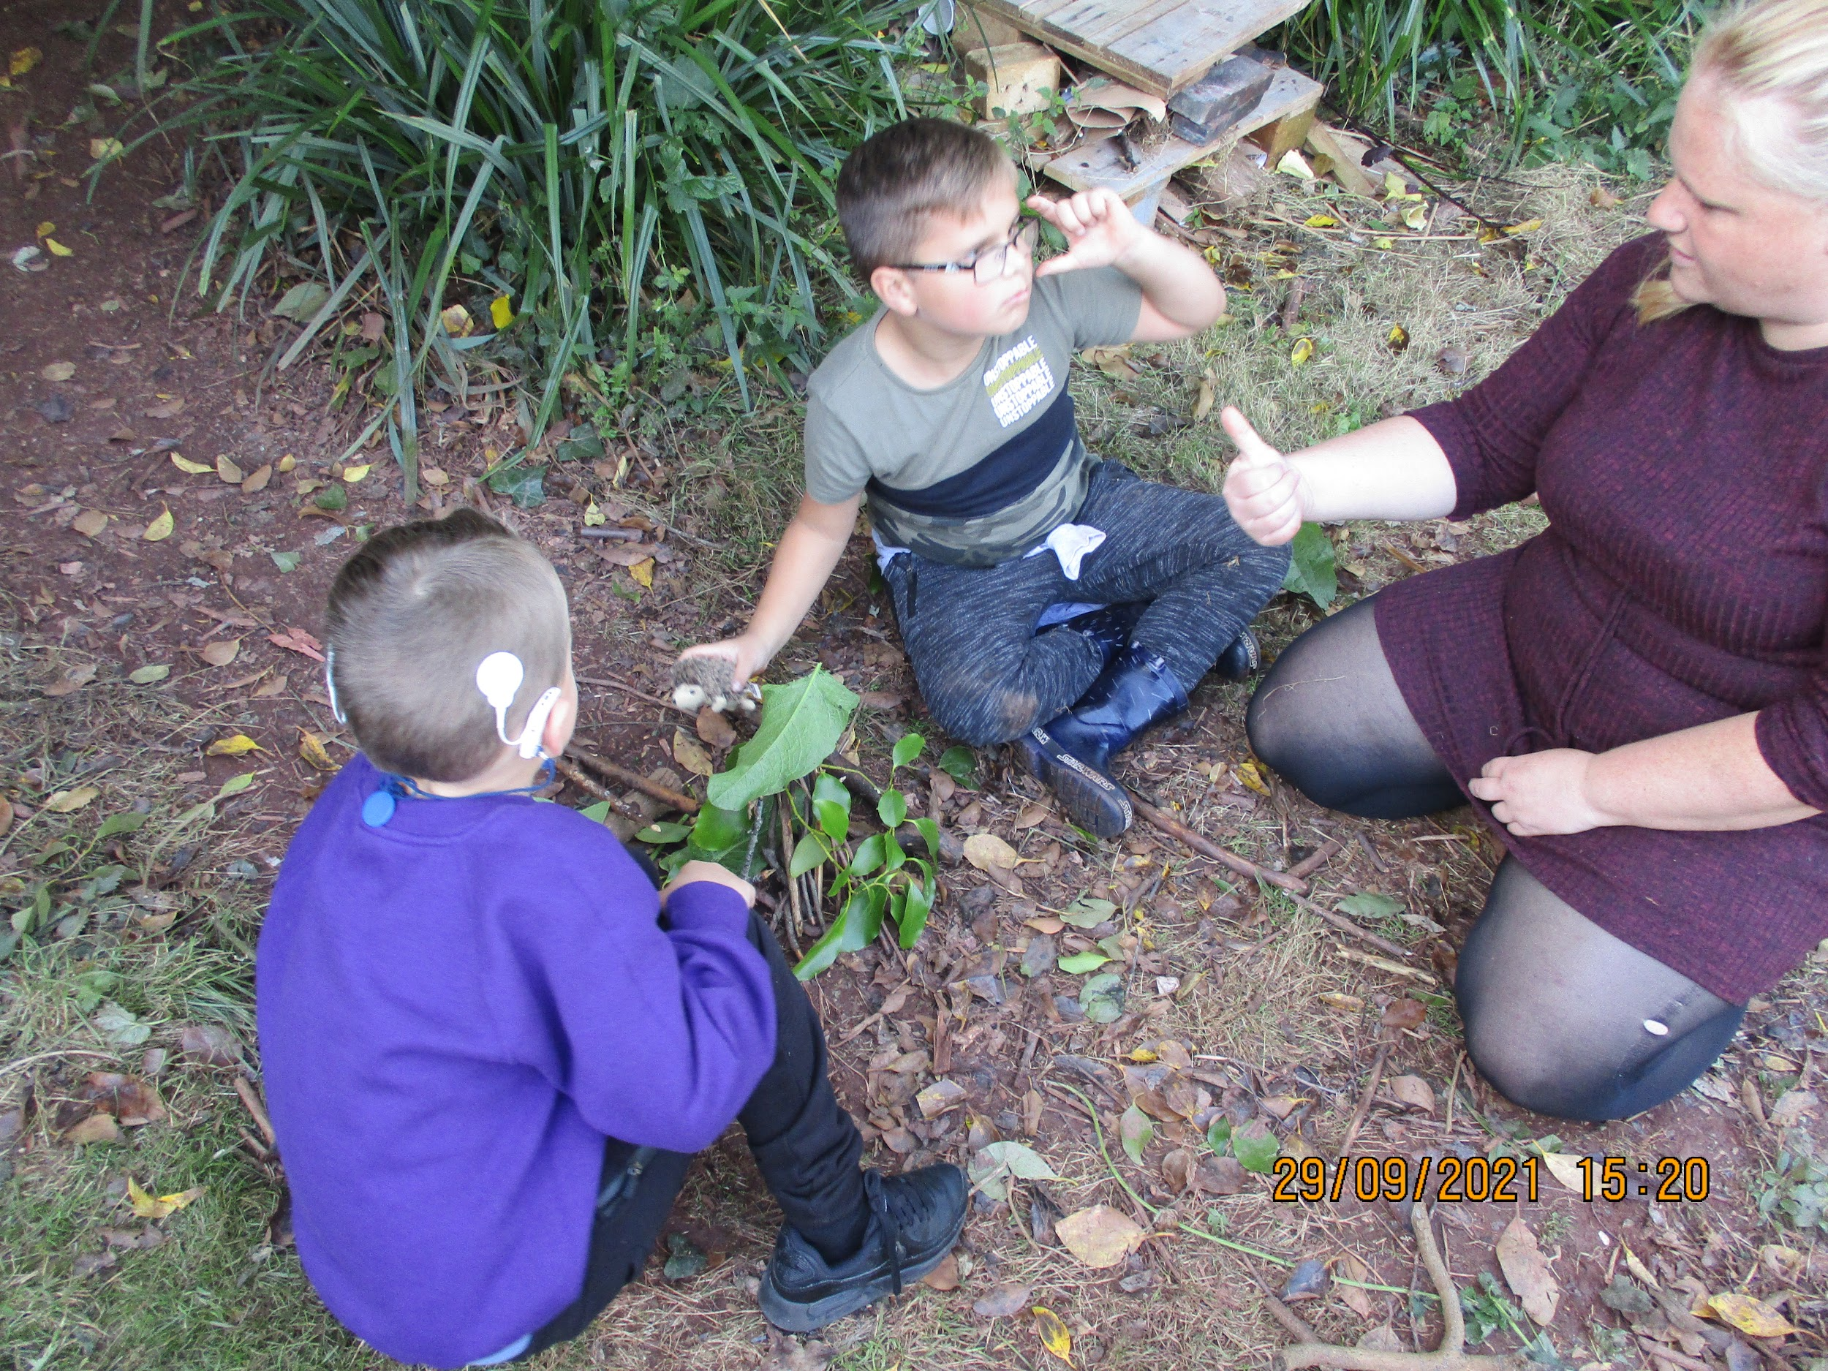
The provision
Resources
Communication
The Hearing Support Centre in St. Margaret’s Academy caters for up to 8 children from 4-11 years with severe or profound hearing loss or moderate hearing loss with additional needs.
Admission to the provision is on a basis of individual need and is agreed in liaison with parents and relevant professionals.
Children are supported by a team of specialists, who have many years experience of working with deaf children.
Mainstream staff in the school are supported to work with children with hearing impairment. Staff receive regular training and support to ensure the children are successfully included and integrated into the school. There is close liaison between the Teacher of the Deaf and other staff to ensure lessons are accessible.
Close links with parents are considered essential. We use home-school books, phone/email contact, and we are happy to meet to discuss issues.
Radio aids are supplied and hearing aids/cochlear implants are checked and monitored regularly.
Professionals from Speech Therapy, Cued Speech and the cochlear implant team base themselves at the centre when working with the children. The Teacher of the Deaf liaises with professionals around the children.
Mainstream classrooms are fitted with soundfield systems
Each child has an individual education plan specific to their needs. We focus on the following, as appropriate to each pupil:
Listening skills
Speech
British Sign Language
Cued Speech
The Team
We have a team of 6 staff including Teacher of the Deaf/Educational Audiologist, Deaf Inclusion Workers and Specialist Teaching Assistants.. Qualifications include: BSL Level 2-6, Cued Speech Level 1- 2,

Slide 2
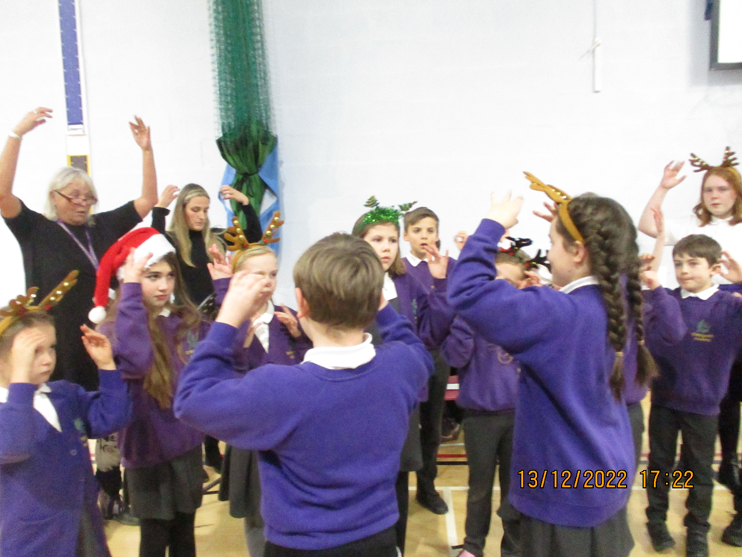
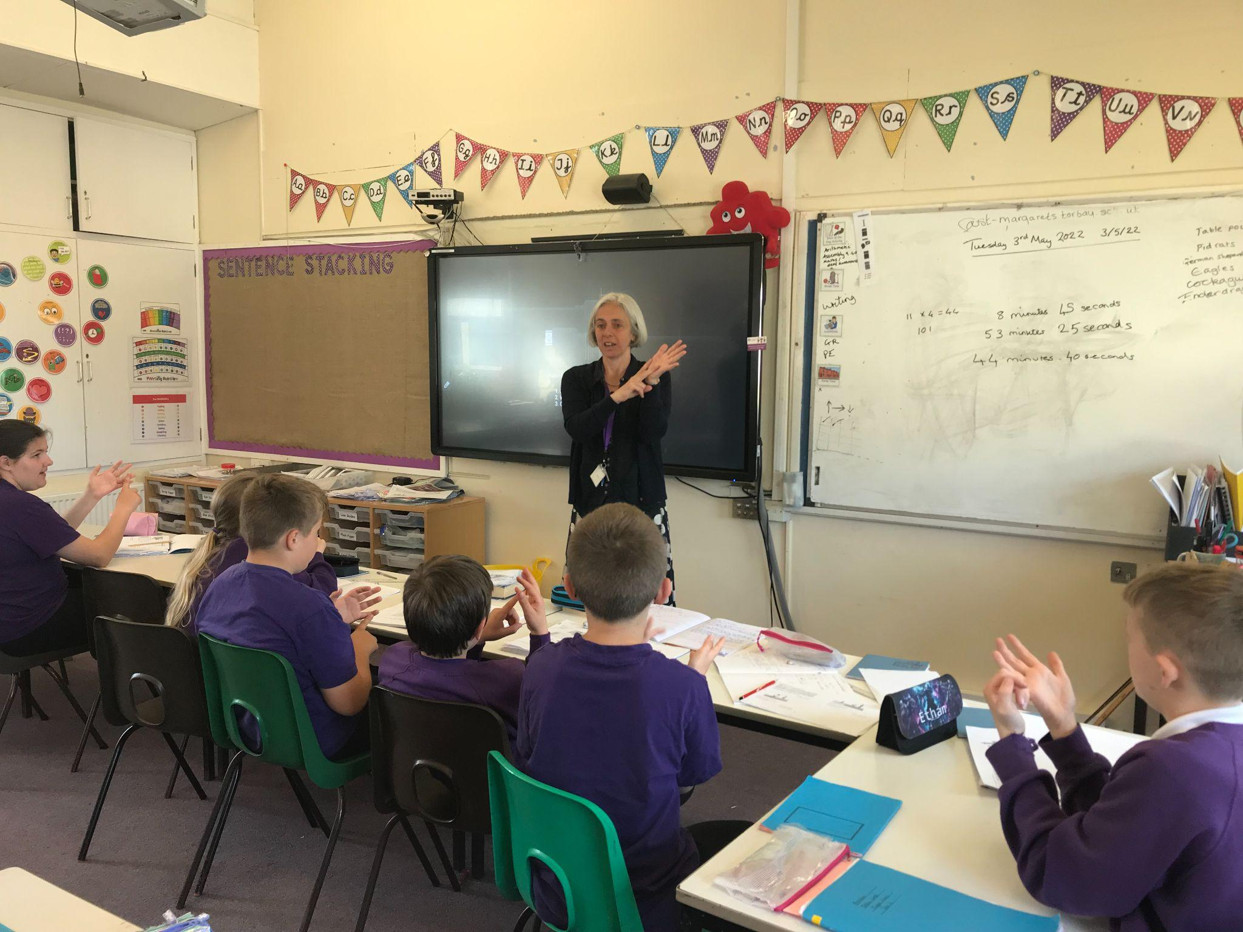
Contact
Jo Saunders
St. Margarets Academy
Barewell Road
Torquay
TQ1 4PA
01803 327090
http://www.st-margaretstorbay.org.uk
Email: jsaunders@st-margarets.torbay.sch.uk
01803 327090
Hearing
Support
Centre
Visits to the Hearing Support Centre are encouraged and welcomed
Supporting deaf children in South Devon
Established 1964

