Slide 1
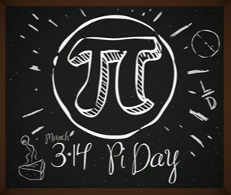
Pi Day March 14th 2021
Celebrations in Year 2 on the 15th March 2021

Slide 2
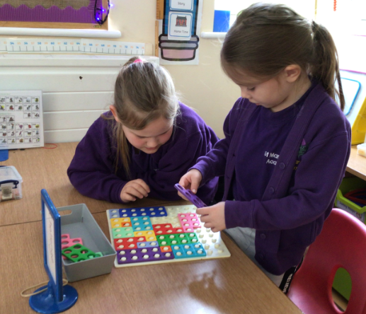
Numicon Challenge
We had to use all of the numicon to cover the board.
We counted how
many pieces
we used.
We then worked out
the total of all of
the pieces.

Slide 3
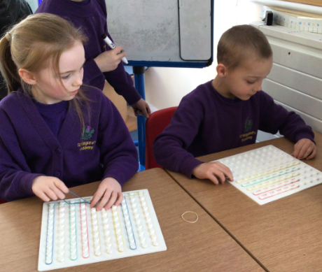
Shape Challenge
We used bands and geo
boards to create 2D shapes.
Can you name the shapes?

Slide 4
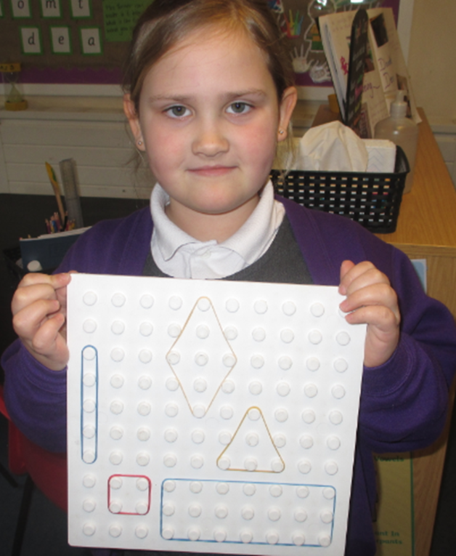
Can you see the different 2D
shapes here?
Do you know their names?
We could name them and describe
their properties.

Slide 5
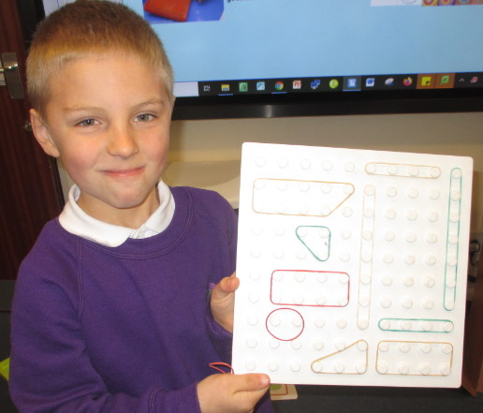
There are many shapes here!
Great creativity.

Slide 6
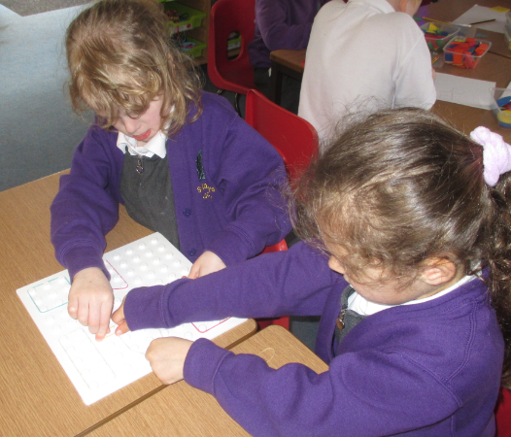
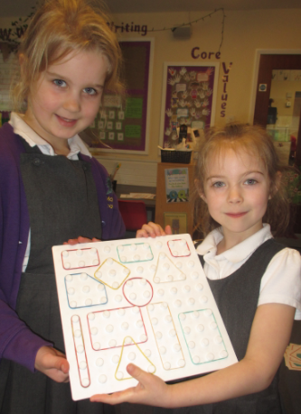
So many shapes in such a small
space and we could describe
them all.

Slide 7
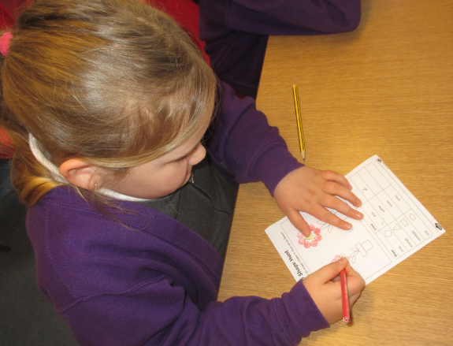
How many? We used our knowledge of shapes to count the number of different 2D shapes which had been used to create a picture.

Slide 8
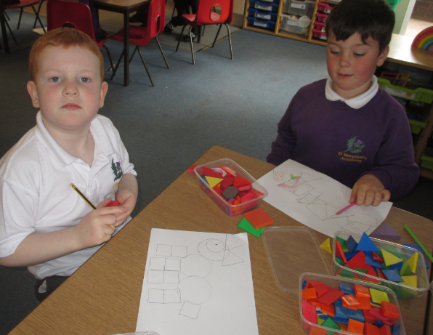
Picture this… We made pictures using 2D shapes. We had to name the shapes and describe the properties of them.

Slide 9
Shape Bingo Can you tick off the shape from the description you are given? We could.

Slide 10
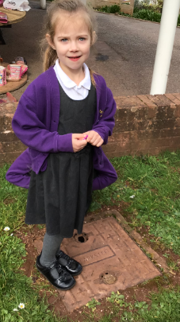
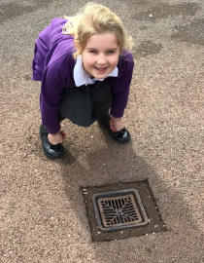
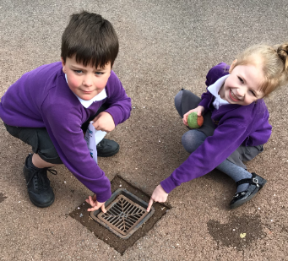
Shape Hunt We looked around to see what shapes we could find in the environment.

Slide 11
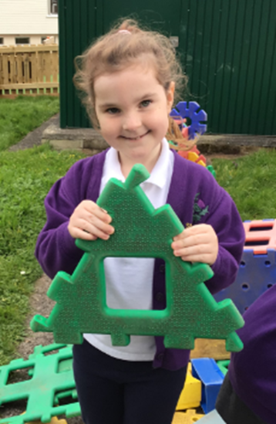
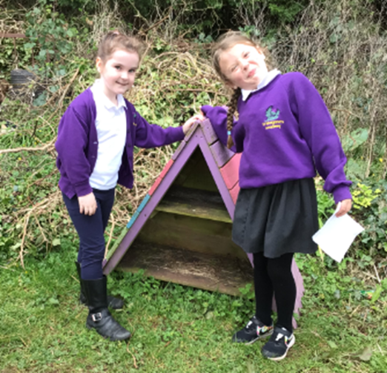
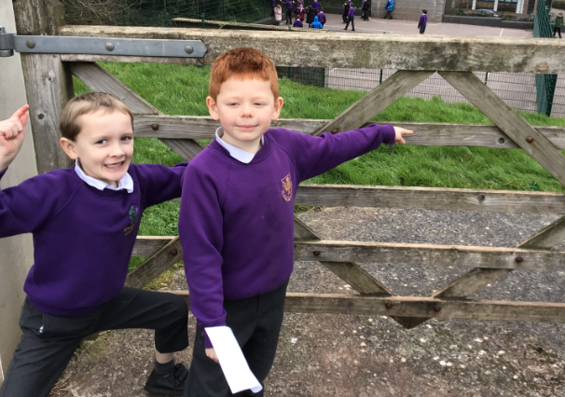
Shapes on their own and shapes within shapes.

Slide 12
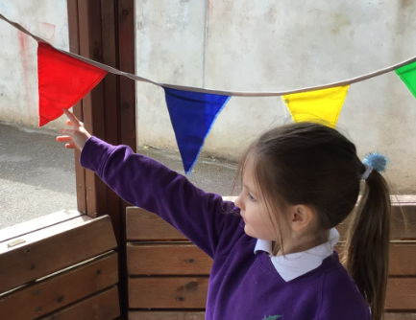
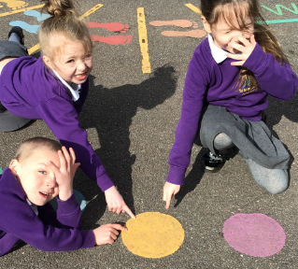
They were everywhere!

Slide 13
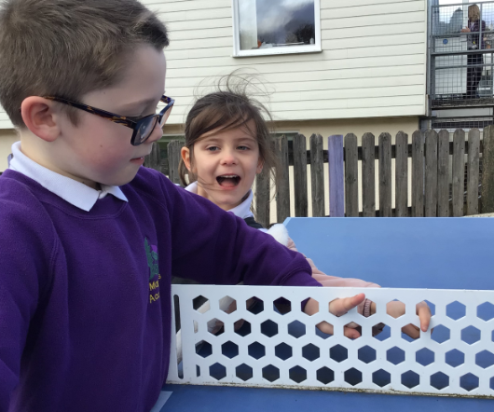
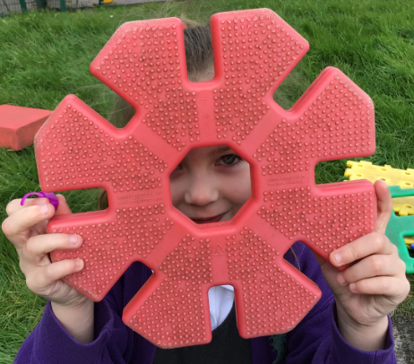
We even found a few hexagons…

Slide 14
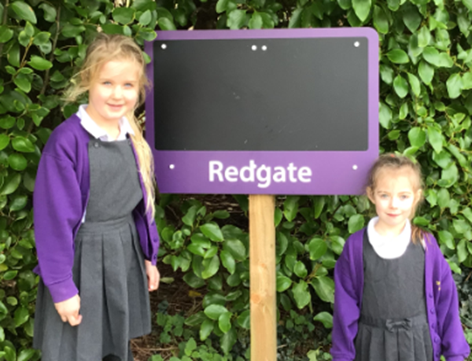
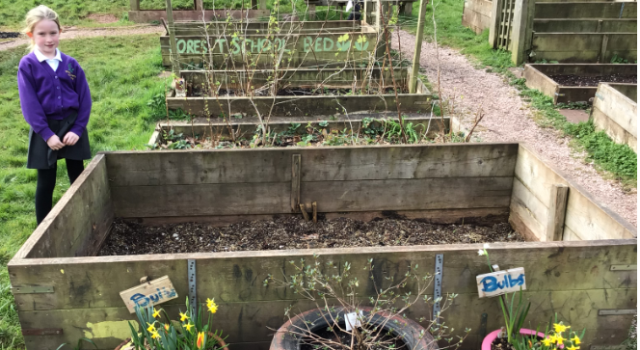
Rectangles…

Slide 15
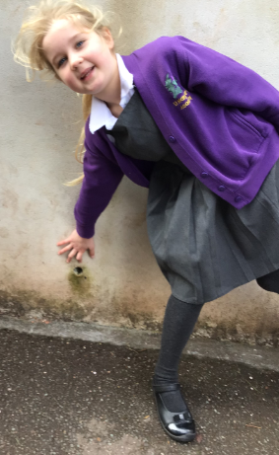
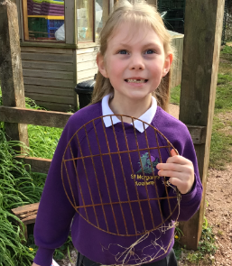
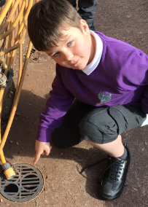
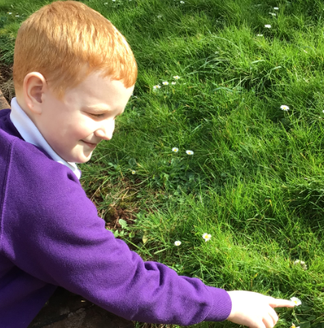
So many circles.

Slide 16
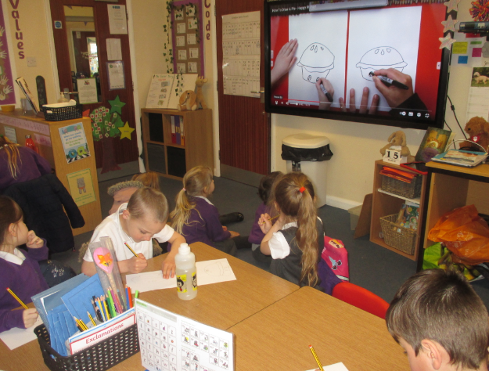
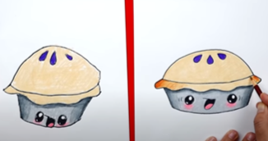
What better way to finish Pi Day than with a draw along?

Slide 18
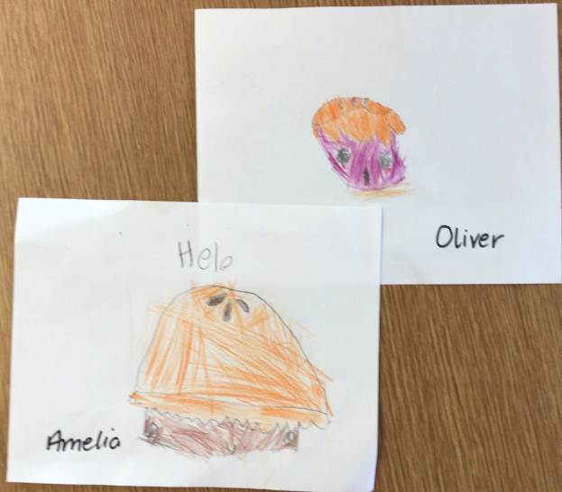

Slide 19
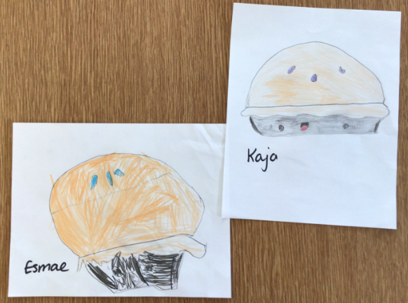

Slide 20
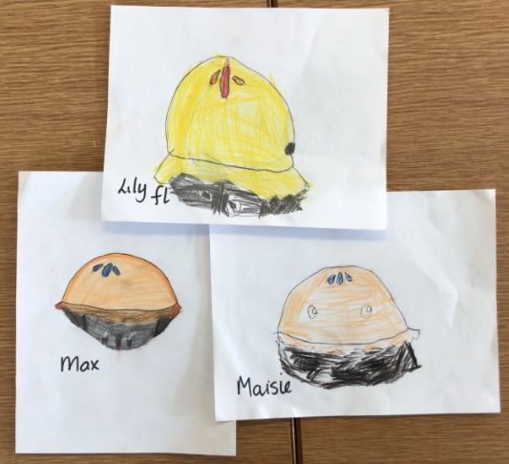

Slide 21
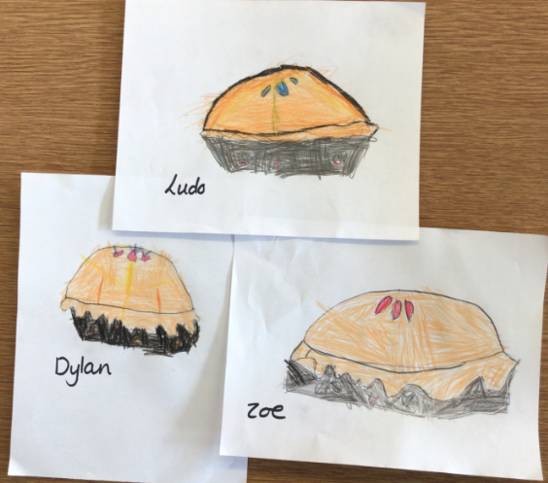

Slide 22
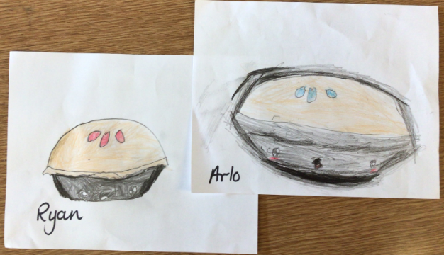

Slide 23
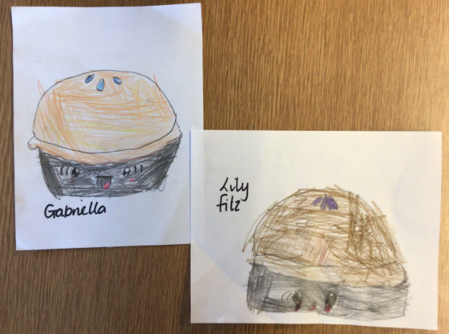

Slide 24
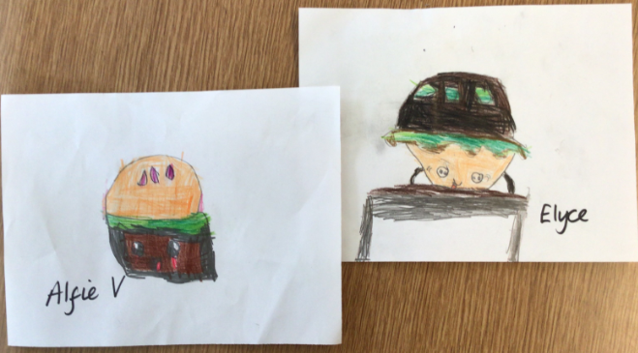

Slide 25
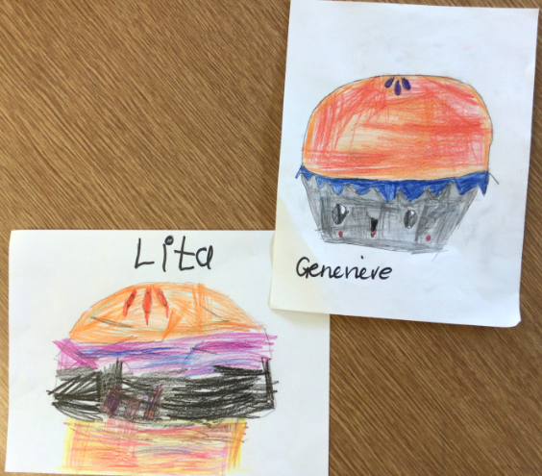

Slide 26
