Slide 1
Meeting for New Parents
26th June 2024
KINDNESS RESPECT RESPONSIBILITY ASPIRATION

Slide 2
School Vision
We want ourselves and the children in our care to be successful, resilient and inquisitive learners who are happy and well-equipped to participate positively in the community and wider society.
School Values
British Values
KINDNESS RESPECT RESPONSIBILITY ASPIRATION

Slide 3
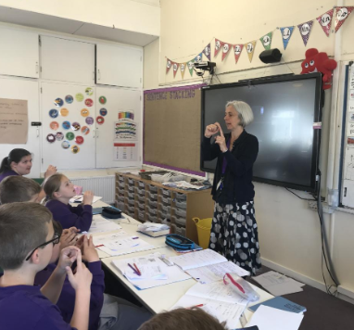
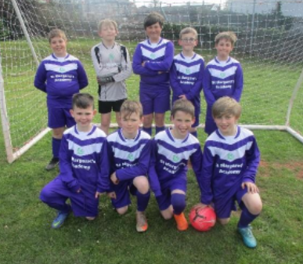
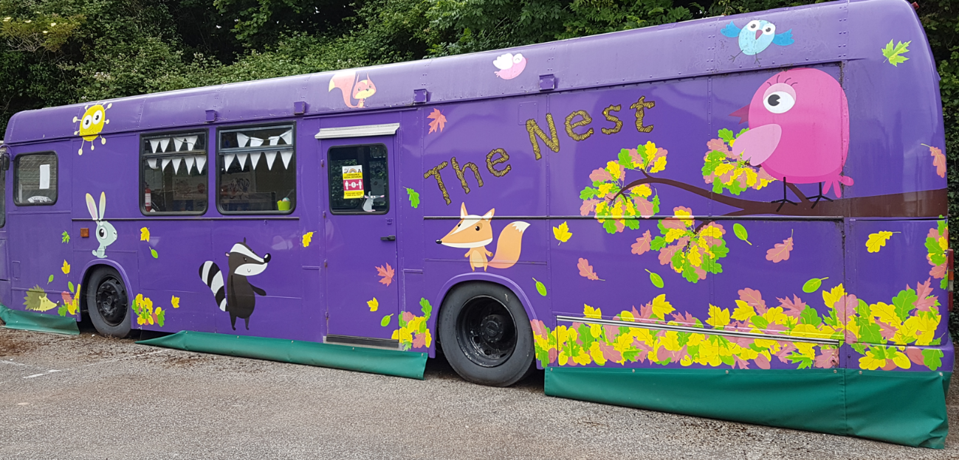
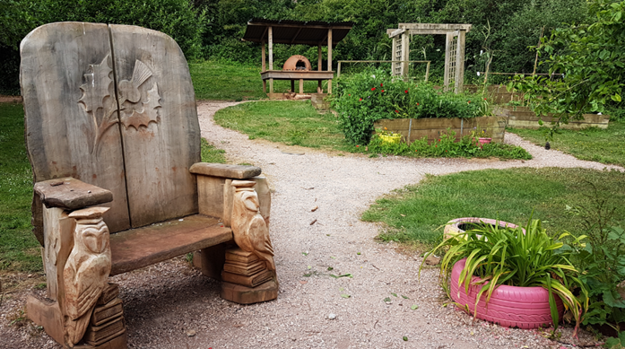
Proud to be a part of
St Margaret’s…
KINDNESS RESPECT RESPONSIBILITY ASPIRATION

Slide 4
Who’s Who?

Slide 5
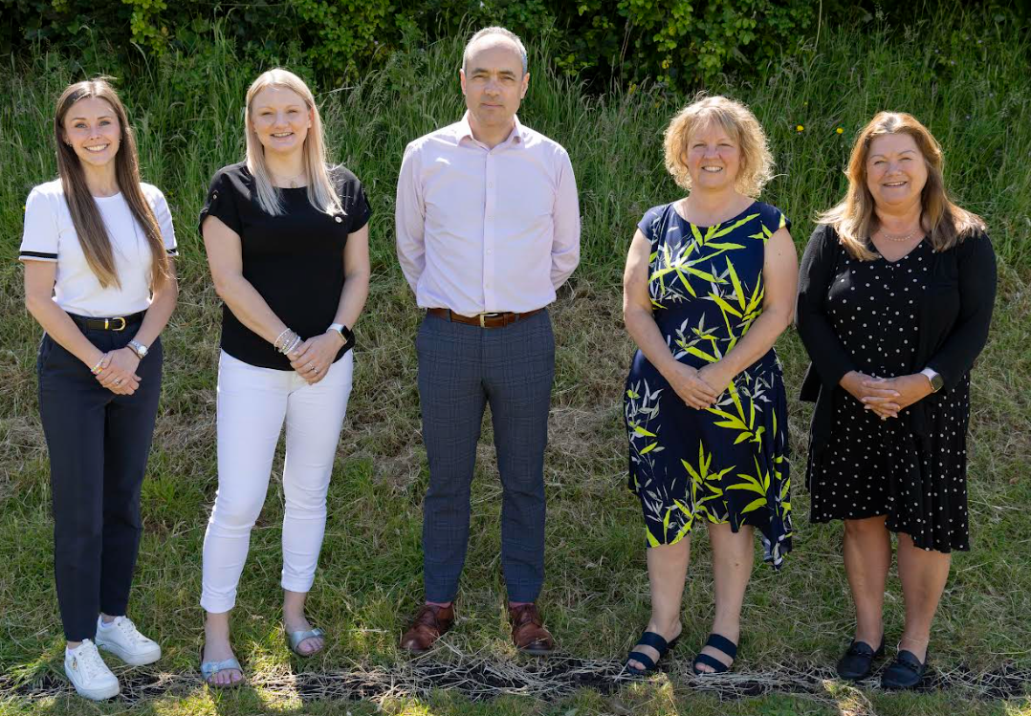
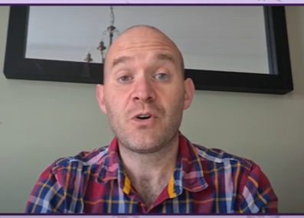
The Senior Leadership Team
Tim Hughes – Head Teacher
Nicole Turner– Deputy Head, Safeguarding Lead and Lead for FS/KS1
Karen Colmer – Business Manager & Governance Professional
Lyndsey Kerswell – Assistant Head Teacher for KS2
Sophie Essam – SENCO and Pastoral Lead
James Bennett
Chair of the Trustees
KINDNESS RESPECT RESPONSIBILITY ASPIRATION

Slide 6
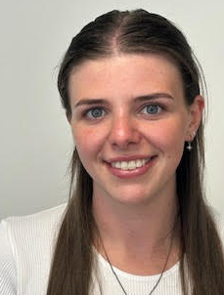
The ‘Acorns’ Team
(aka Reception – Foundation Stage (FS) – Early Years)
Miss Kathryn Leworthy
Higher Level Teaching Assistant
Miss Jo Watkinson
Teacher and Foundation Stage SENCO
Mrs Leanna Russell
Foundation Stage Leader and Teacher (Monday-Thursday)
Mrs Sophie Essam
Teacher (Friday)
Miss Jessica Vaccaro
Teaching Assistant
Mrs Michelle Heaviside
Teaching Assistant
Mrs Anna Peart
Teaching Assistant
Mrs Gemma Duggan
Teaching Assistant
KINDNESS RESPECT RESPONSIBILITY ASPIRATION

Slide 7
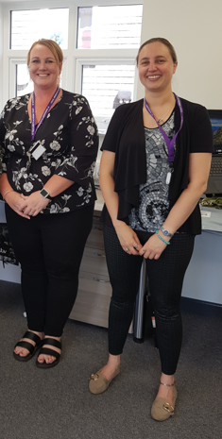
Front Office Team
Sam Newman – Administrator, Attendance and PTA Liaison
Laura Malladine – Administrator
KINDNESS RESPECT RESPONSIBILITY ASPIRATION

Slide 8
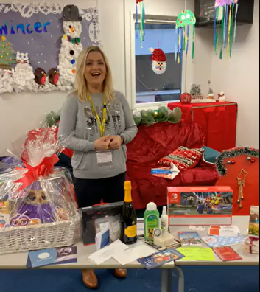
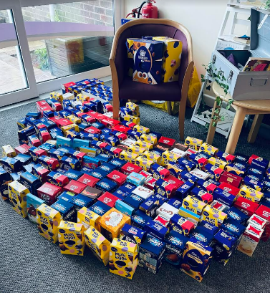
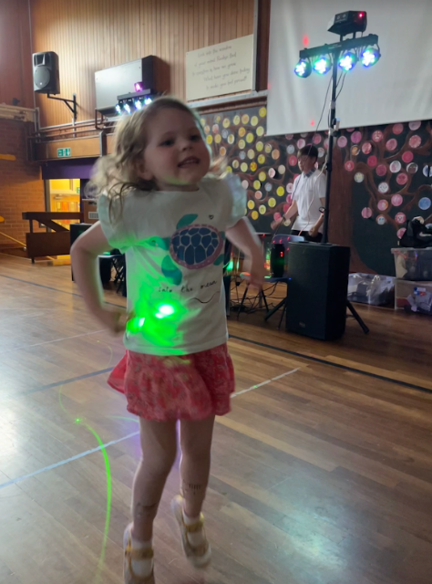
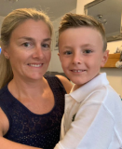
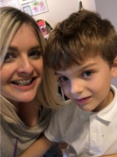
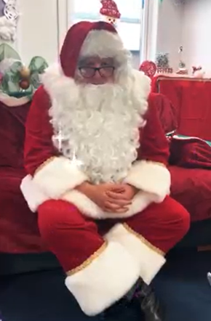
The PTA:
Laura Kenyon
and Felicity Morris
How to get involved?
Join meetings
Help with events (before or during)
Share your skills
Join the PTA FB
Sign up for Amazon Smile - select St Margaret’s
What is the PTA?
Registered charity
Enhance the education for all children (e.g. new library)
Raise funds
Provide resources
Social events
Support special events

Slide 9
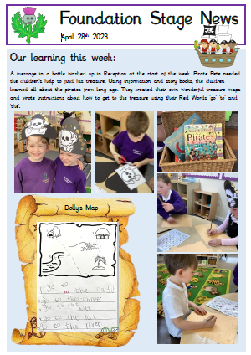
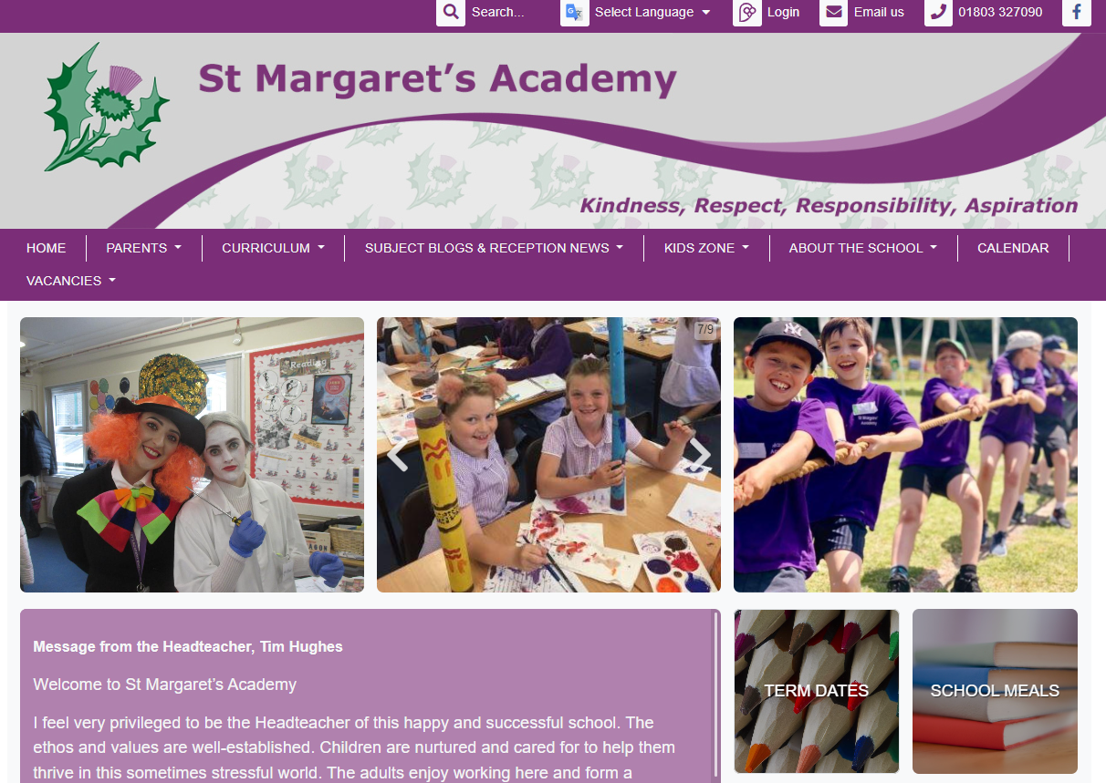
Working in Partnership - Home – School - 7 Years
General information and updates: weekly school newsletter, website (home page ‘Parents’ tab, Facebook, emails, texts, parents meetings (briefly on the gate or book an appointment)
Curriculum information: website (Curriculum Information), Foundation Stage Newsletter, parent workshops.
Progress with learning: parent consultations,
end of year reports and informal conversations.
Health, wellbeing, clubs and meals:
School Gateway app and Medical Tracker

Slide 10
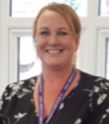
Attendance
Absence makes keeping up hard; children fall behind very quickly
Balancing pressures on school with pressures on families
90% or less is classed as ‘persistent absence’
At less than 95% we will send a letter
Attend every day unless ill
If absent without notice, we will contact you if we do not receive a call on a daily basis to ensure we know your child is safe.
KINDNESS RESPECT RESPONSIBILITY ASPIRATION

Slide 11
Transition into School
Home Visits: July
Early Years Picnic: Wednesday 17th July 2024
3.30pm – 4.30pm.
Taster session: one session to play (parent and child) on one of the following dates Monday 9th, Tuesday 10th or Wednesday 11th September 2024 – your child’s specific time will be in the pack
Part Time week: morning or afternoonThursday 12th – Wednesday 18th September 2024
Full Time start: From Thursday 19th September.
Notes:
Leanna - Visit morning – you will have received on your welcome letter. You are invited to come into school with your child and explore the envrionment. A nice chance for taster session before they go off on holiday.
Home visit – coming to get to know your child in a secure environment, you can have a 1:1 conversation with us about your child’s interests/needs, date will come in a letter in july
Staggered start – your children have come for a range of different pre-school settings, move to school is a big step, positive feedback about the process. Two staggered weeks, first week morning or afternoon only, second week morning only for all children and lunch.
Your child’s class/teacher is in their pack but lots of opportunities to mix.
11

Slide 12
Timings of the Day
Breakfast Club opens at 7.40am (£3.50 / child)
Gates open at 8.40am
Registration is at 8.50am and learning starts promptly
End of day is 3.20pm (collection starts from 3.15pm)
After School Club runs until 5.20pm (£9.00 / child, sibling cost £7.00)

Slide 13
What’s in the Welcome Pack?
The pink form
A welcome letter from the Chair of Trustees
A welcome letter from the Head Teacher
A welcome letter from the Foundation Stage team
Information from the PTA
Home arrangements form - to be completed and returned
Road to School map
Information about school dinners including how to book and a sample menu
Information about the School Gateway app
Attendance information
Uniform checklist

Slide 14
Google Forms for Completing
GDPR – we need active consent for (these will go out after the meeting)
School trips (local walks)
Acceptable IT Use Agreement
Images and videos use, including social media
Marketing flyers from groups associated with the school e.g. sports and PTA
Guinea pig
Home school agreement
We need medical details and emergency consents
KINDNESS RESPECT RESPONSIBILITY ASPIRATION

Slide 15
The Pupil Premium - £2530
The pink form (found in the pack)
Important note:
this is not the universal free school meal offer.
OR…
apply online:
https://forms.torbay.gov.uk/freeschoolmeals
KINDNESS RESPECT RESPONSIBILITY ASPIRATION

Slide 16
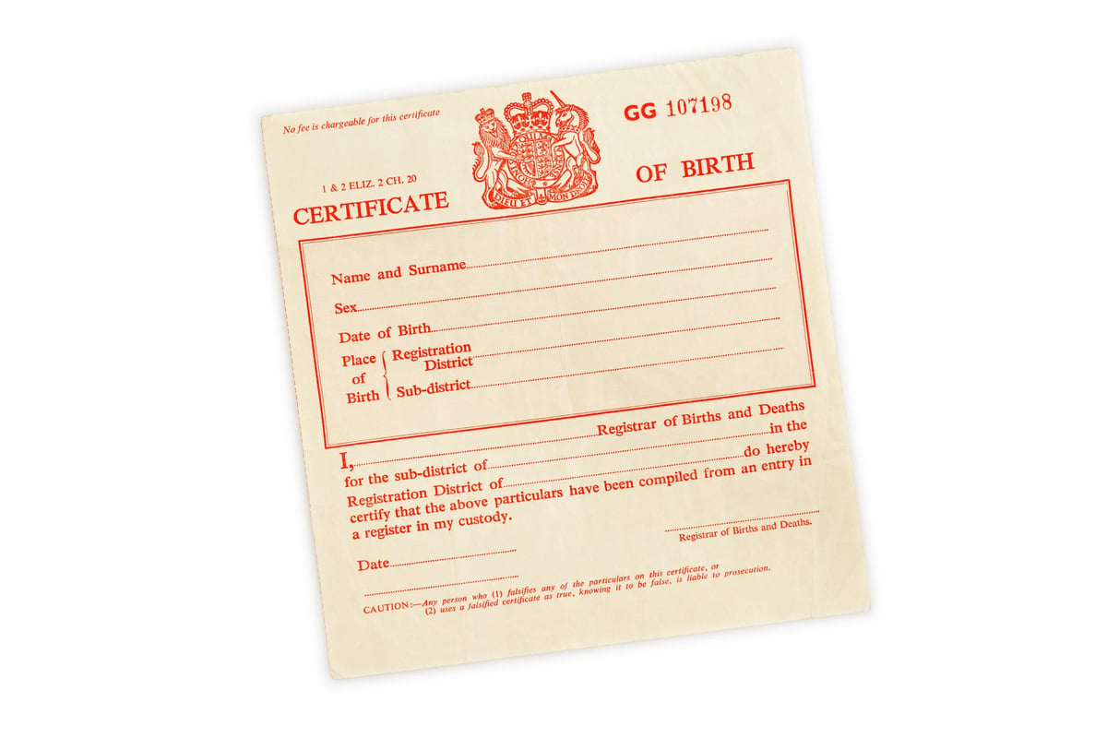
Birth Certificates
Please bring anytime up to your child starting school so we know who has PR, accurate spellings and DOBs.

Slide 17
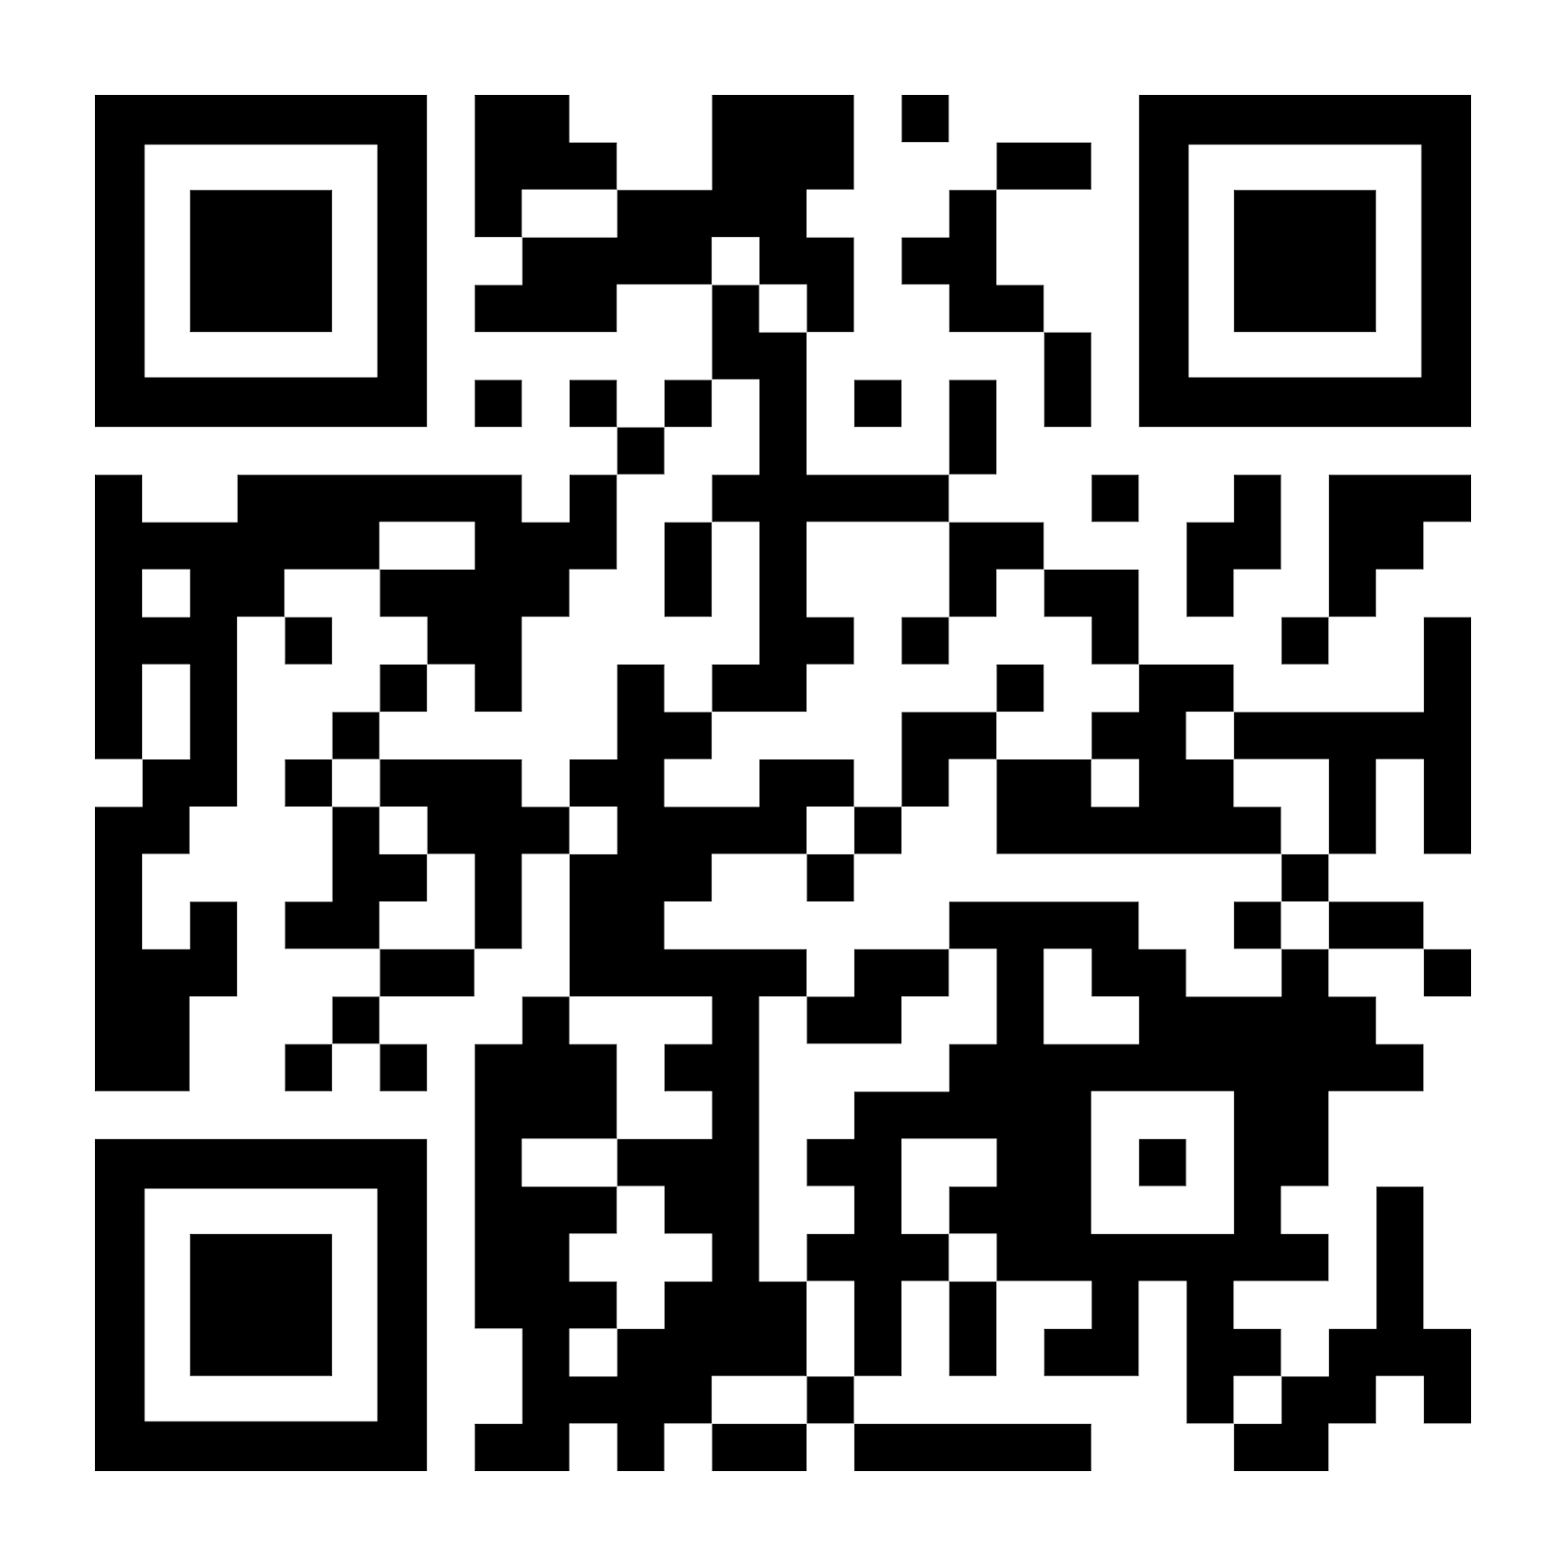
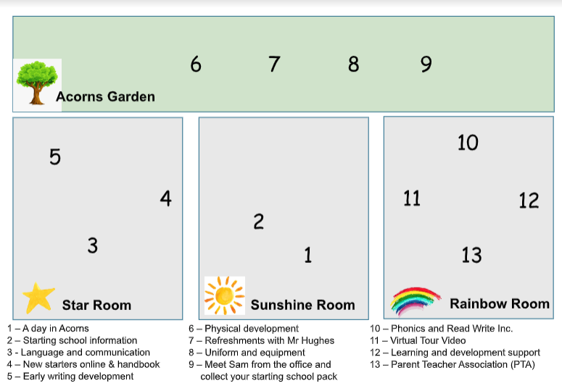
Treasure Map for School Readiness, Routines and Foundation Stage Learning
Collect some treasure from each location.
There is some paper treasure but it’s mostly QR codes that take you to our web site.

