Slide 1
Torbay

Slide 2
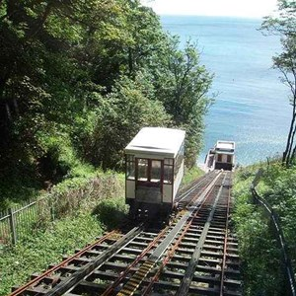
A UNESCO designated
Global Geopark

Slide 3
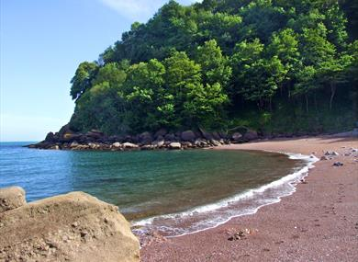
400,000,000 years in the making…

Slide 4
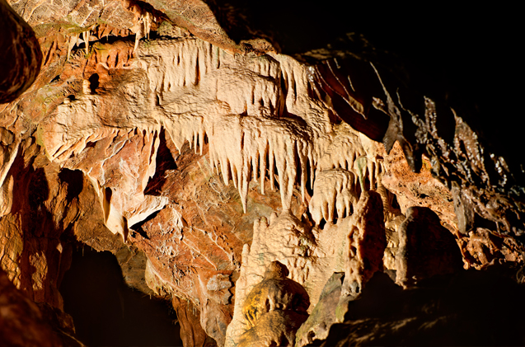
1 of only 7 in the UK

Slide 5
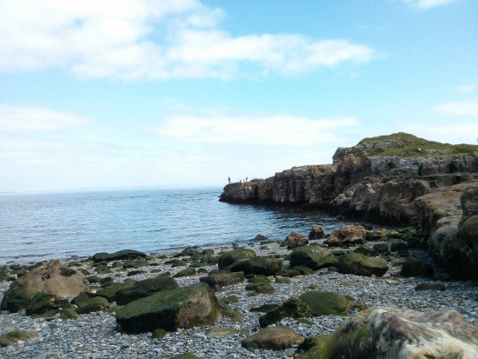
1 of only 147 in the world

Slide 6
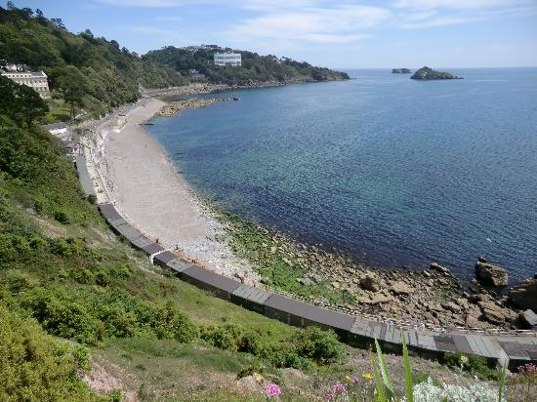
- geological interest and sustainability

Slide 7
UNESCO
(United Nations Educational, Scientific and Cultural Organization)

Slide 8
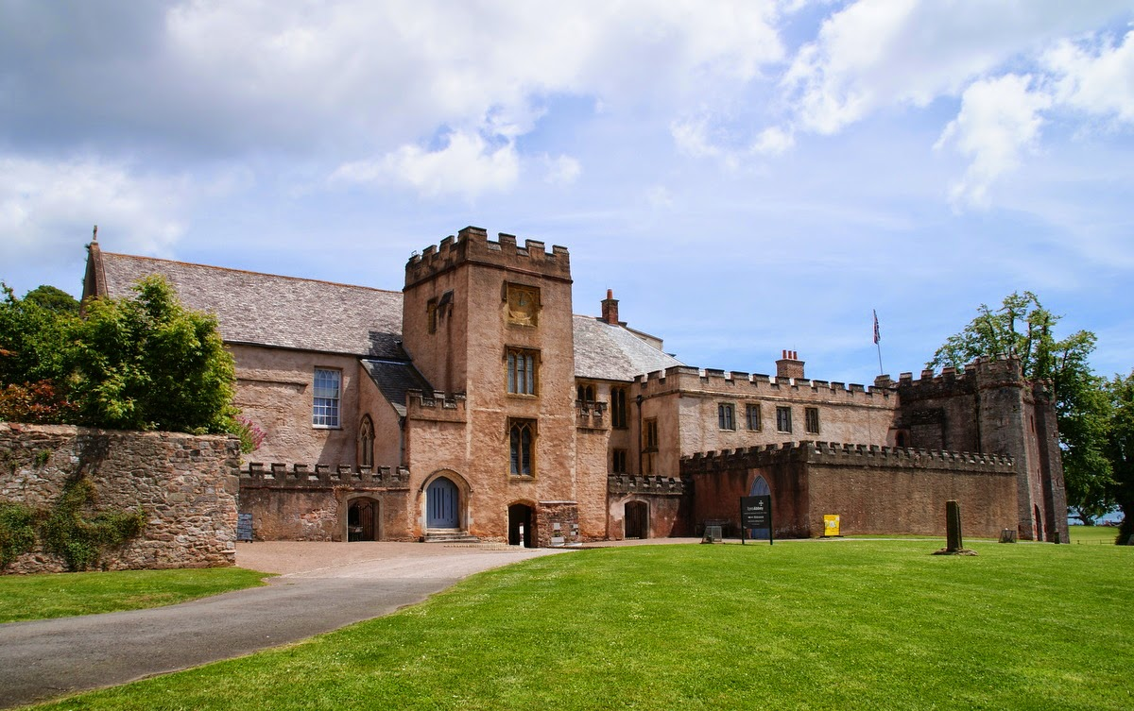
- seeking to build peace through international cooperation

Slide 9
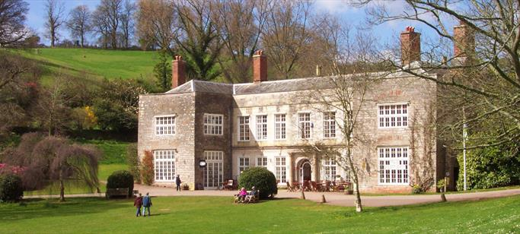
Over 1,000,000 children in the UK have never seen the
beach.

Slide 10
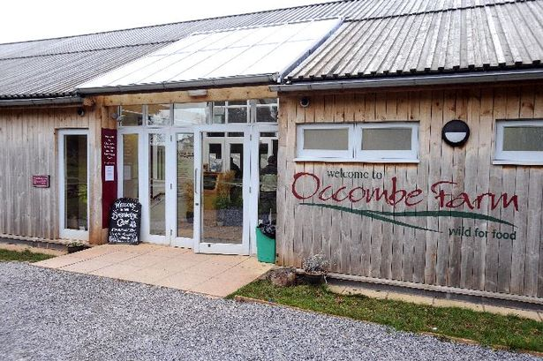
Be thankful.

Slide 11
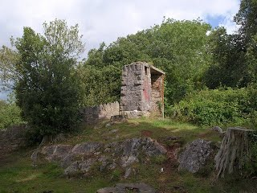
Enjoy each day.

Slide 12
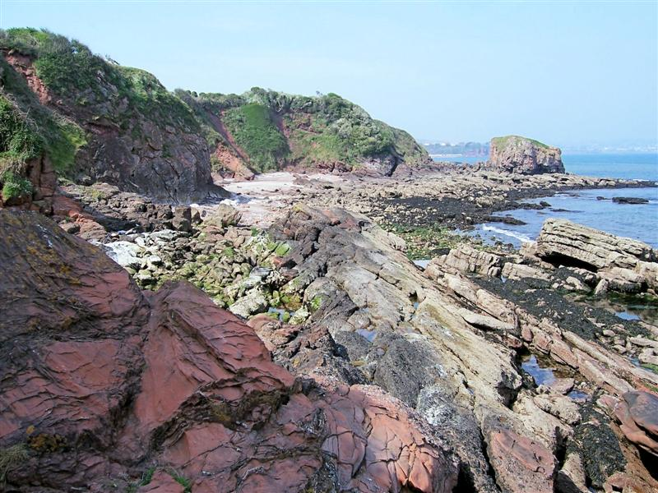
Enjoy each moment in the day.

Slide 13
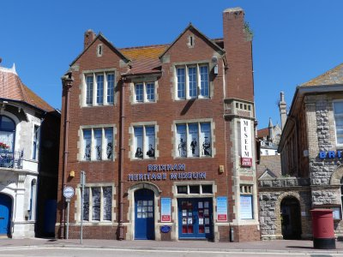
Smile.

Slide 14
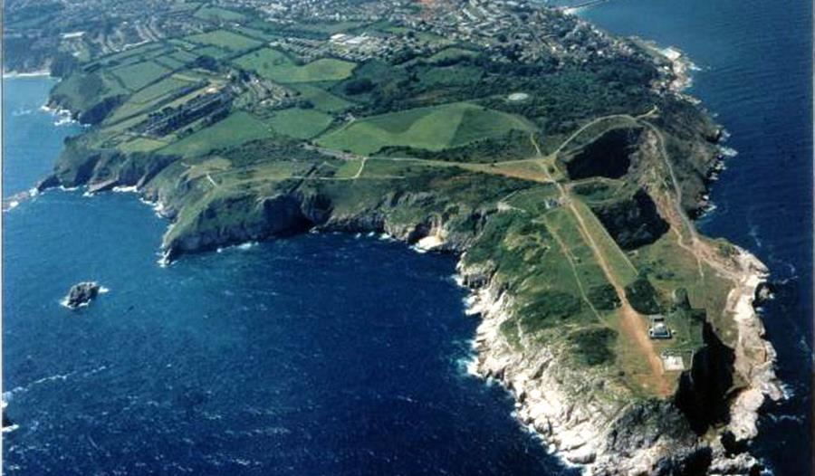
Slow down.

Slide 15
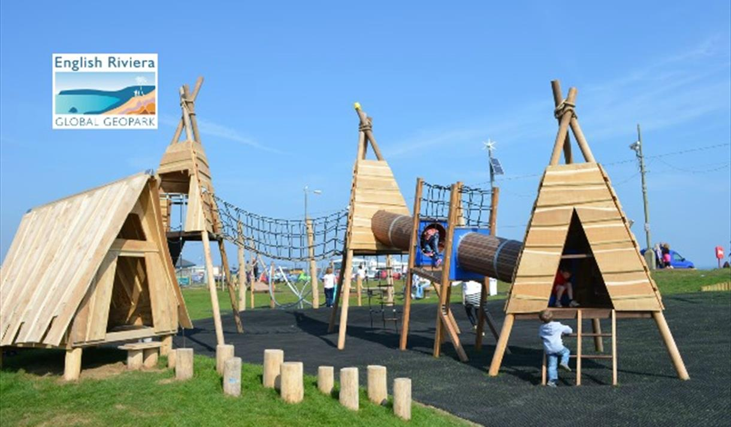
Play.

