Slide 1
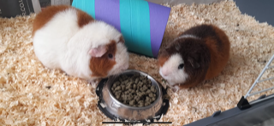
Roald and Dahl

Slide 2
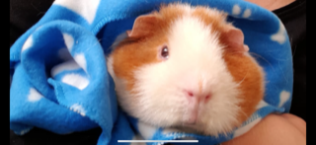
Roald
This is Roald and he is a Teddy Bear Guinea pig. He is 1 year old and has always lived with his brother Dahl. Dahl gets on his nerves a bit but they do love each other and Roald wouldn’t want to be without him! Roald likes to hide in the tunnel because he feels safe when he is in there. He can get a bit nervous when you first pick him up but once he’s cuddled up in his blanket he can sometimes fall asleep! Stroke his nose very gently and keep your voice really quiet and he might drift off.
He loves listening to stories and
Harry Potter is my favourite!
o

Slide 3
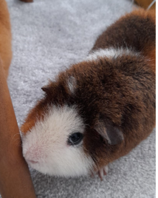
Dahl
This is Dahl and he is a Teddy Bear Guinea pig.
He is 1 year old and has always lived with his brother Roald,
he is very noisy and can get up to mischief! Sometimes Roald will tell him to go away because Roald just likes to be left on his own. Dahl can be a bit wriggly so if you cuddle him please make sure you hold him in a blanket. His favourite things to eat are hay and iceberg lettuce but he likes all sorts of vegetables, in fact… he loves food!!
Please chat to Dahl and read him some of your reading books when you go to visit!

Slide 4
Teddy Bear Guinea Pigs
Teddy guinea pigs get their name from their appearance, which resembles a teddy bear. They have thick, wiry hair that sticks out from the body, instead of lying flat and smooth against the skin. They also have a wider, larger nose than other breeds, which contributes to their unique appearance.
Teddy guinea pigs are known for being calm and friendly. Many Teddy guinea pigs are very tolerant of handling and may even
enjoy cuddling with their owners.
This makes them a good option for
children or first-time guinea pig owners.

Slide 5
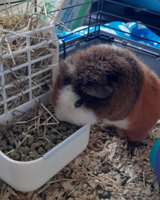
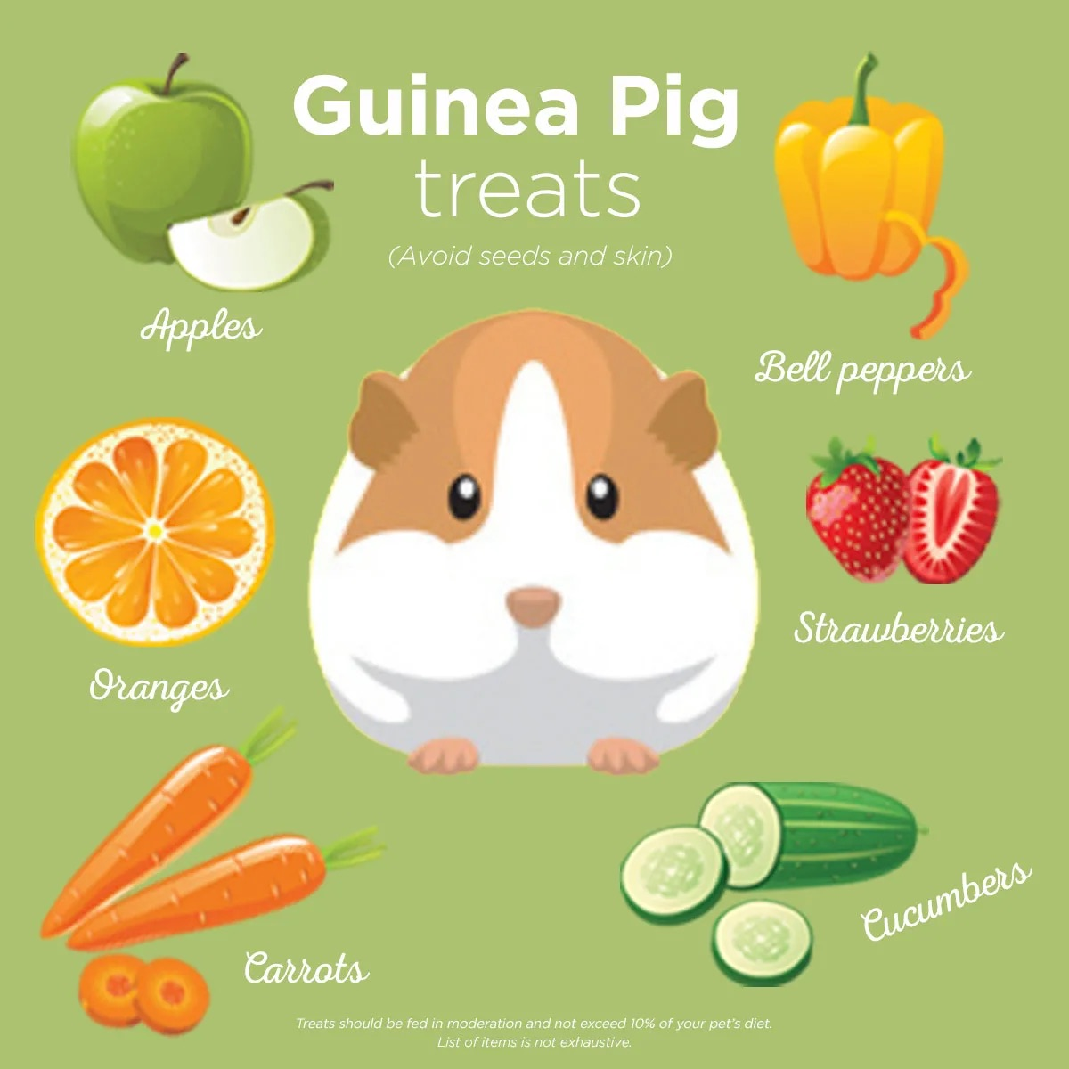
What they like to eat…
Daily
1 bowl of nuggets
1 bowl of green hay
1 ball of hay
1 bowl of vegetables (Kitchen)
Fresh water as needed.
Treats we might sometimes give them –
but always check with Mrs Turner or Mrs Tandy

Slide 6
Some rules to keep them safe…

Slide 7
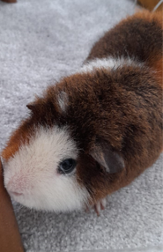
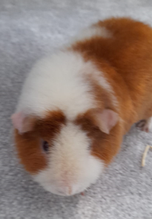
Another rule to keep them safe…

Slide 8
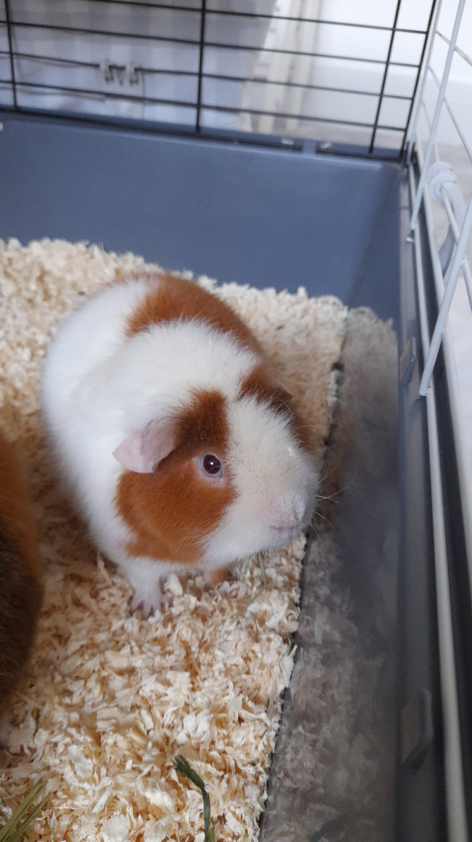
Their adventures so far…

Slide 9
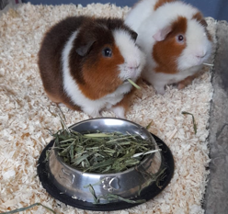
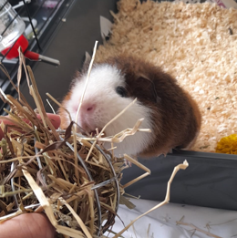
more adventures…

Slide 10
Please Help To Keep Us Safe

