Slide 1
Key Stage 1
Outdoor Learning with
Alex Mack
from
Devon Waste Education Team.

Slide 2
Today Alex came in to school to work with the children in KS1. At the start of the lessons Alex talked to everyone about the things they might waste and how a lot of it goes to the landfill.

Slide 3
Even more of the waste goes to an incinerator in Plymouth. As a country we can only help the planet if we remember the 3Rs…
Alex talked about how clothes can be recycled and that lots of boxes and packaging from our recycling boxes at home are used in class in the Workshop Area.

Slide 4
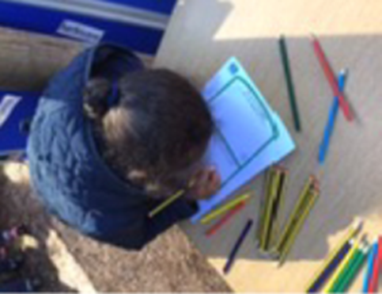
Year 1 worked with Alex in the morning. She told them that food waste can be used to make compost. In Year 1 they have been learning all about what a plant would need to help it to grow. The children were able to tell Alex that plants need water, light, the correct temperature, time and soil in order to grow healthy. To help them remember, they created an image to show the list of foods which can be put into a compost bin.

Slide 5
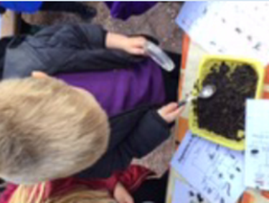
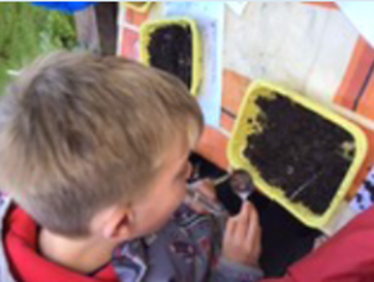
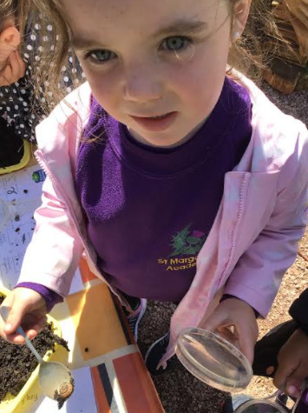
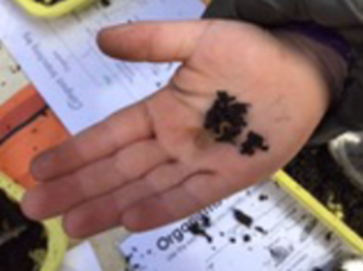
They worked in groups searching for and identifying minibeasts in some compost.

Slide 6
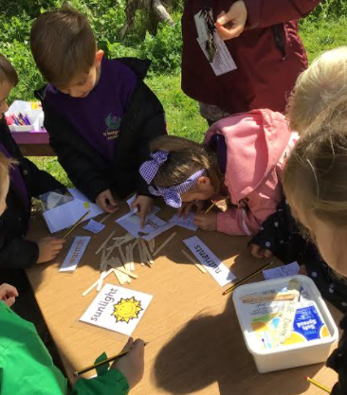
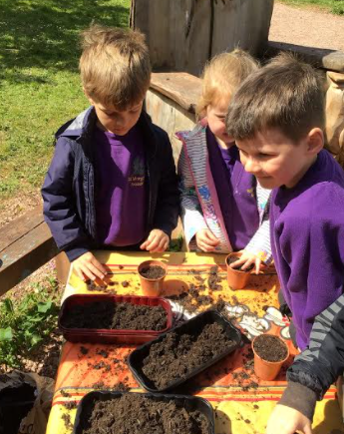
They planted pea seeds and labelled what plants need to grow.

Slide 7
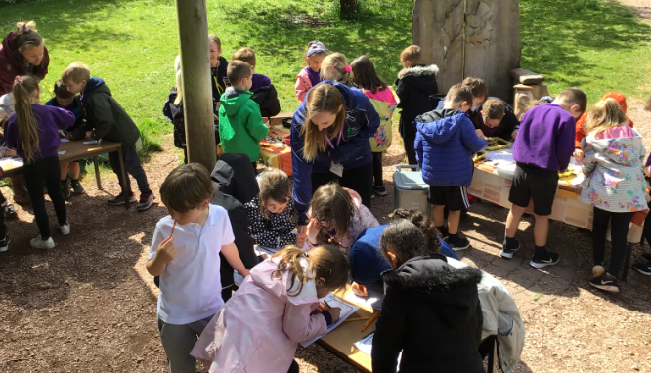
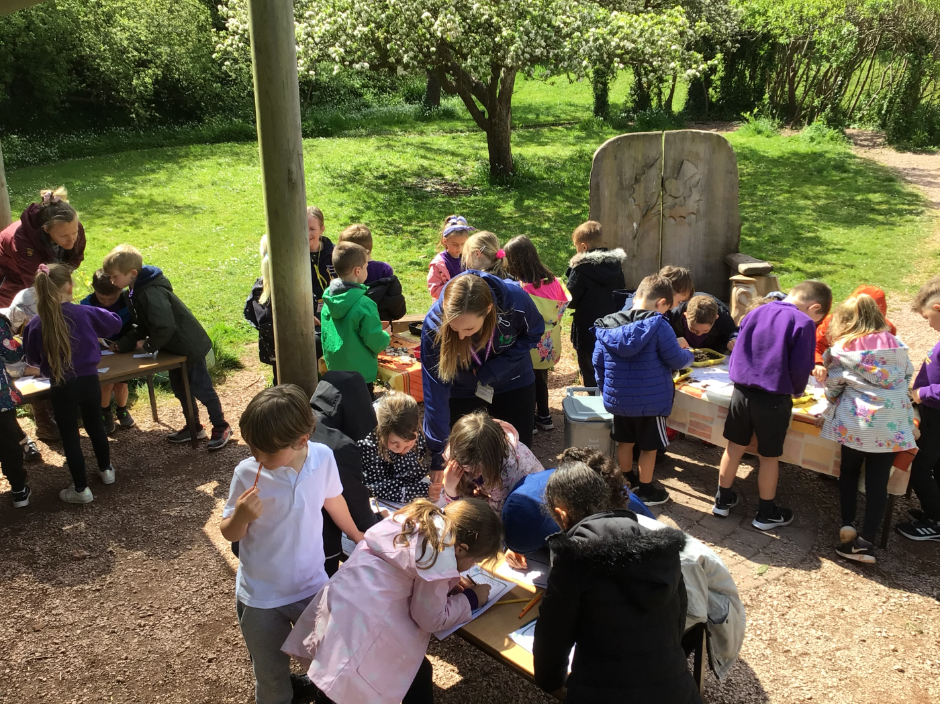
Year 1 had a lovely morning in the orchard.

Slide 8
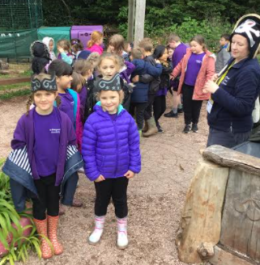
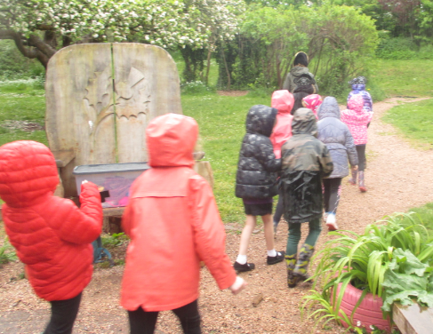
In the afternoon Year 2 worked with Captain Alex and they were either the crew on ‘Apple Ship’ or ‘Oak Ship’. Once they had worked on their ‘Arrghh’ and ‘shiver me timbers’ they were ready to set sail on an adventure. They were plastic searching pirates and sang a little chant as they rowed around the oceans.
‘Plastic isn’t fantastic, SAVE OUR SEAS!’

Slide 9
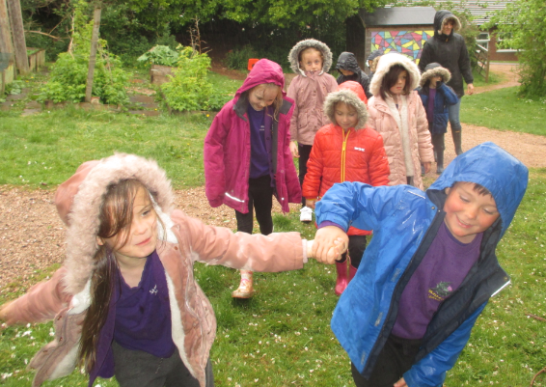
They rowed around the oceans until they met…

Slide 10
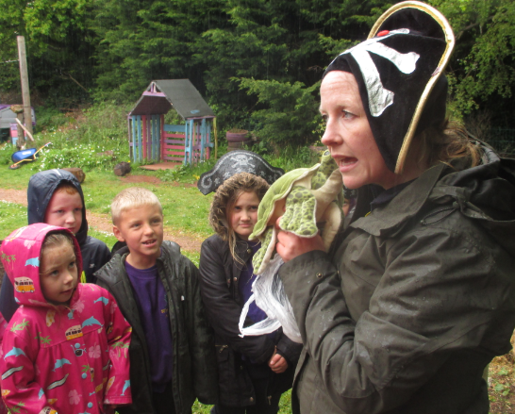
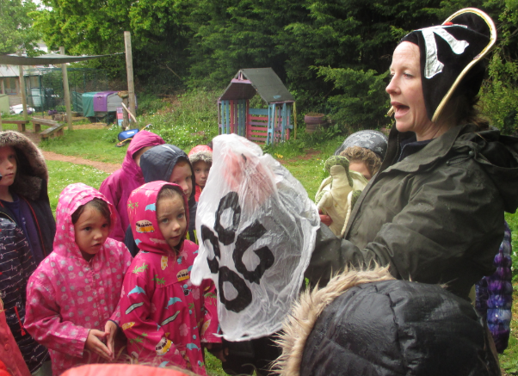
Tommy Turtle. He was wrapped in a plastic bag. When they freed him he was able to tell them that he had seen the plastic bag in the ocean and thought it was a tasty jelly fish. He was caught in the bag but some turtles eat the bags and then their stomach becomes full and it makes it difficult for them to eat.
Everyone can reuse plastic bags so they don’t end up in the ocean!

Slide 11
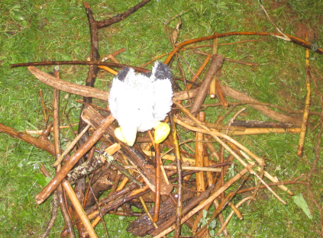
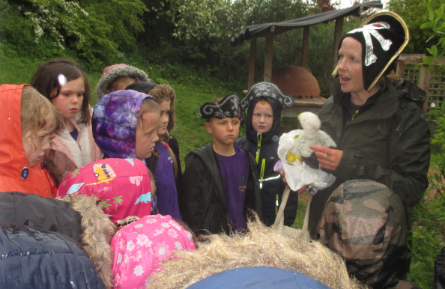
After facing the storms and rain they reached another island and met Sammy Seagull. He had made a nest from the plastic in the ocean. They helped him by making a nest from twigs for his family.
Did you know birds see bits in the ocean and swoop to get them thinking they are food for their family… they end up feeding their chicks bits of plastic.
Sammy liked the nest and
was very happy.

Slide 12
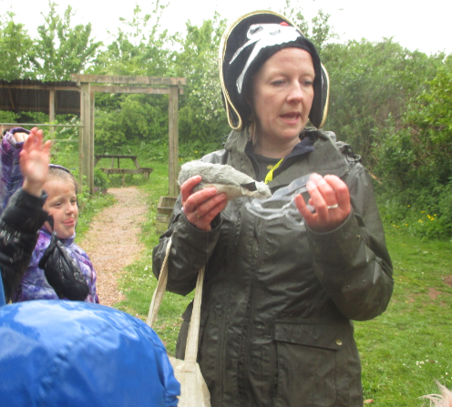
Sophie Seal was pleased to see Year 2 because she was also caught in a plastic bag. It was stopping her from swimming and once she had been rescued, she was able to swim away and search for food.

Slide 13
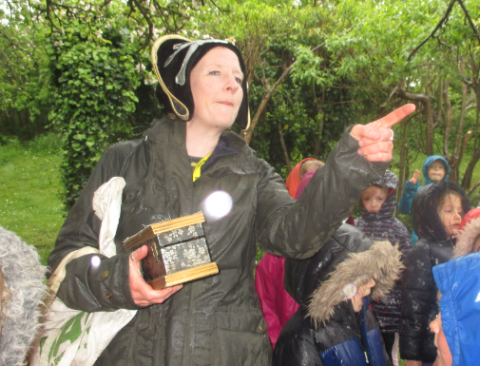
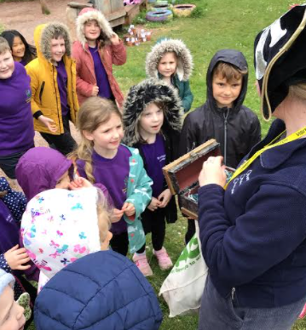
The last stop on their adventure was to find Alex’s treasure.
It was a chest full of Jewels. The children shared the treasure by making their own ‘Pirate of plastic’ medal.

Slide 14
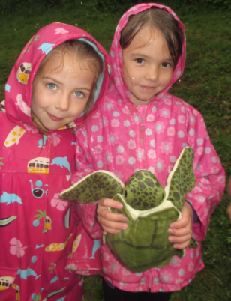
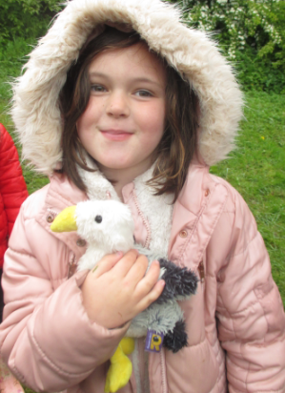
The friends Year 2 helped were much happier after the children had cleared away the plastic.

Slide 15
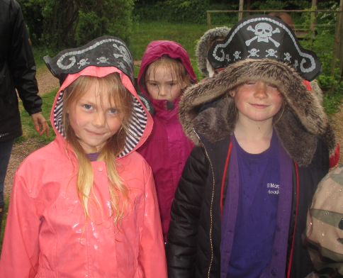
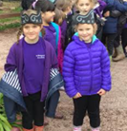
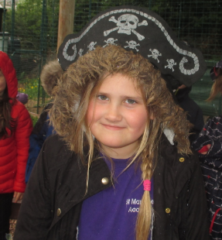
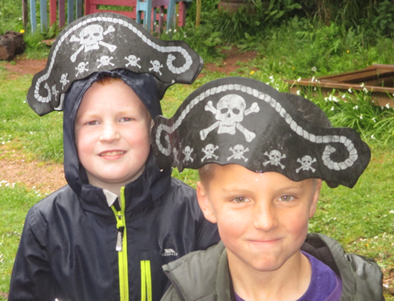
Every pirate ship needs a
‘first mate’. Here are some of
the Year 2 ‘first mates’.

