Slide 1
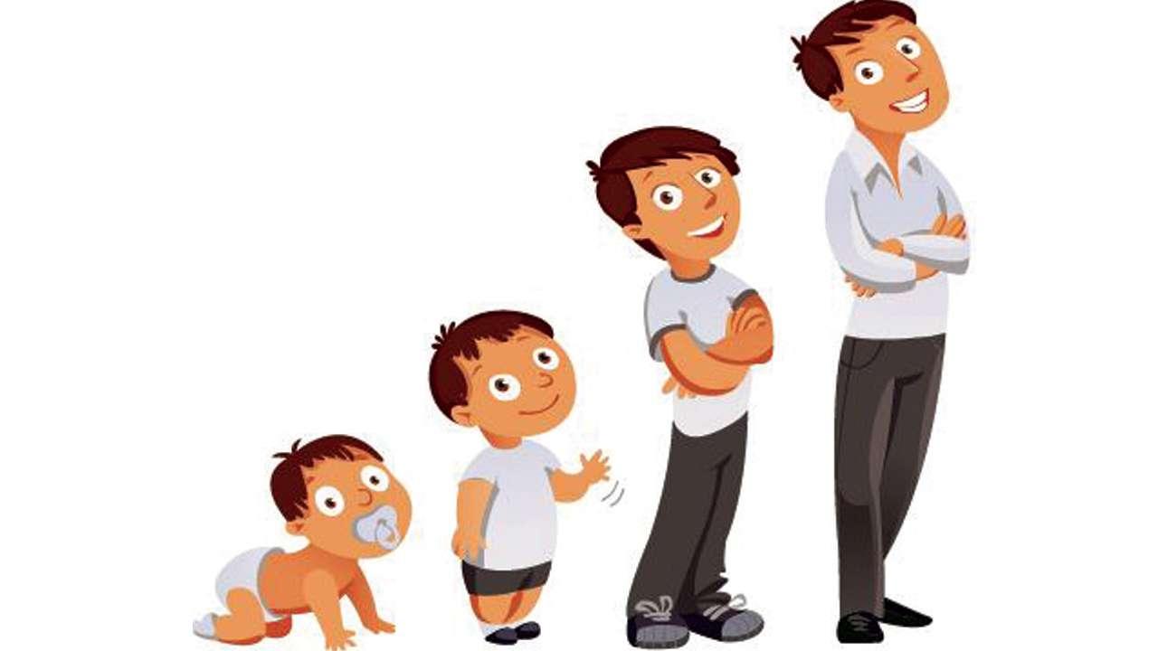
“It takes a village to raise a child.”

Slide 2
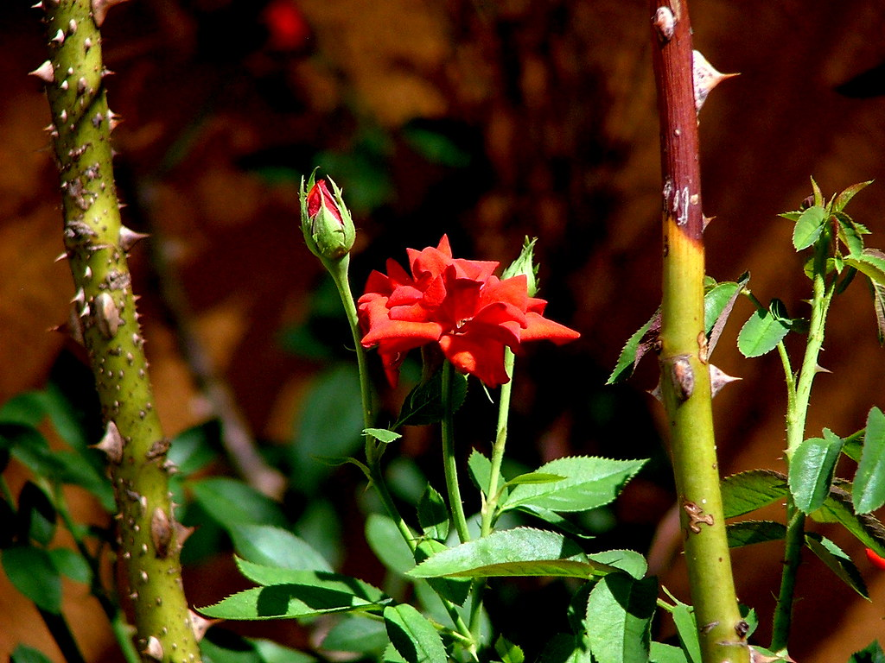

Slide 3
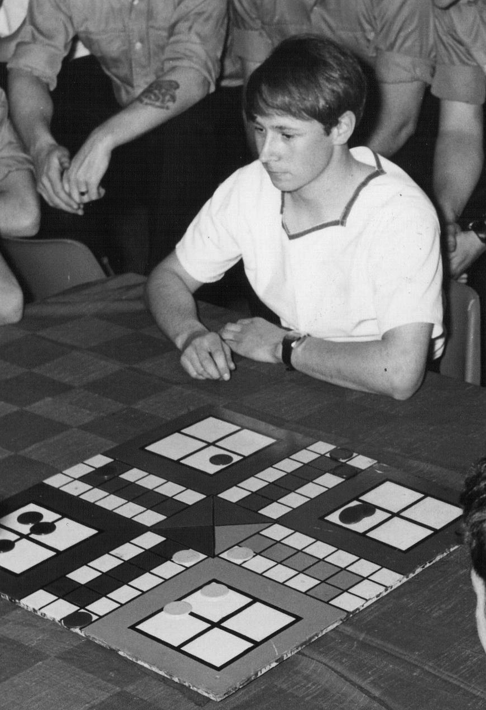
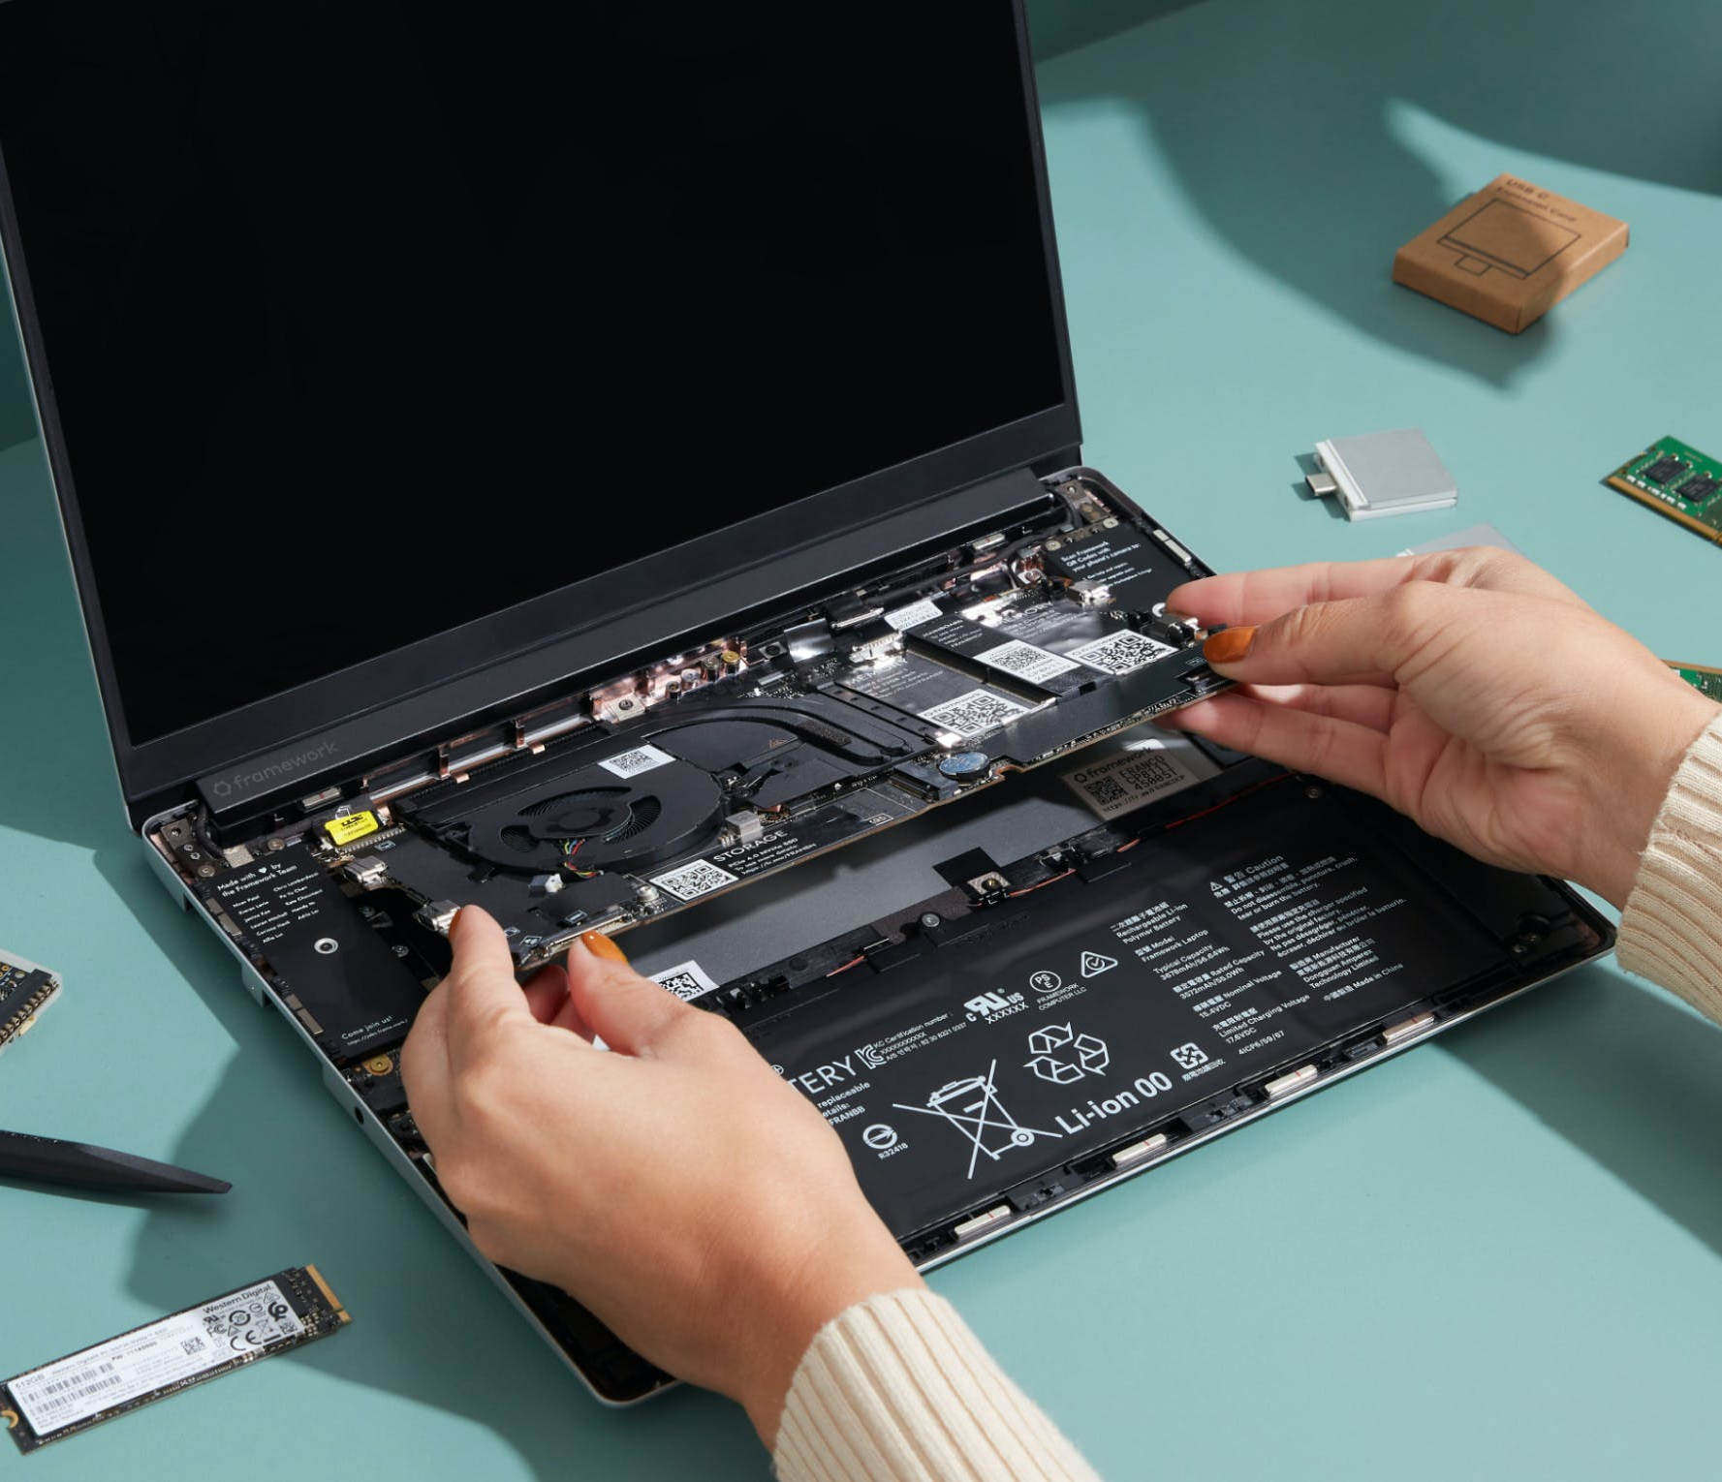

Slide 4
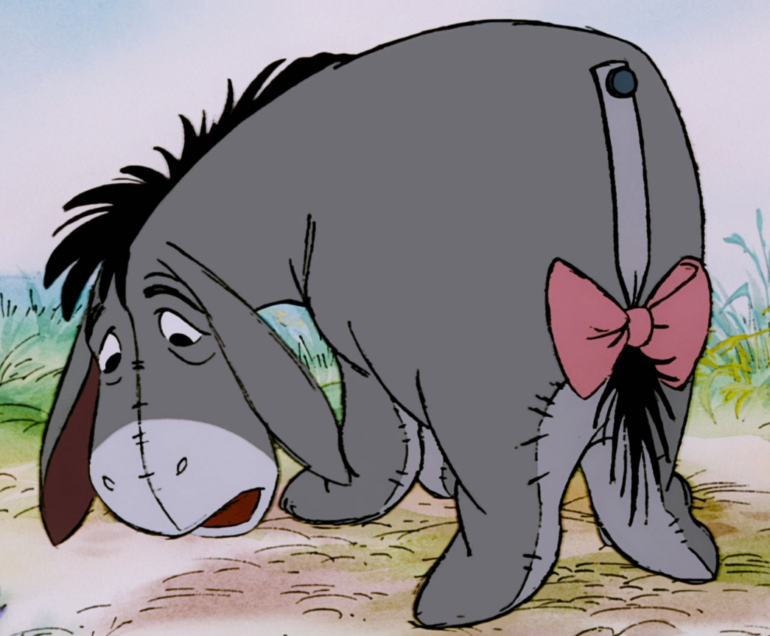
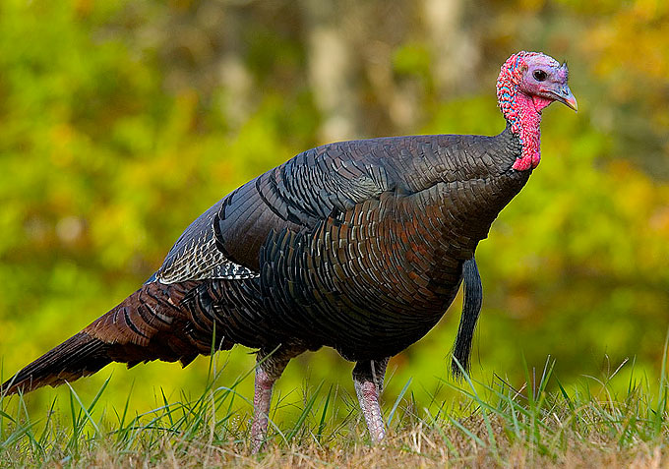
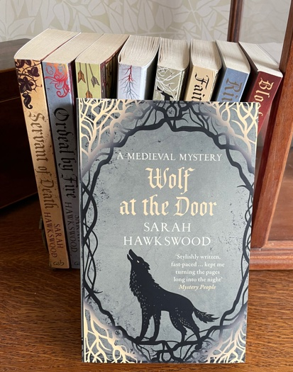

Slide 5
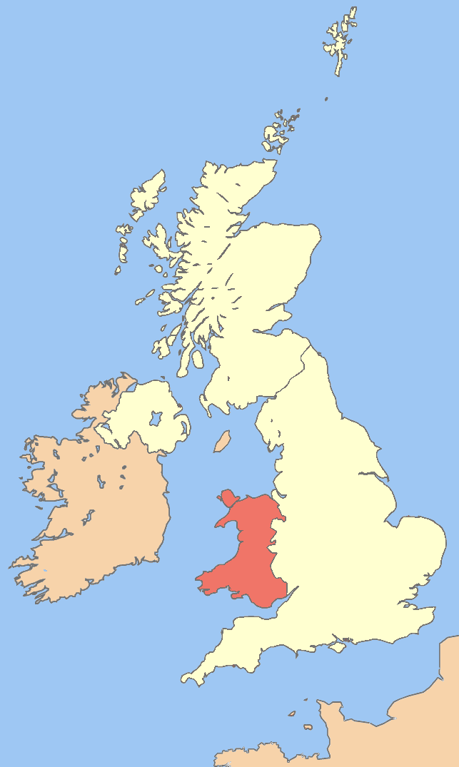
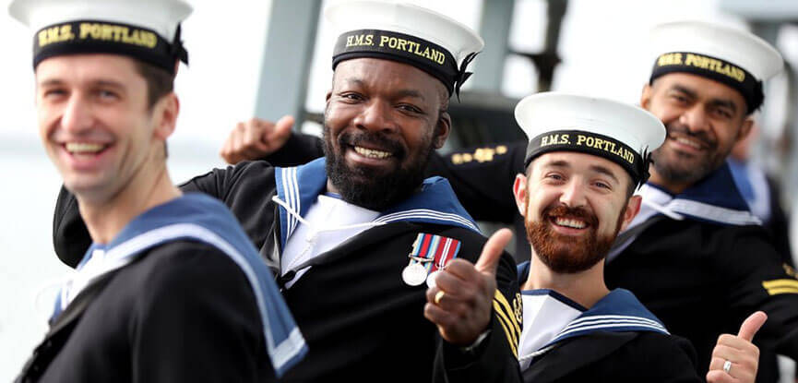

Slide 6
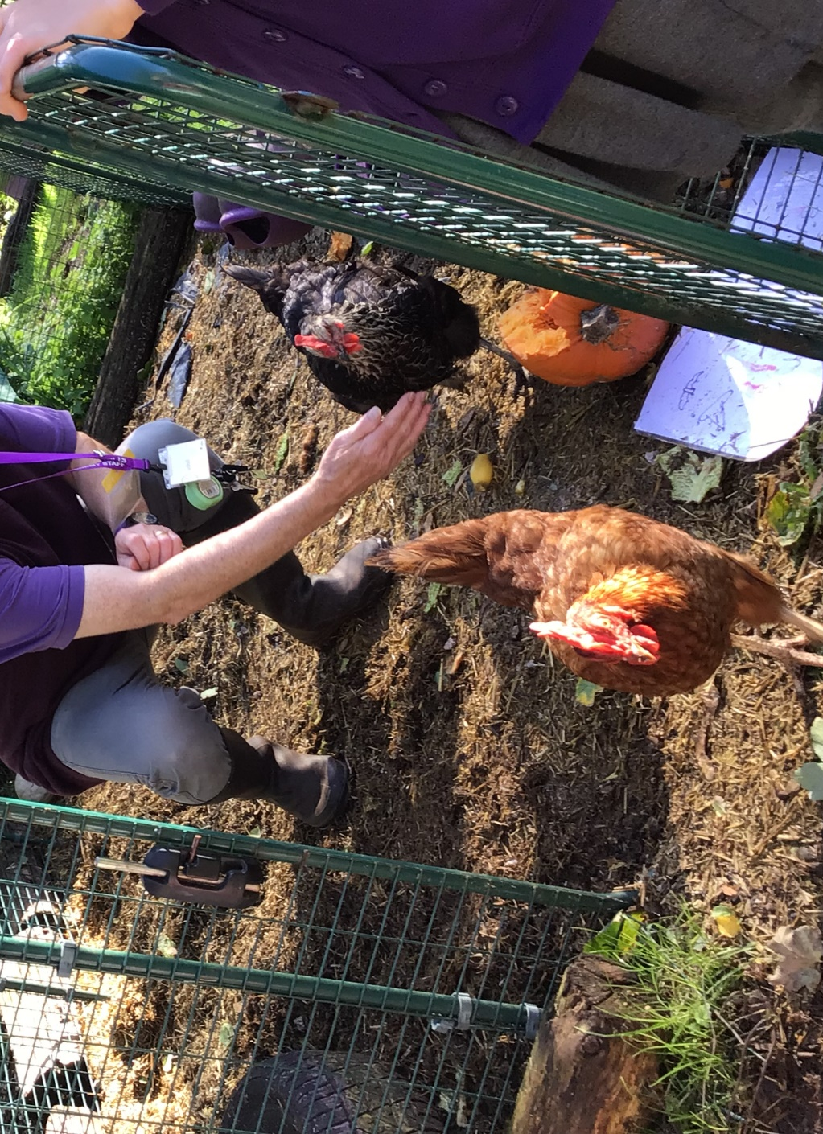

Slide 7
Mrs Deeley
Mr Kelley
Mr Thomas

Slide 8
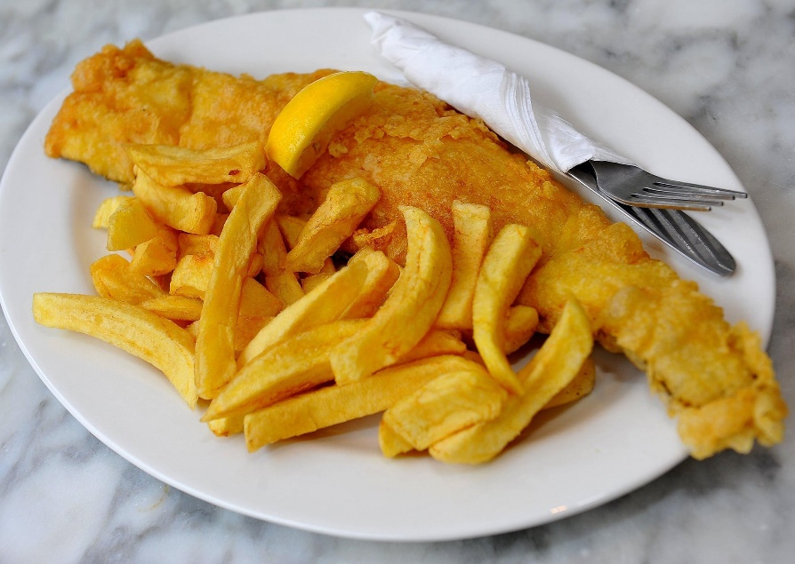
Working in catering before St Margaret’s
Nearly 12 years at St Margaret’s, seeing children move from Reception to Year 6
After School Club
Catering
Enjoyed school theme days and decorating cakes
New adventure:
Looking forwards to seeing her son in Wales and spending time with grandchildren

Slide 9
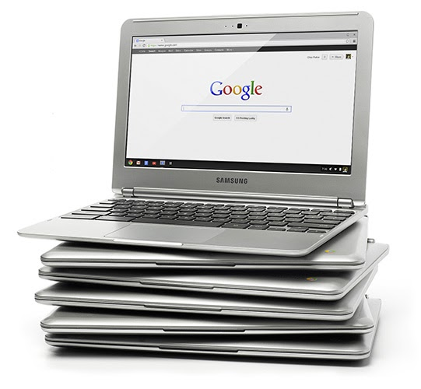
Worked in computing before joining us
Nearly 9 years at St Margaret’s
Made St Margaret’s work – behind the scenes in the digital lockdown world e.g. Chromebooks
Talented writer with a great sense of humour making staff laugh
New adventure:
Growing his own fruit and vegetables
Saving the world with renewable energy
Reading, reading and more reading

Slide 10
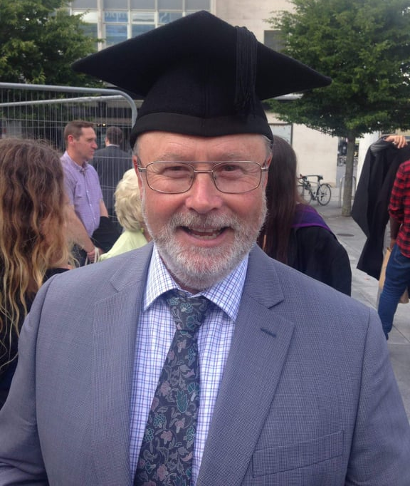
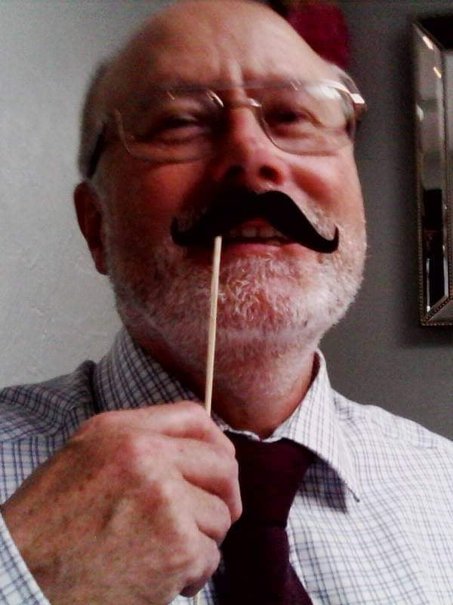
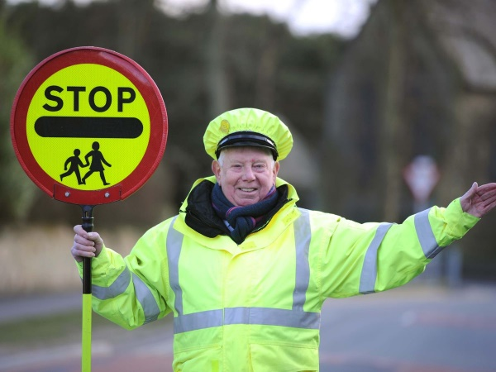
Worked in the Royal Navy as an Electrical Mechanic
Nearly 9 years at St Margaret’s as an MTA
Much more than an MTA
Mr Thomas’s Selection Box seeing us through the first lockdown
The Orchard while being frightened of birds!!
Zoom lockdown party – James Bond Thomas
New adventure:
Gardening
Growing tomatoes just for himself!!!
Helping ex-forces members
Torre Community Partnership
Getting locked in his garage

Slide 11
Good luck and best wishes…

