Slide 1
Meeting for New Parents
7th June 2023
St Margaret's Academy - Virtual Tour Video (stmargaretstorbay.org.uk)
KINDNESS RESPECT RESPONSIBILITY ASPIRATION

Slide 2
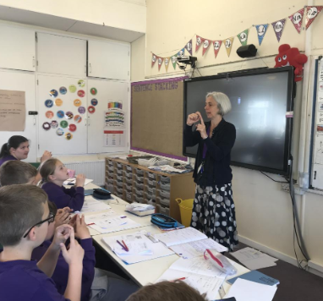
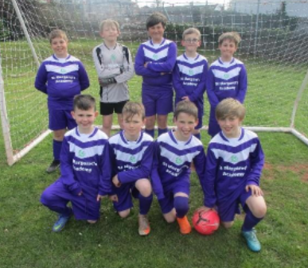
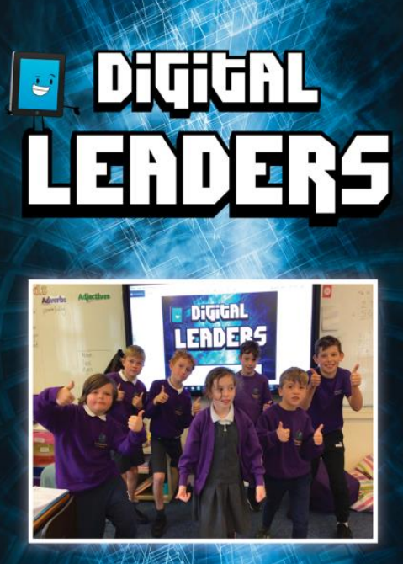
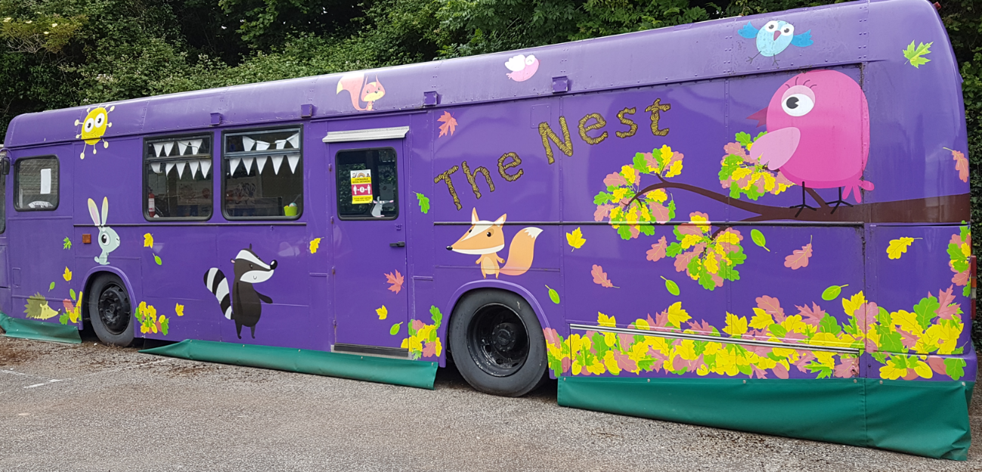
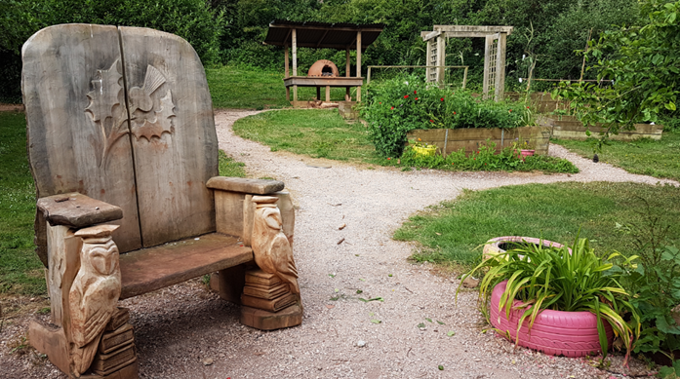
Proud to be a part of
St Margaret’s…
KINDNESS RESPECT RESPONSIBILITY ASPIRATION

Slide 3
School Vision
We want ourselves and the children in our care to be successful, resilient and inquisitive learners who are happy and well-equipped to participate positively in the community and wider society.
School Values
British Values
KINDNESS RESPECT RESPONSIBILITY ASPIRATION

Slide 4
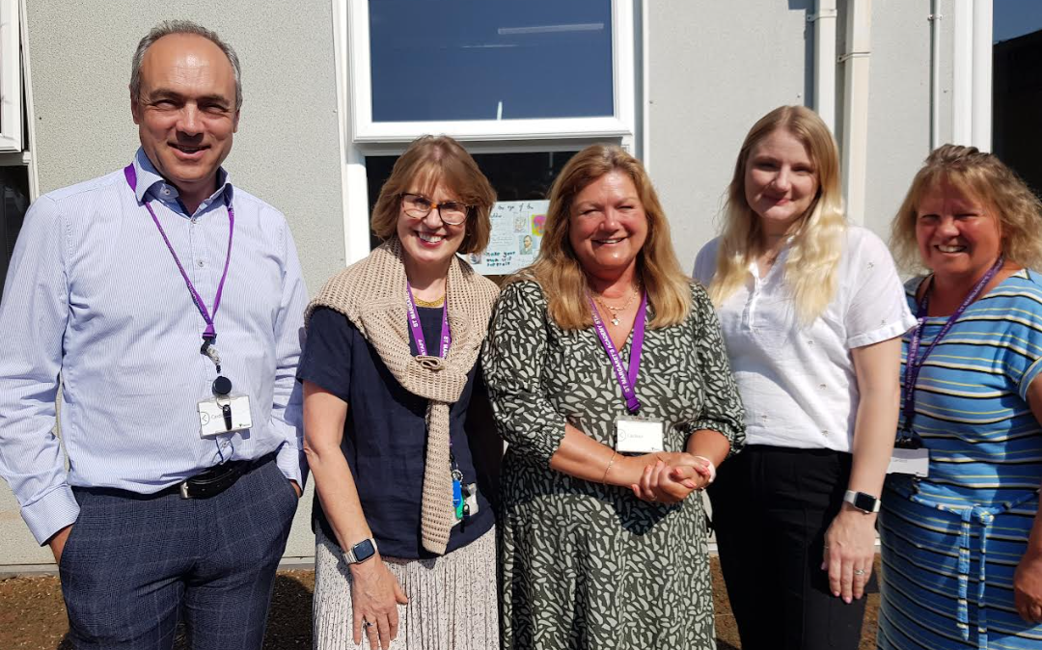
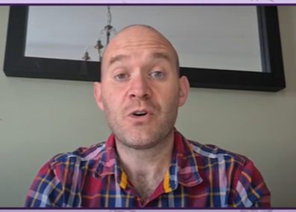
Who’s who?
The Senior Leadership Team
Tim Hughes – Head Teacher
Sara Pike – Deputy Head / Safeguarding Lead / SENCO / Pastoral
Karen Colmer – Business Manager & Governance Professional
Lyndsey Kerswell – Assistant Head Teacher for KS2
Nicole Turner – Assistant Head Teacher for FS and KS1
James Bennett
Chair of the Trustees
KINDNESS RESPECT RESPONSIBILITY ASPIRATION

Slide 5
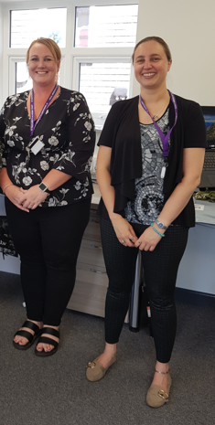
Front Office Team
Sam Newman – Administrator, Attendance and PTA Liaison
Laura Malladine – Administrator
KINDNESS RESPECT RESPONSIBILITY ASPIRATION

Slide 6
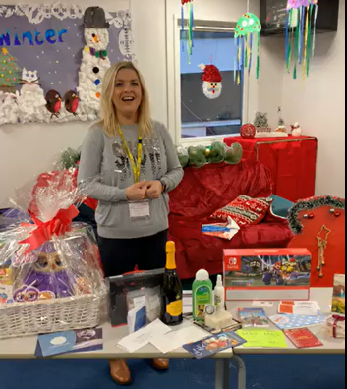
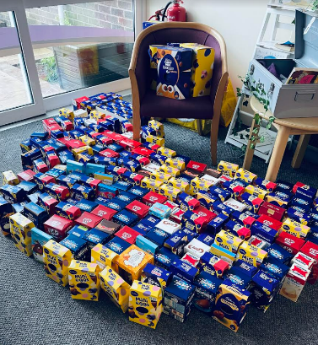
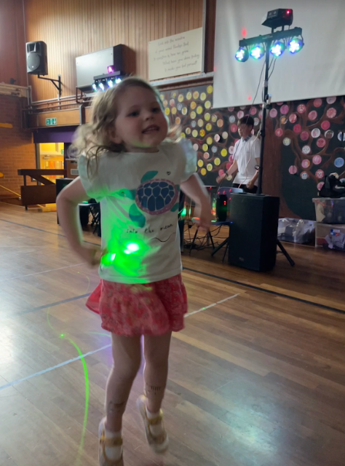
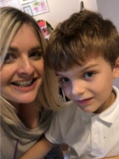
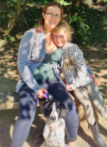
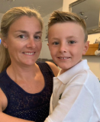
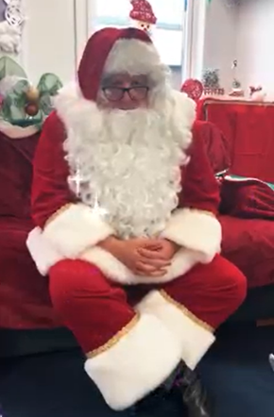
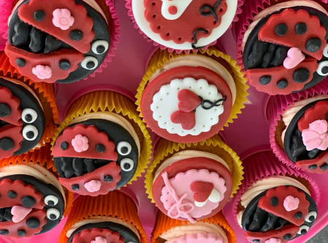
The PTA: Laura Kenyon, Felicity Morris and Jenny Plumb
How to get involved?
Join meetings
Help with events (before or during)
Share your skills
Join the PTA FB
Sign up for Amazon Smile - select St Margaret’s
What is the PTA?
Registered charity
Enhance the education for all children (e.g. new library)
Raise funds
Provide resources
Social events
Support special events

Slide 7
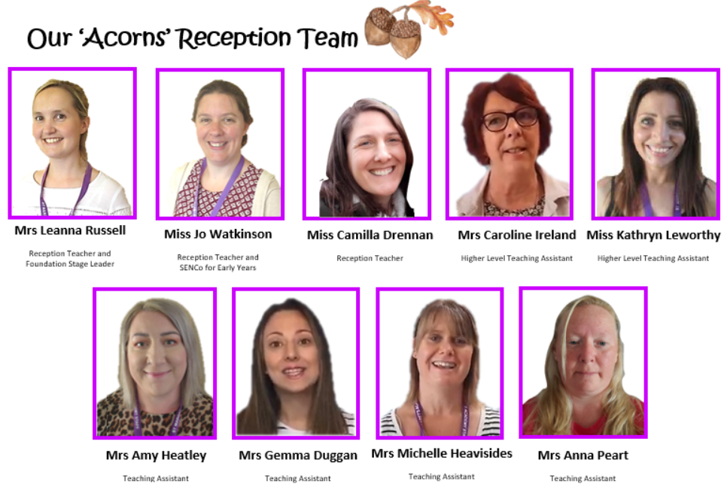
The Foundation Stage Team
KINDNESS RESPECT RESPONSIBILITY ASPIRATION

Slide 8
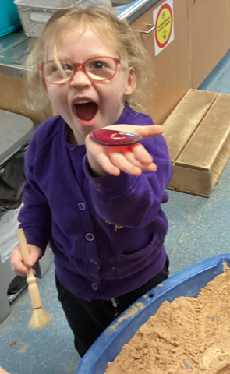
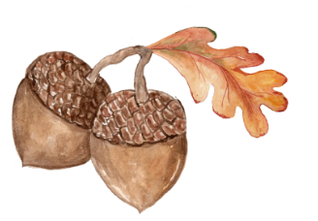
All About Acorns
“Mighty oaks from little acorns grow.”
Notes:
Leanna
8

Slide 9
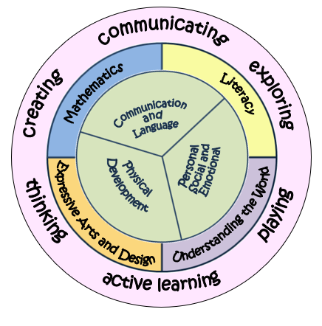
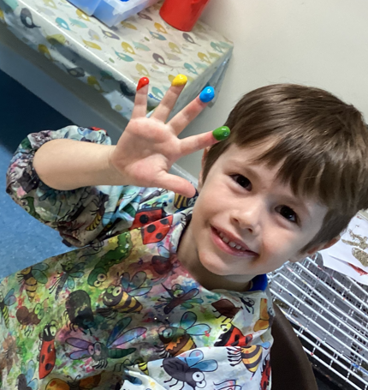
The EYFS Curriculum
The Early Years curriculum runs from Birth to 5 and during your child’s Reception school year they are also working towards their Early Learning Goals. (ELG)
The curriculum is split into 7 areas:
3 Prime and 4 Specific
KINDNESS RESPECT RESPONSIBILITY ASPIRATION
Notes:
Leanna
9

Slide 10
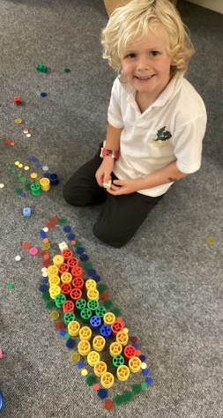
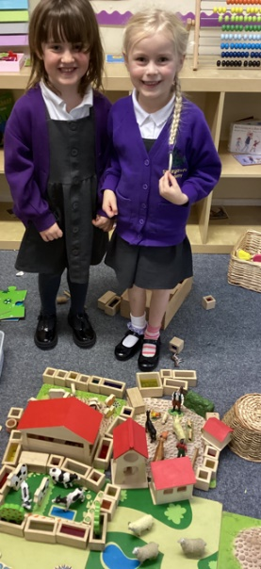
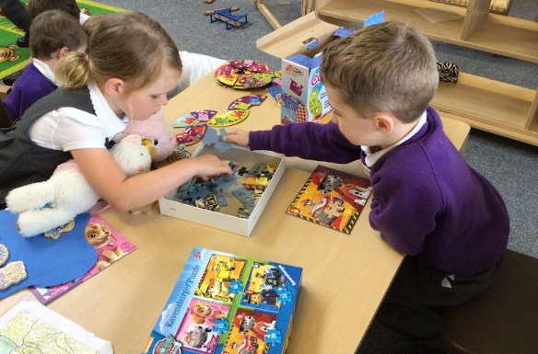
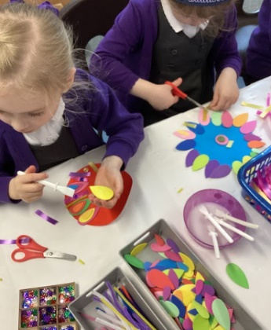
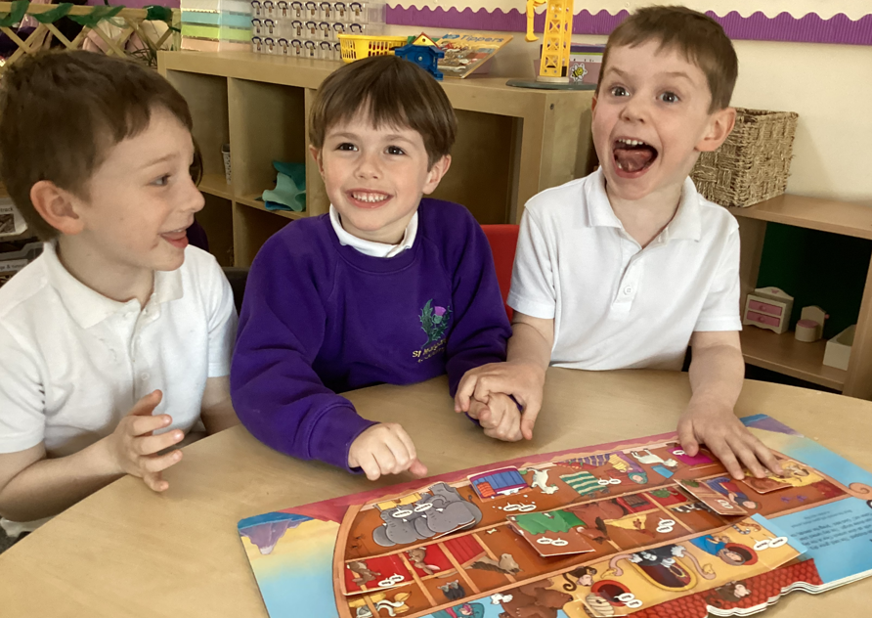
Welcome Time: settling in
Notes:
Leanna
10

Slide 11
Timings of the day
Acorns school day begins at 8:45am
Registration is taken at 8:55am
End of Acorns school day is 3:10pm
Breakfast Club: 8.00 – 8.45am £2.50
After School Club 3.05 – 5.15pm £7.70 (£5.50 per additional sibling)

Slide 12
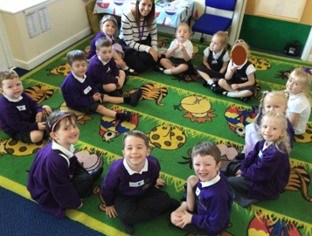
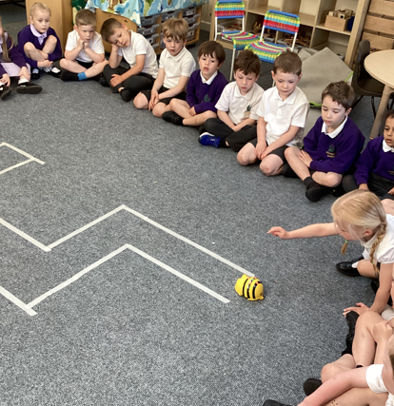
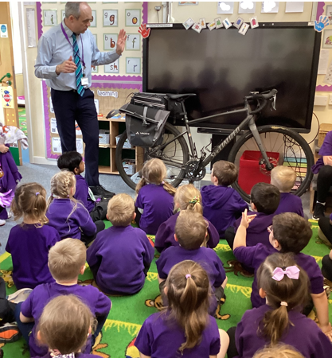
Time to Learn Together
Carpet Time
Huddle Time
Notes:
Leanna
12

Slide 13
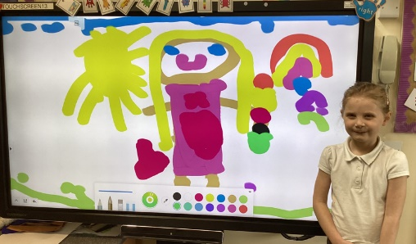
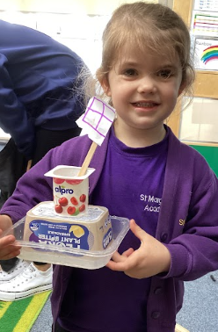
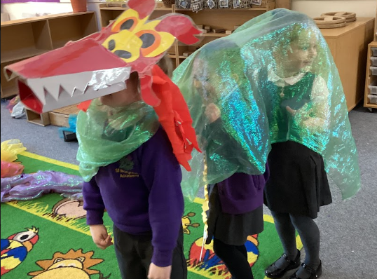
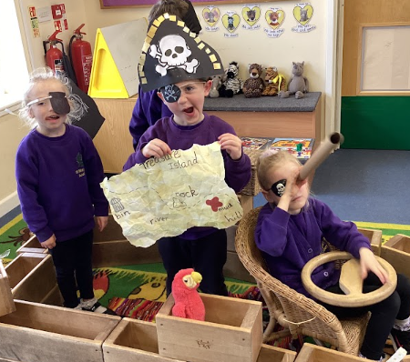
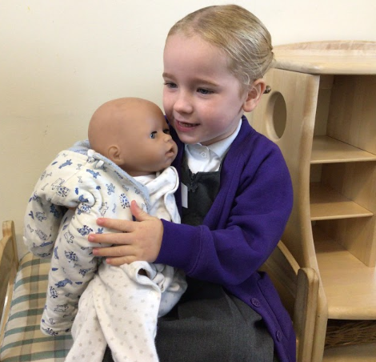
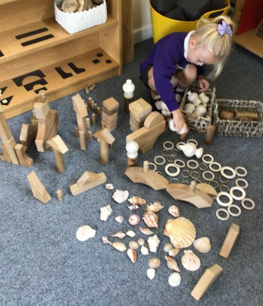
Busy Time: Learning through play
Notes:
Leanna
13

Slide 14
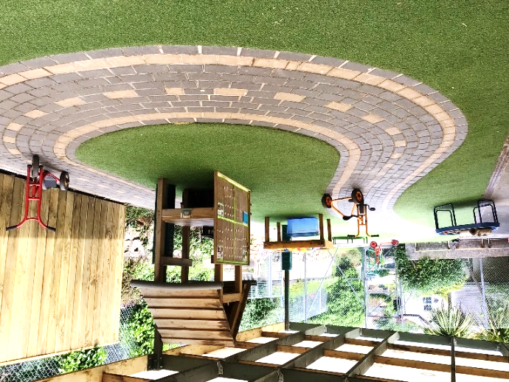
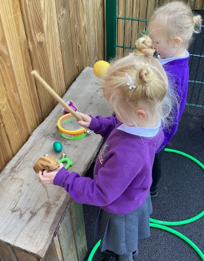
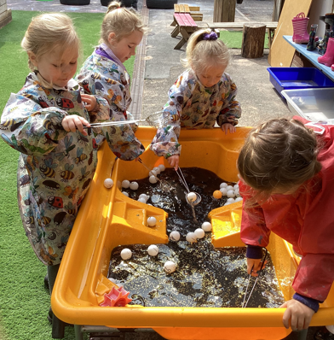
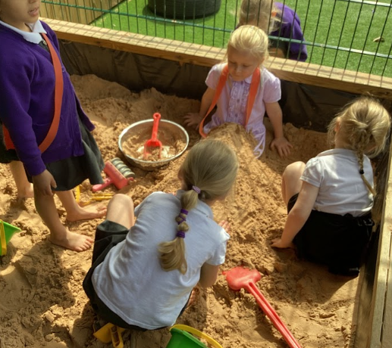
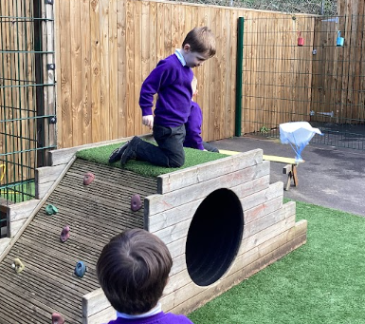
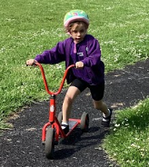
Busy Time: Learning through play
Notes:
Leanna
14

Slide 15
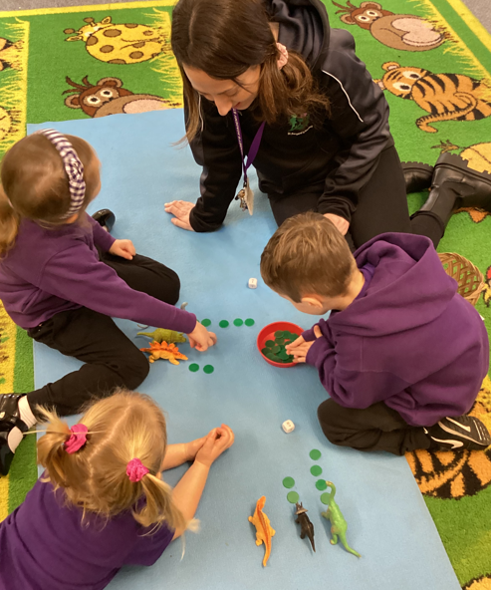
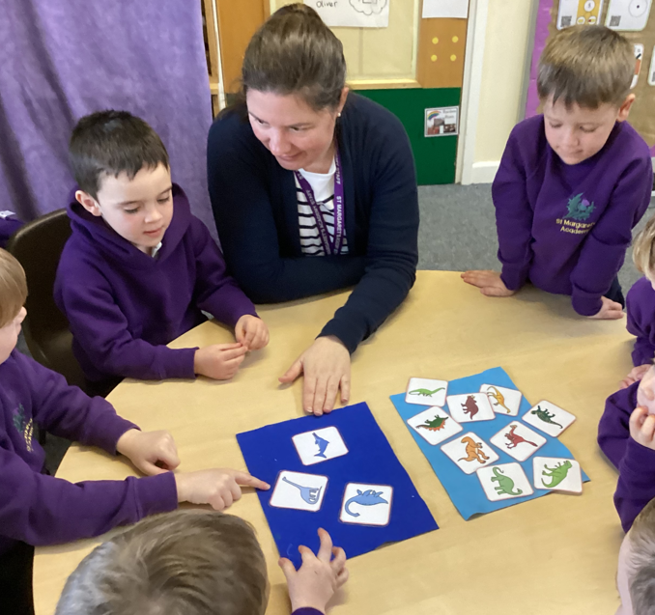
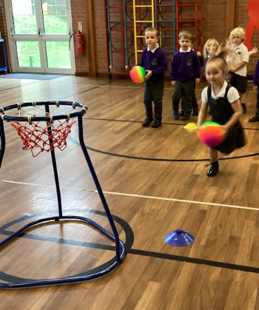
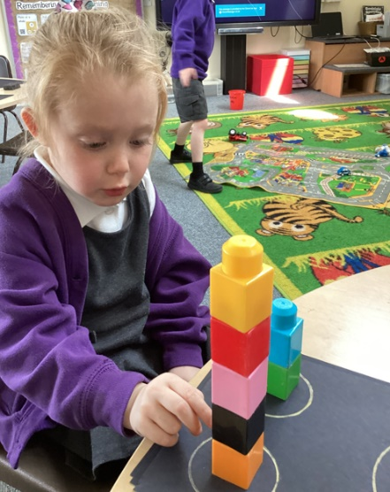
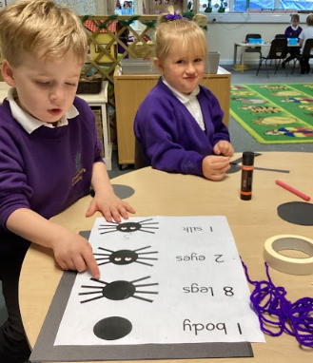
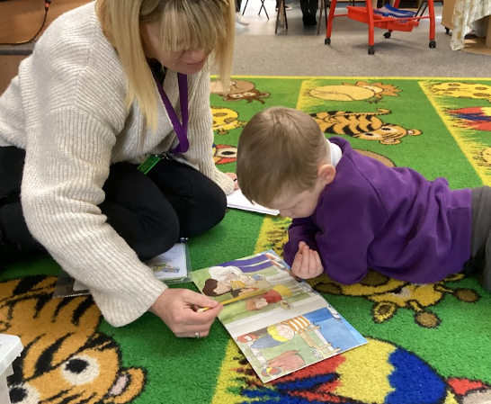
Learning led by an adult
Notes:
Leanna
15

Slide 16
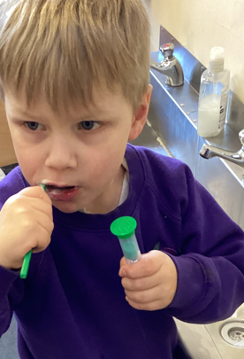
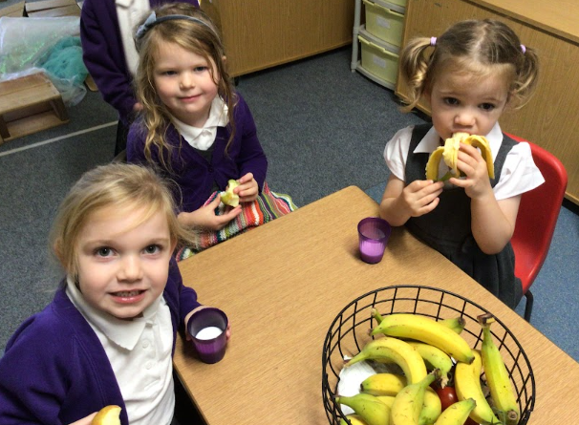
Snack Time and Lunch Time
Notes:
Leanna
16

Slide 17
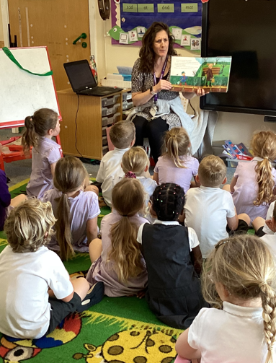
Winding down: Story time and home
Notes:
Leanna
17

Slide 18
First few weeks….
Settling in: building relationships, learning routines, familiarising with the environment, learning names etc.
Developing independence: further information on your ‘School Readiness’ poster in your packs
Baseline assessment: spending 1:1 time with your child to get to know their starting points
Notes:
Camilla
18

Slide 19
Early Learning
“What happens early,
matters for a lifetime.”
Chat, Play, Read
Children love to talk about all sorts of things – make time to have back and forth conversations.
Play helps children to learn about the world and themselves. Sometimes it is helpful if you sensitively join in with your child’s play too.
Sharing books with your child will help them to develop a love of reading. Have fun together – use silly voices and act the story out.
Notes:
Camilla
19

Slide 20
Characteristics of Effective Learning
The ways in which the child engages with other people and their environment:
playing and exploring
active learning
creating & thinking critically
Enables effective and motivated learning across all seven areas of the curriculum.
Notes:
Leanna
20

Slide 21
Our Learning Dinosaurs
Each dinosaur represents a learning characteristic.
The children learn how each dinosaur behaves and try to do this themselves.
We praise and label the children’s learning behaviour to help them become familiar with the language.
Ask-a-raptor
Stick-a-saurus
Notes:
Jo
21

Slide 22
Notes:
Jo
22

Slide 23
General Communication
General information and updates: Weekly school newsletter, website, emails, parents meetings, end of year reports.
Curriculum information: Learning prompts, newsletter information, parent workshops.
Progress with learning: parent consultations, end of year reports, informal conversation.
Health and wellbeing: illness or injury in school,
Please keep us informed.
Notes:
Camilla - We are keen to ensure we work in close partnership with you throughout the year.
We have an open door policy and are therefore happy for you to come and talk to us when you feel you need to.
In addition to this, we have termly parent consultation meetings each term which are an important time for you to come and find out about your child’s progress, their strengths and areas to develop.
We aim to maintain good communication in a variety of ways.
General school information is provided through the website, email or text messages.
We will also update you with letters about information specific to FS.
If you have important information you need to let us know about, particularly things which may impact on your child during their day in school please pop in and talk to us.
It’s important that your records are kept up to date e.g. mobile numbers so we can be certain to get hold of you.
23

Slide 24
Transition into school
Home Visits: June and July
Early Years Picnic: 19th July at
3.30pm – 4.30pm.
Taster session: on one of the following dates Tuesday 5th September. Wednesday, 6th September or Thursday 7th September.
Part Time week: Monday 11th – Friday 15th September.
Full Time start: From Monday 18th September.
Notes:
Leanna - Visit morning – you will have received on your welcome letter. You are invited to come into school with your child and explore the envrionment. A nice chance for taster session before they go off on holiday.
Home visit – coming to get to know your child in a secure environment, you can have a 1:1 conversation with us about your child’s interests/needs, date will come in a letter in july
Staggered start – your children have come for a range of different pre-school settings, move to school is a big step, positive feedback about the process. Two staggered weeks, first week morning or afternoon only, second week morning only for all children and lunch.
Your child’s class/teacher is in their pack but lots of opportunities to mix.
24

Slide 25
Working in Partnership – 7 Years
Attendance
Absence makes keeping up hard
Balancing pressures on school with pressures on families
90% or less is classed as ‘persistent absence’
At less than 95% we will send a letter
Attend every day unless ill.
If absent without notice, we will contact you if we do not receive a call on a daily basis to ensure we know your child is safe.
Communication
Both ways
Website for curriculum and useful parent info
Various parent events e.g parents evenings, curriculum meetings, curriculum workshops
Facebook, email, text, newsletters and Medical Tracker
From home: any changes at home, chats on the gate, longer chats via appointment.
Booking meals info in pack. Use School Gateway app e.g. booking trips and clubs
KINDNESS RESPECT RESPONSIBILITY ASPIRATION

Slide 26
What’s in the Welcome Pack?
The pink form
A welcome letter from the Chair of Trustees
A welcome letter from the Head Teacher
A welcome letter from the Foundation Stage team
Information from the PTA
Home arrangements form - to be completed and returned
Road to School map
Information about school dinners including how to book and a sample menu
Information about the School Gateway app
Attendance information
Uniform checklist

Slide 27
Google Forms for Completing
GDPR – we need active consent for
School trips
Acceptable IT Use Agreement
Images and videos use
Marketing flyers from groups associated with the school e.g. sports and PTA
Guinea pig
We need medical details and emergency consents
KINDNESS RESPECT RESPONSIBILITY ASPIRATION

Slide 28
Uniform Requirements
Boys- Day Wear | Girls- Day Wear
Black shoes; flat soles with grip | Black shoes; flat soles with grip or plain simple black boots during the winter months
Grey trousers or grey tailored shorts | Grey trousers, grey tailored shorts, grey pinafore or grey skirt Purple and white check summer dress or purple and white check summer all-in-one skort
White polo shirt (with or without logo) or white shirt with collar | White polo shirt (with or without logo) or white shirt with collar
Plain black, grey or white socks | Plain grey tights, plain white socks or grey socks
Purple sweatshirt | Purple sweatshirt or cardigan
KINDNESS RESPECT RESPONSIBILITY ASPIRATION

Slide 30
The Pupil Premium - £1455
The pink form (found in the pack)
Important note:
this is not the universal free school meal offer.
OR…
apply online:
https://forms.torbay.gov.uk/freeschoolmeals
KINDNESS RESPECT RESPONSIBILITY ASPIRATION

Slide 31
Any birth certificates?

Slide 32
Just Playing
When I'm building in the block area, please don't say I'm "just playing."
For you see, I'm learning as I play, about balances and shapes.
Who knows, I may be an architect someday.
When I'm getting all dressed up, setting the table, caring for the babies,
Don't get the idea I'm "just playing."
For you see, I'm learning as I play; I may be a mother or father someday.
When you see me up to my elbows in paint, or standing at an easel,
Or moulding and shaping clay, please don't let me hear you say, "He is just playing."
For you see, I'm learning as I play. I'm expressing myself and being creative.
I may be an artist or an inventor someday.
When you see me hunting the bushes for bugs, or packing my pockets with choice things I find, don't pass it off as "just play.‘ For you see, I'm learning as I play. I may be a scientist someday.
When you see me learning to skip, hop, run and move my body,
Please don't say I'm "just playing." For you see, I'm learning as I play.
I'm learning how my body works. I may be a doctor, nurse or athlete someday.
When you ask me what I've done at school today, and I say, "I just played',
Please don't misunderstand me, for you see, I'm learning as I play.
I'm learning to enjoy and be successful in my work.
I'm preparing for tomorrow.
Today, I am a child and my work is play.
- Anita Wadley
KINDNESS RESPECT RESPONSIBILITY ASPIRATION

