Slide 1
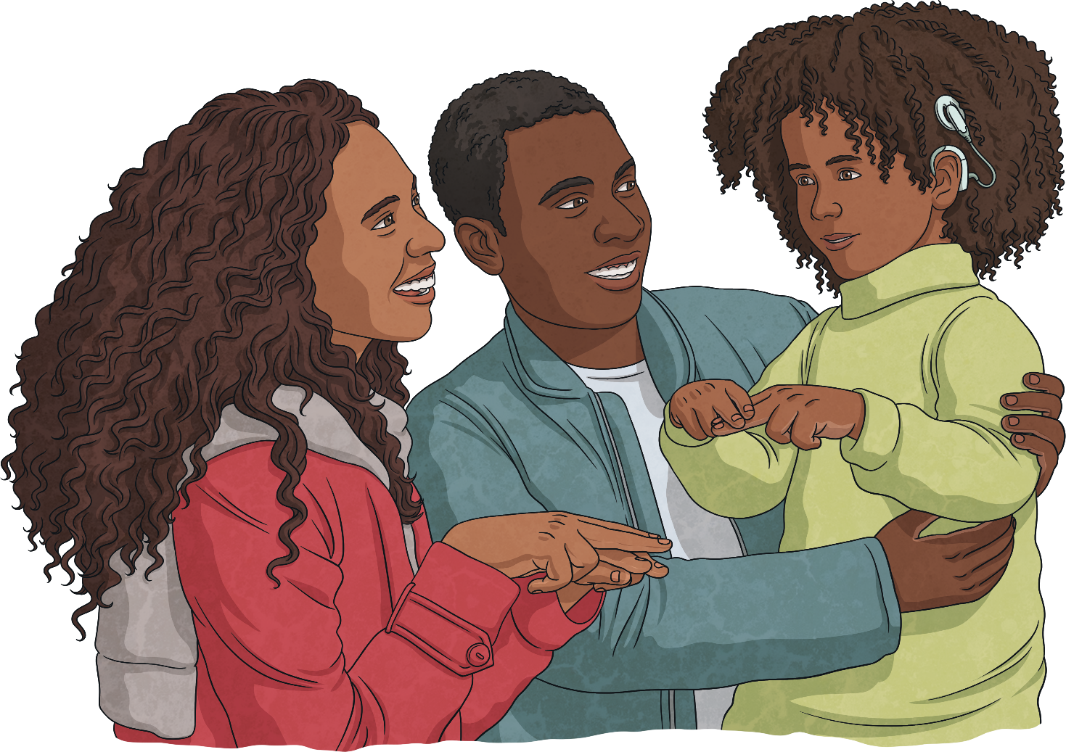
Things that Deaf people use

Slide 2
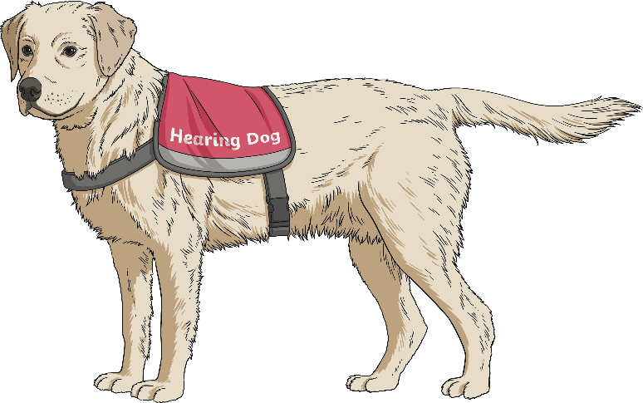
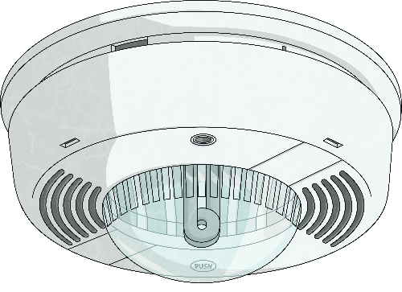
What is Assistive Equipment?
Assistive equipment helps with independence, safety and wellbeing

Slide 3
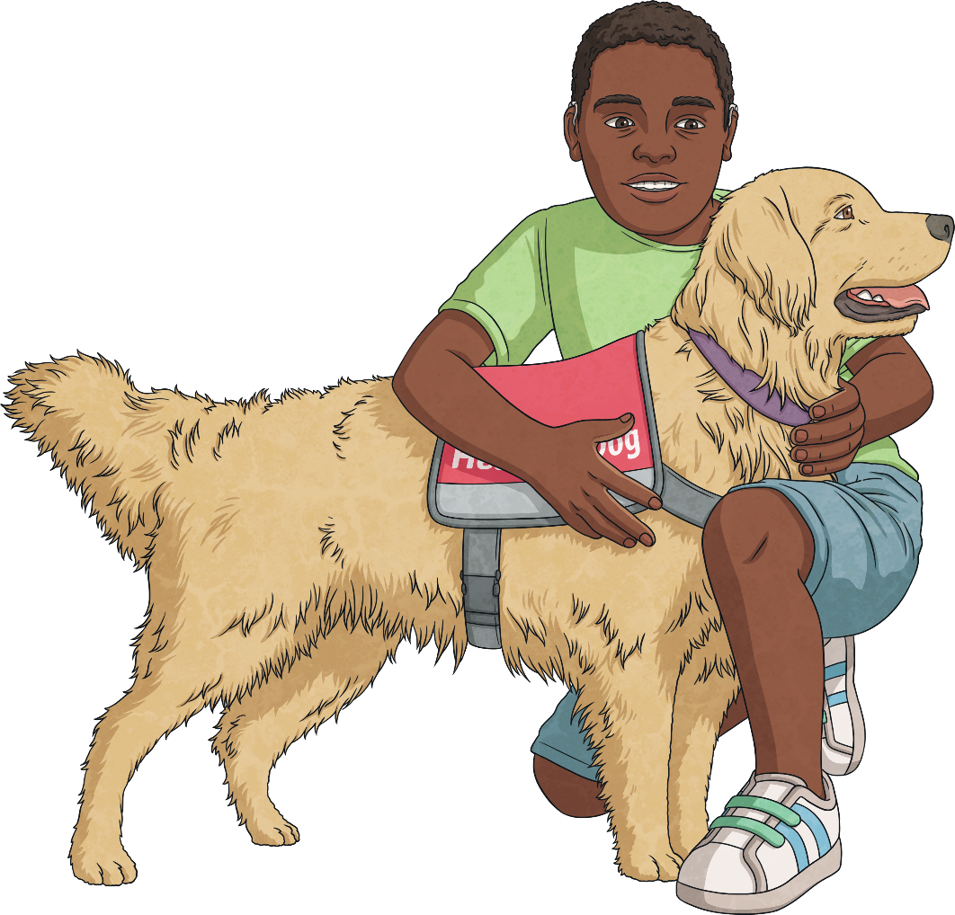
Hearing Dogs
Hearing dogs are highly trained to support and alert Deaf people to sounds. At present, there are 1000 working hearing dogs in the UK.
Hearing dogs can alert their owners to sounds, such as doorbells, fire alarms and telephone calls.
.

Slide 4
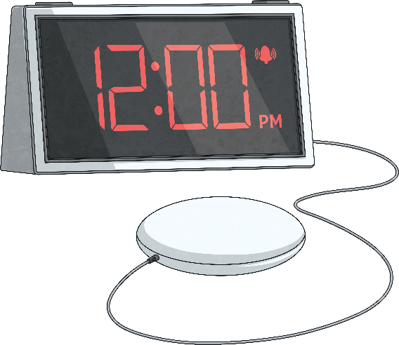
Alerting Devices
Smoke Alarms
Smoke alarms can link wirelessly to pagers or vibrating pads (which can go under pillows) and the alarms may also have flashing lights.
Alarm Clocks
Alarm clocks may contain extra loud alarms, flashing lights and vibrating pads to alert the person.

Slide 5
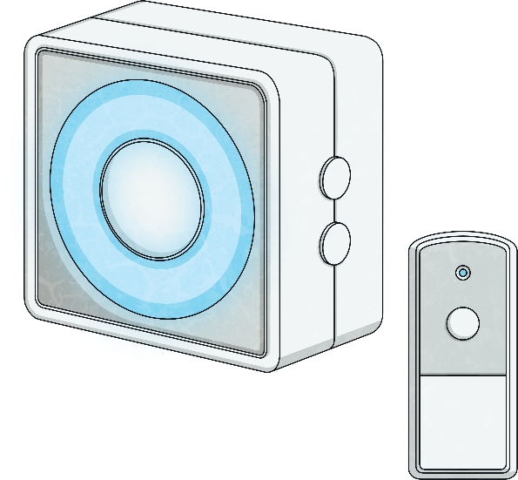
Alerting Devices
Doorbells
A Deaf person can be alerted through a pager or phone, which will then vibrate, make a loud sound or a flashing light will appear.

Slide 6
Communication Support
Hearing Loop
This is the sign you might see if there is a hearing loop in a building, maybe in a supermarket or cinema.

Slide 7
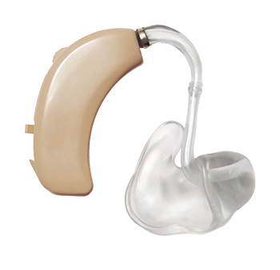
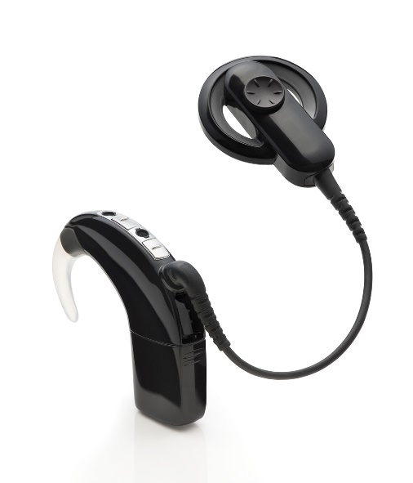
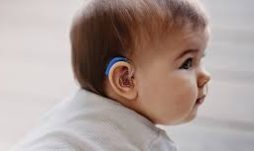
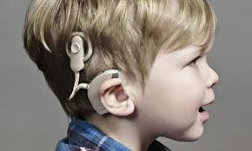
Hearing aids and cochlear implants

Slide 8
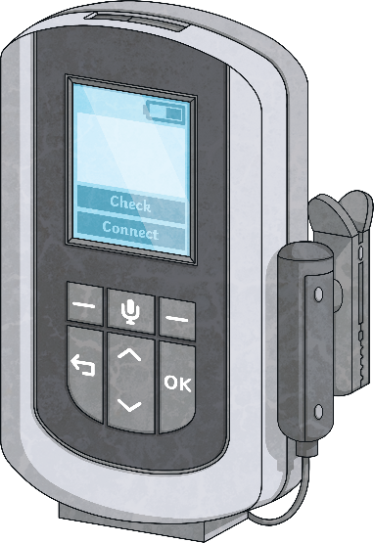
Communication Support
ALD or Radio Aid
An ALD (assistive listening device), or radio aid, is a way of helping people hear speech more clearly. It uses radio waves to transmit sounds to the hearing aid. A special receiver in the hearing aid links the systems together.

Slide 9
British Sign Language
British Sign Language
BSL is a recognised language for Deaf people in the UK. It does not follow English grammar or word order

Slide 10
Entertainment Support
Going to the Cinema
Cinemas usually have subtitled films so people can follow the dialogue in the film.
Going to the Theatre
Most theatres show live British Sign Language (BSL) performances with an interpreter.

Slide 11
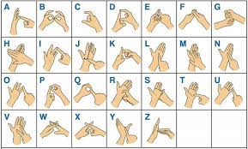

Slide 12
Signs to use around school
Hello
Thank you
Please
You’re welcome
What’s your name?
My name is …
Where is …?
Lunch time
Break time
Do you want to play?

