Slide 1
Reading is to the mind
What exercise is to the body!
Share a book

Slide 2
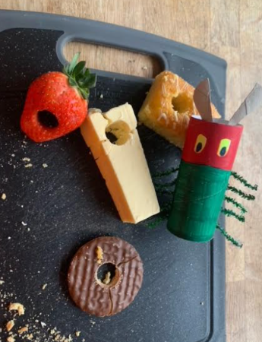
Did you guess who it was?
The Very Hungry Caterpillar

Slide 3
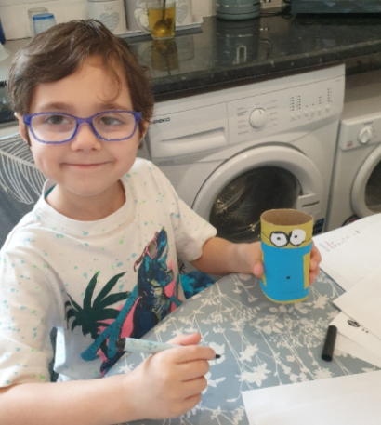
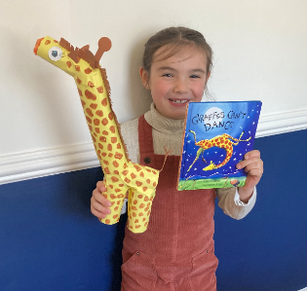
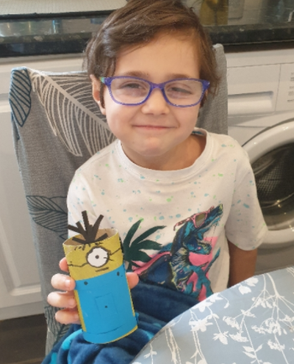
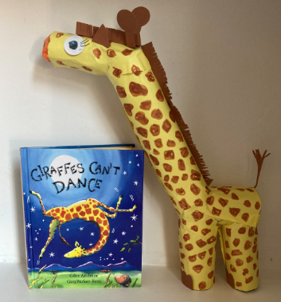
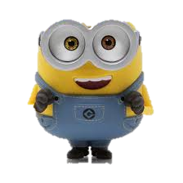
Emilia made
a giraffe who
can’t dance!
Bob and Kevin
by Lyncoln
Y2

Slide 4
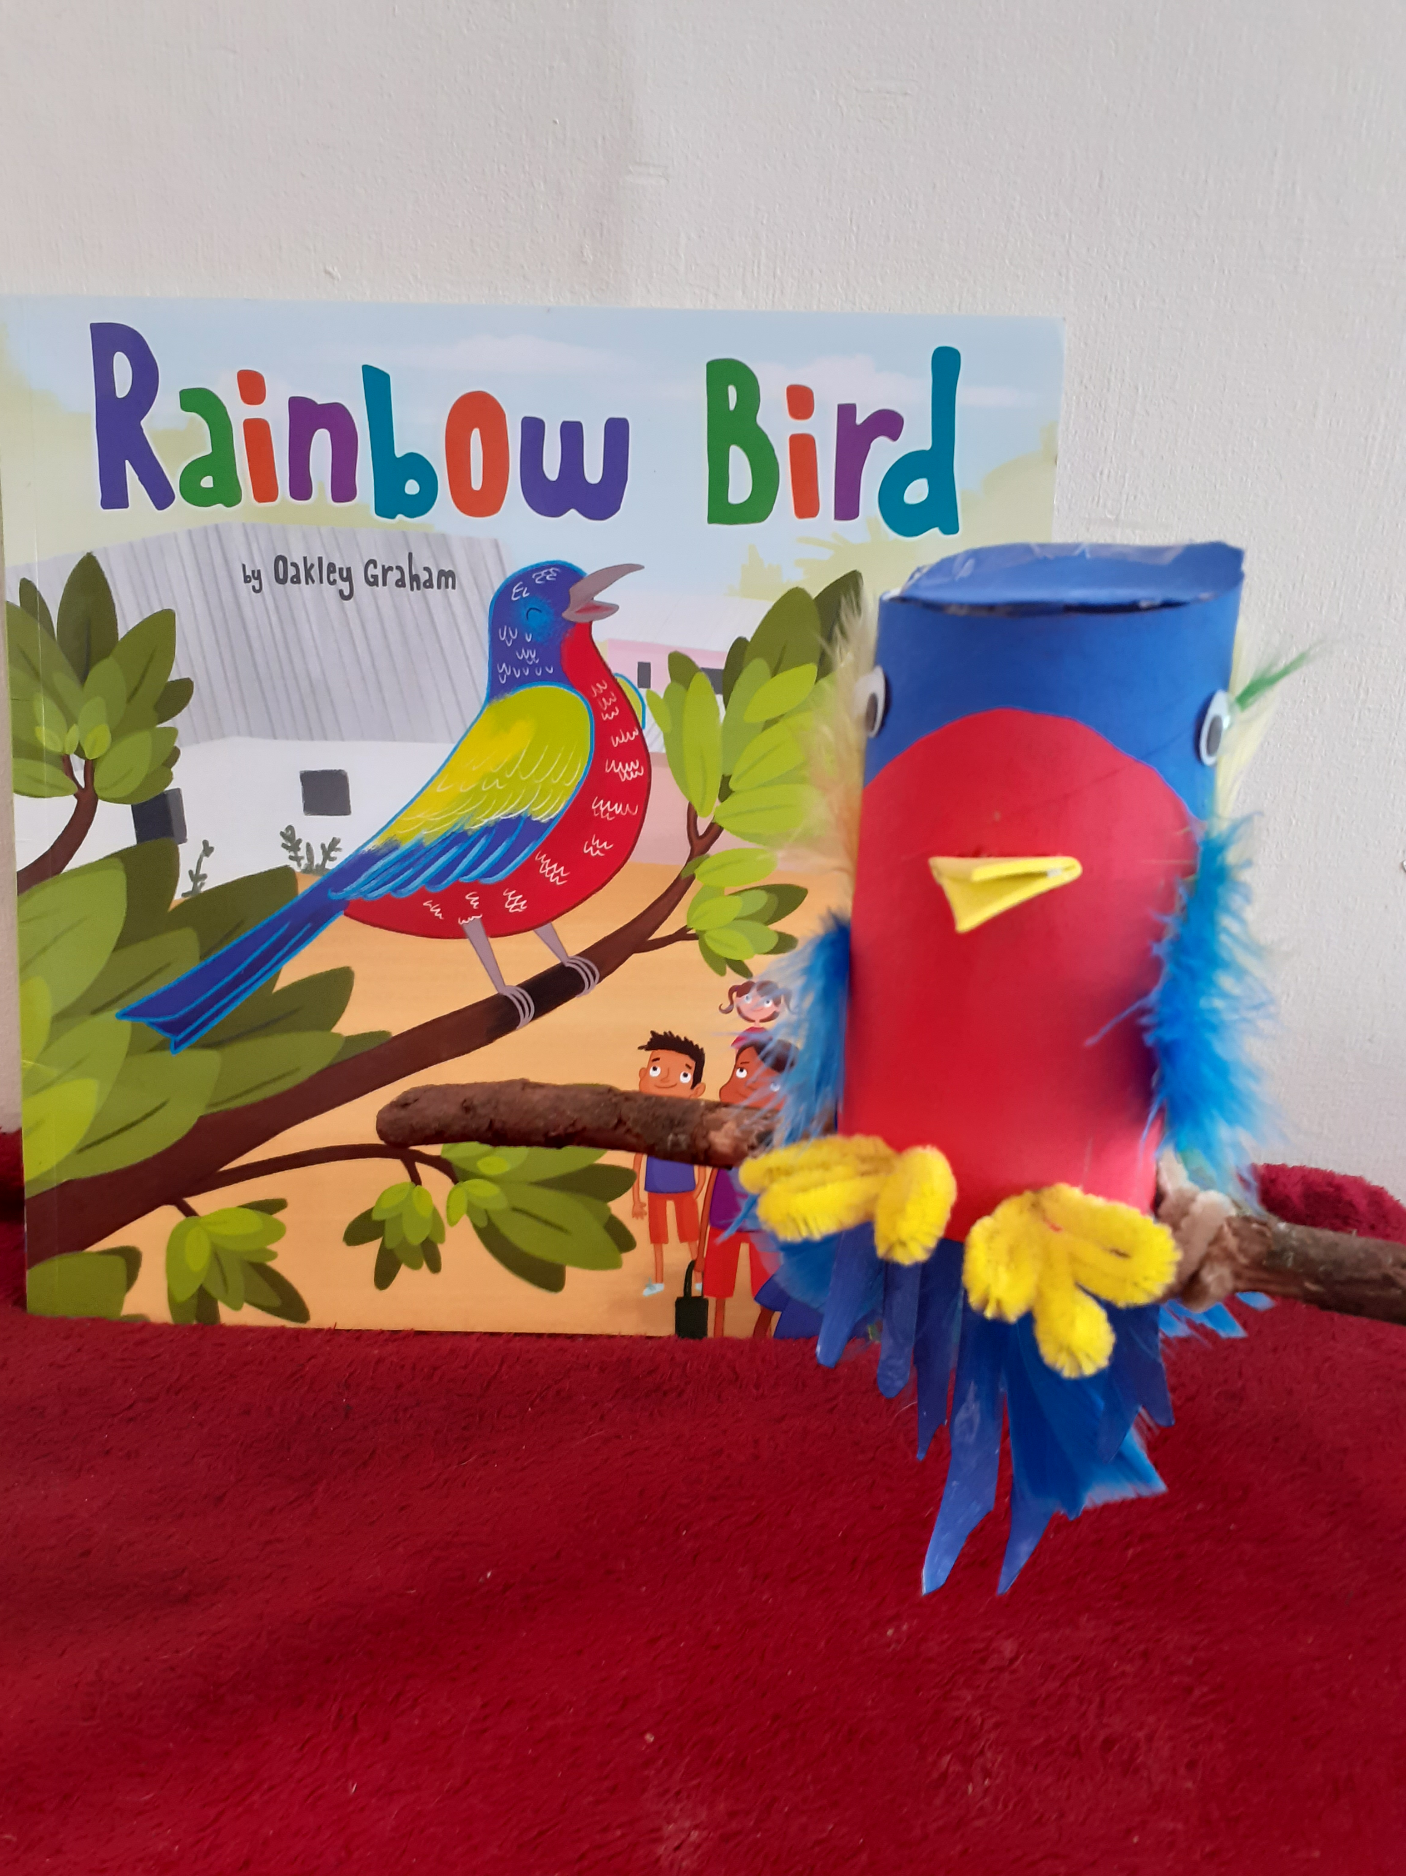
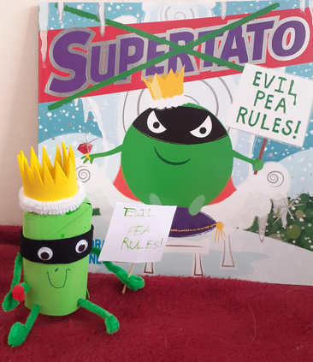
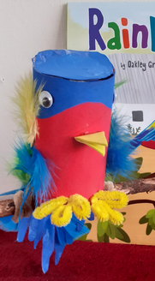
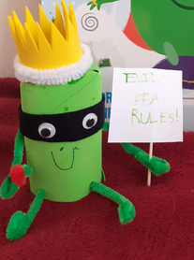
The Evil Pea
by Oliver
Y1
The Rainbow Bird
by Poppy
Y1

Slide 5
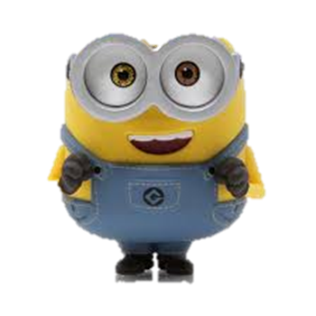
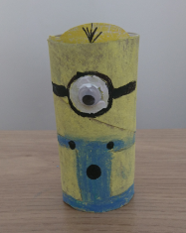
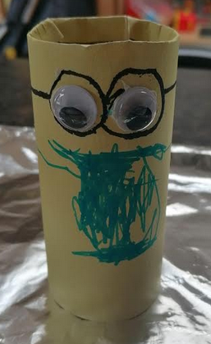
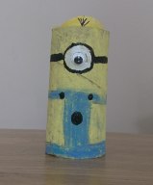
A Minion
by Georgia
Y4
A Minion
by Jack
Reception

Slide 6
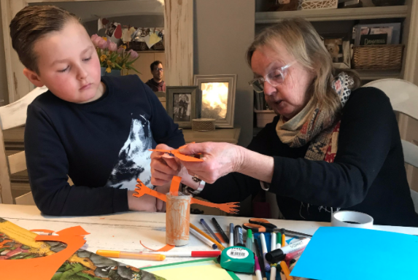
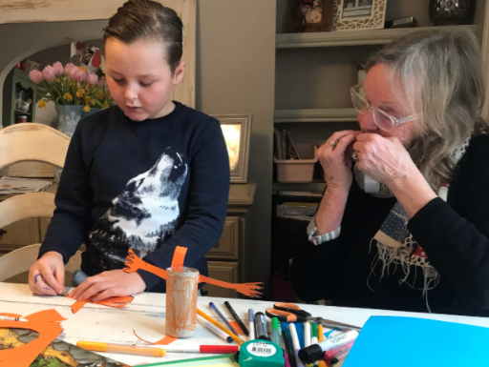
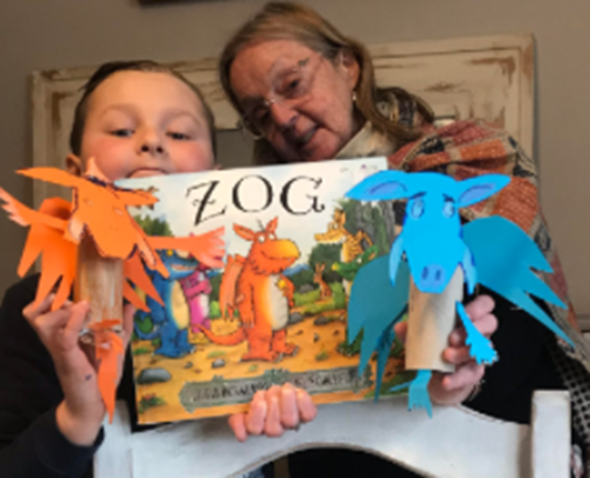
Zog and his friend
by Kyle
Y3

Slide 7
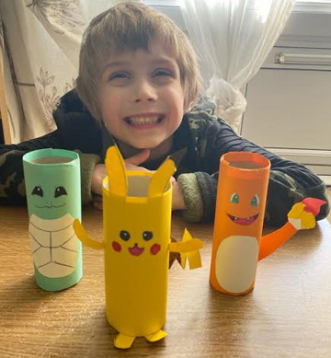
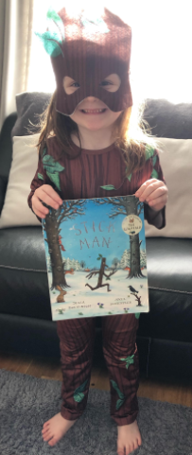
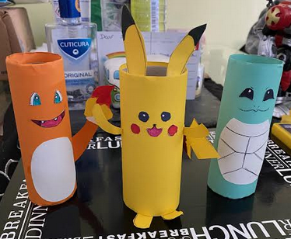
Stick Man
by Rocco
Y1
Pokemon
by Isaac
Y1

Slide 8
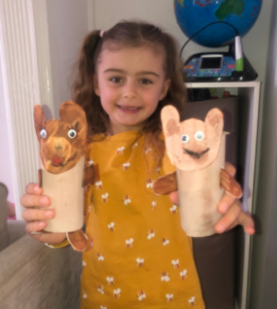
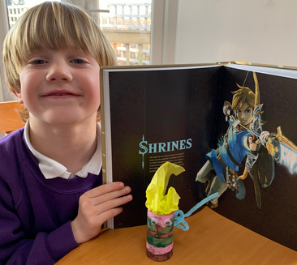
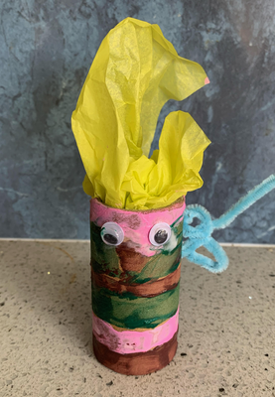
Austin made Link from his
Legend of Zelda book.
This is his favourite book
along with his encyclopaedia.
Traditional Tale Characters
by Evie
Y1

Slide 9
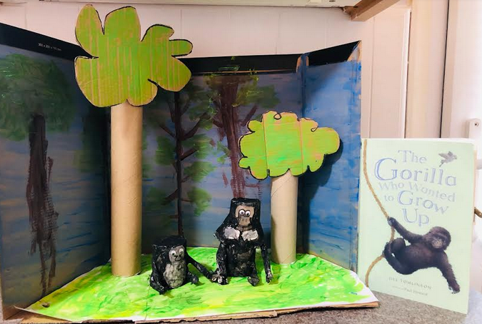
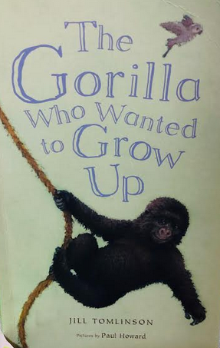
From the story ‘The Gorilla Who Wanted to Grow Up’
Pongo and whoopsie
by Henry
Y1

Slide 10
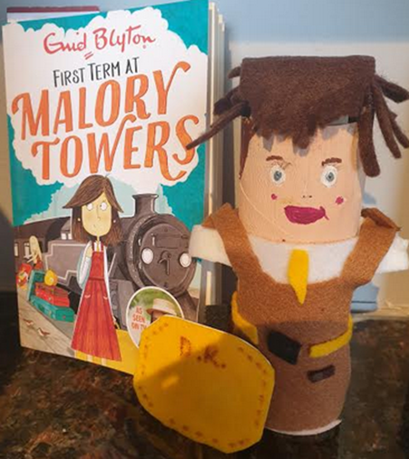
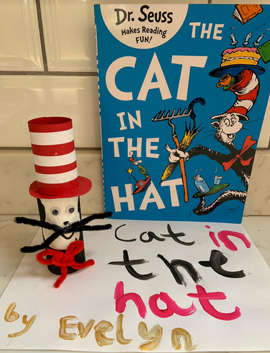
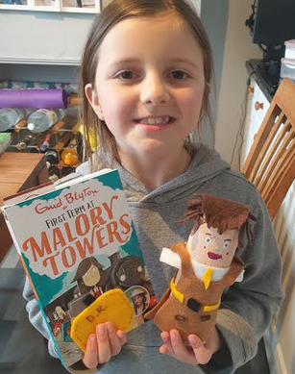
Darryl Rivers from
Malory Towers
by Ruby
Y4
The Cat in the Hat
by Evelyn
Reception

Slide 11
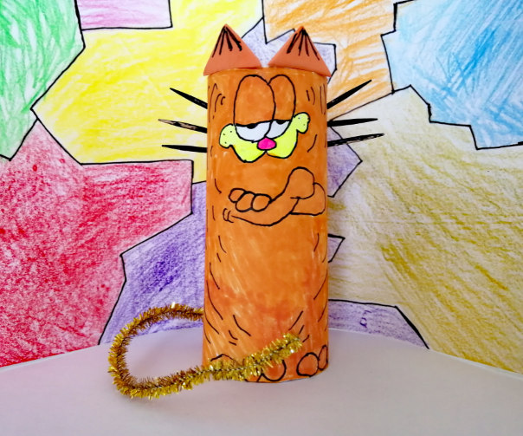
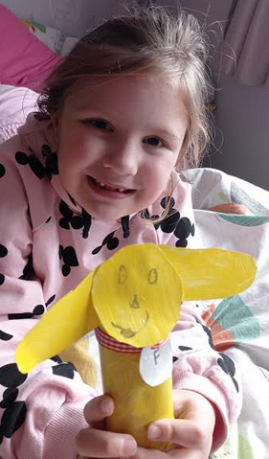
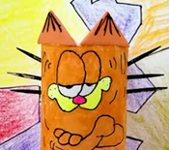
Garfield
by Olivia
Y5
Floppy Dog
by Paige
Y2

Slide 12
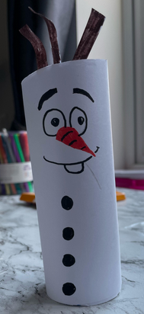
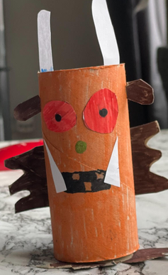
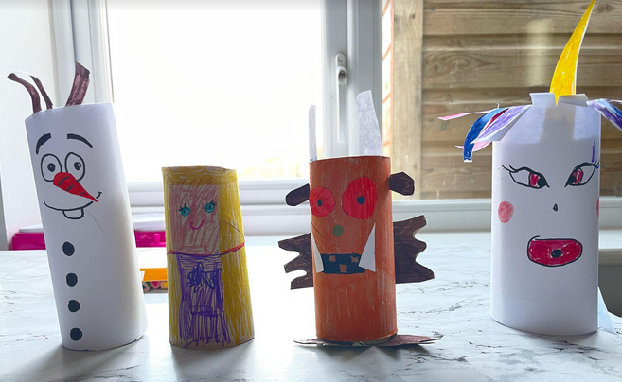
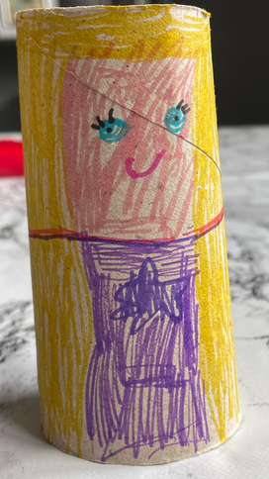
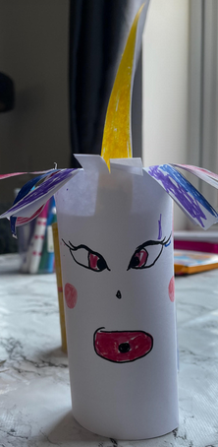
Can you name the different characters
created by Lily?
Y2

Slide 13
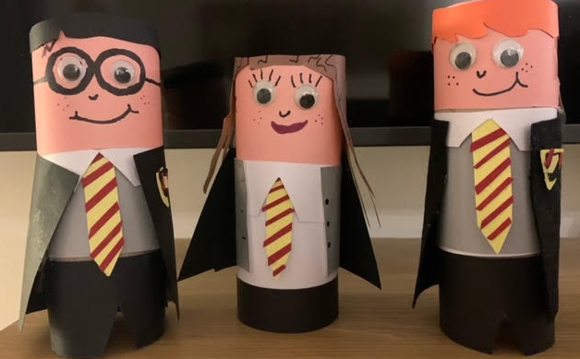
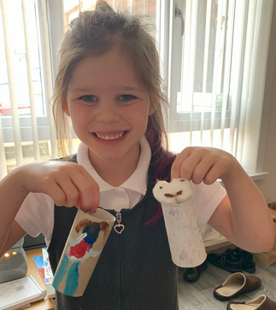
Harry Potter, Hermione and Ron
by Ella
Y6
Mary and her Little Lamb
by Rosie
Y1

Slide 14
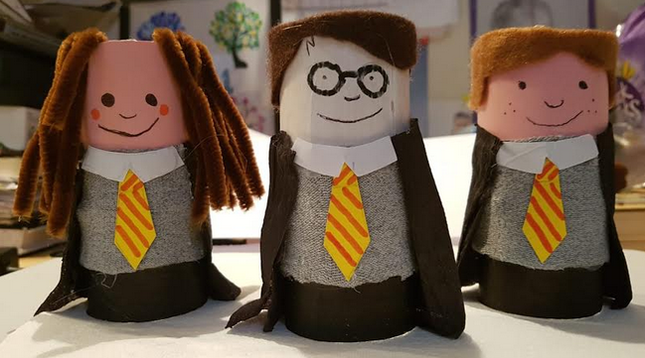
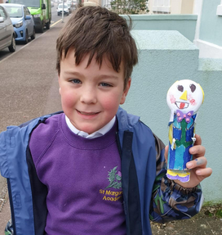
Moonface from The Faraway Tree
by Noah
Y2
Harry Potter and his friends, Hermione Granger and
Ron Weasley
by Amelia
Y5

Slide 15
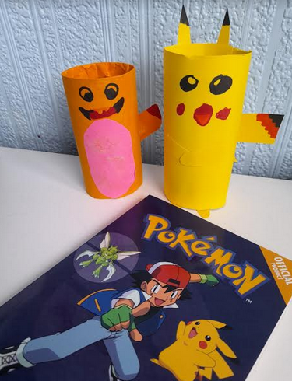
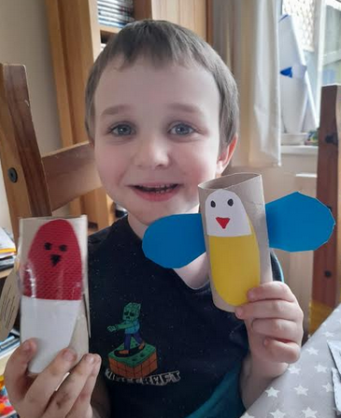
Pokemon Characters
by Nate
Y4
Birds from his RSPB book
by Ethan
Y1

Slide 16
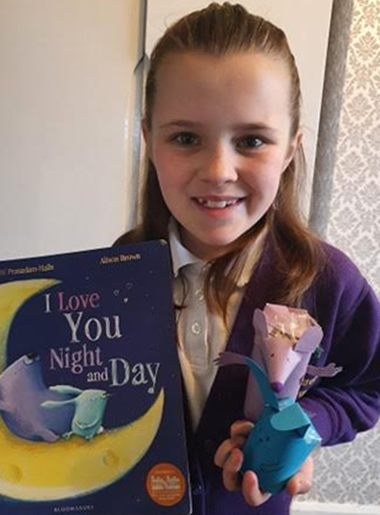
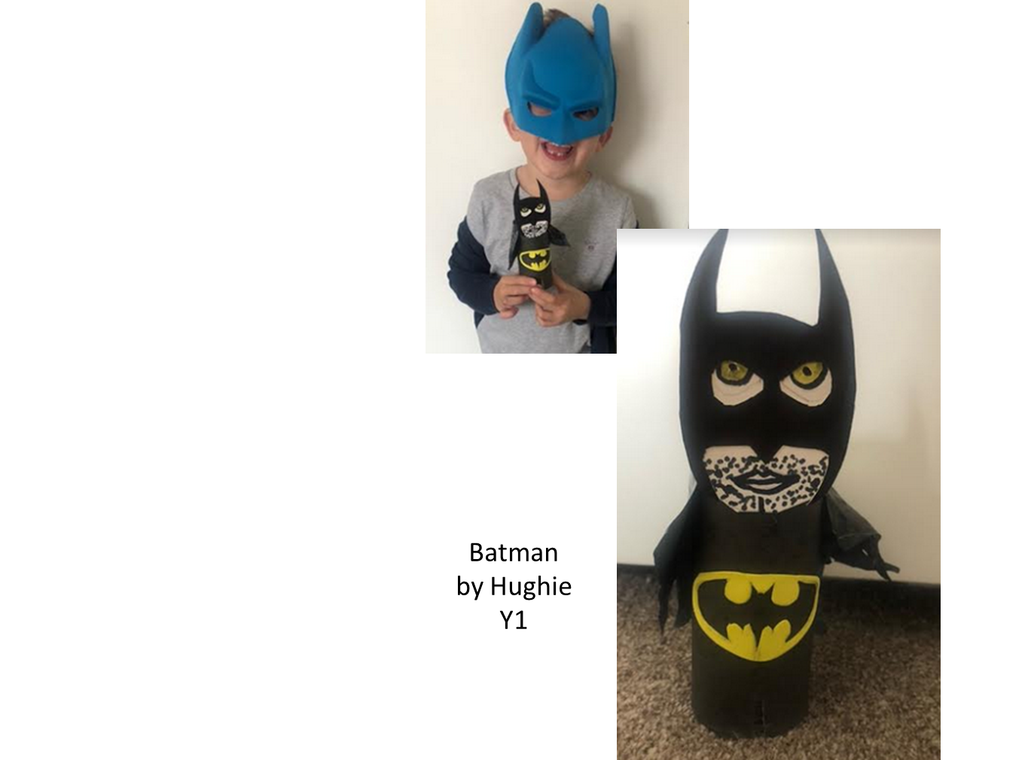
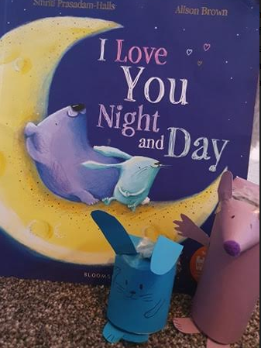
The Bear and the Bunny
by Isla
Y4

Slide 17
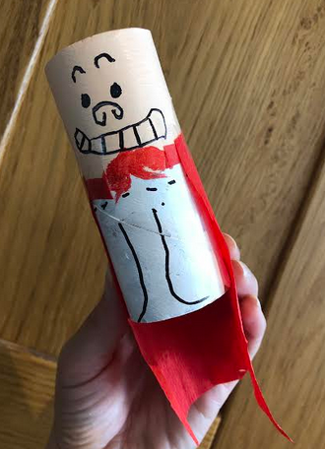
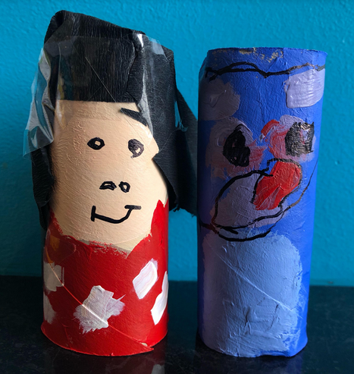
Captain Underpants
by Oscar
Y5
Lilo and Stitch
by Lola
Y1

Slide 18
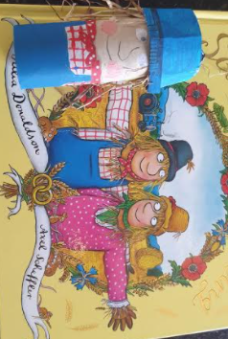
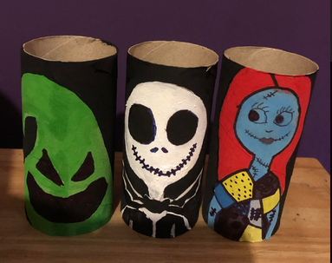
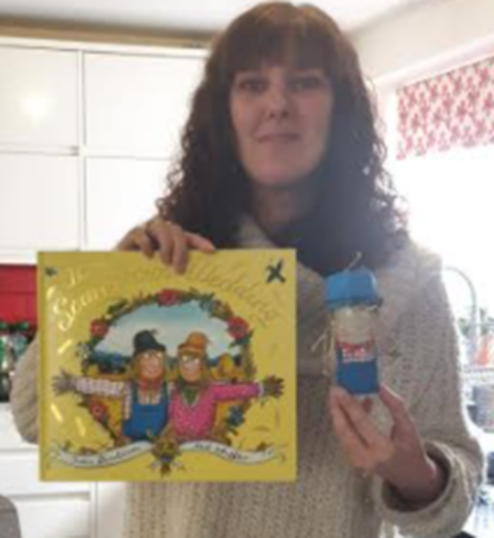
Lucy in Y6 has created her three favourite
characters from the poem
‘The Nightmare Before Christmas’
Oogie boogie, Jack Skellington and Sally
Miss Tozer has created the Scarecrow!

Slide 19
Characters from Traditional Tales
Rapunzel
by Isabella
Reception
Little Red Riding Hood
by Darcy
Y1
Rapunzel
by Kristina
Y1

Slide 20
Michael in Y1 made
The Snail and the Whale characters’
This has always been one of his favourite books.
Happy World Book Day.

Slide 21
Super Heroes
by Theon
Y1
Alan and his sharp teeth
by Fletcher
Y1

Slide 22
The boy, the mole, the fox and the horse
by Lacey
Y5
Minions and Olaf
by Rayyan
Reception

Slide 23
An animal friend
by Saphia
Sophie and The BFG
by Eryn
Y3

Slide 24
The Lion Cub Who Could Not Roar
by Jackson
Y1
The Very Hungry Caterpillar
by Violet
Y3

Slide 25
Olaf and his friends
by Juliet
Y6
Paddington Bear
by Lola
Y6

Slide 26
Knights and Bikes
by Evelyn
Y1
Sonic
by Dylan
Y2

Slide 27
A range of characters
by Gemma
Y6
Mrs. Price is just about full up now after eating ALL the sandwiches, ALL the cakes and drinking ALL the tea in the pot!

Slide 28
The parrot from the Monkey puzzle book by Julia Donaldson
by Ava
Y2
The Singing Mermaid
by Lilli
Y2

Slide 29
Odd Dog Out
by Ella
Y4
Duggee & Betty from the book –
Hey Duggee
by Lily
Y2

